Slide 1
Communicating Your Research Through Story Maps
Jeremy Kenyon
Research Librarian
Bruce Godfrey
GIS Librarian

Slide 2
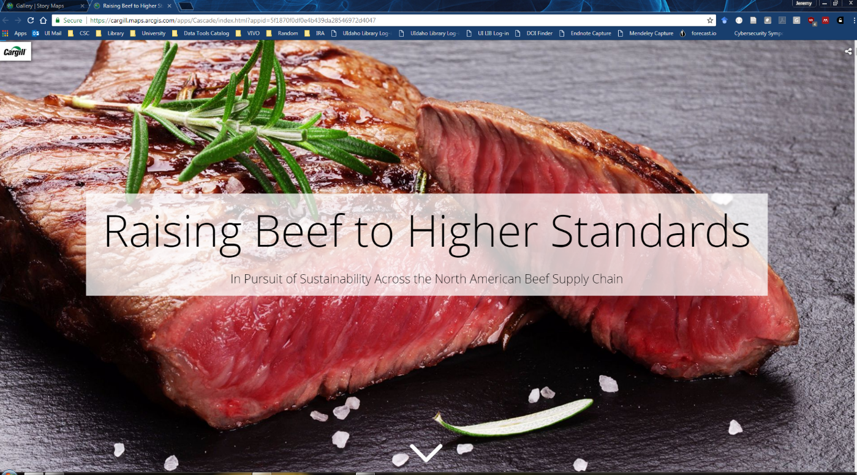
What are Story Maps?
Apps that let you combine maps, photos, text, and videos in order to tell a story.
https://storymaps.arcgis.com
Notes:
Great Wetlands Map: http://story.maps.arcgis.com/apps/MapSeries/?appid=aed61922c4b444ba843d19e676e80004

Slide 3
1. Start with a plan
Think through your narrative
  What is the goal (or the point) of this story?
  How are you going to get the reader there?
Details*
Maps(!)
Data
Conclusion
Follow-up
Introduction
Context
*An effective story map often omits irrelevant subjects, categories, and details. (ESRI, 2016)
Notes:
ESRI. (2016). Storytelling with Maps: Workflows and Best Practices. http://storymaps.esri.com/downloads/Building%20Story%20Maps.pdf

Slide 4
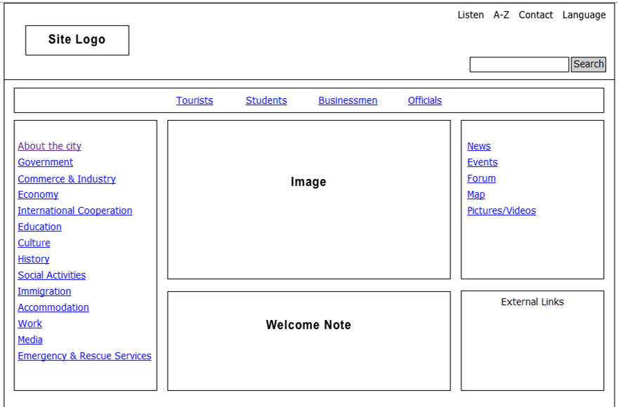
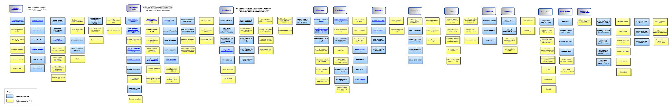
1. Start with a plan
Wireframe, mockup, or story board what you intend to do

Slide 5
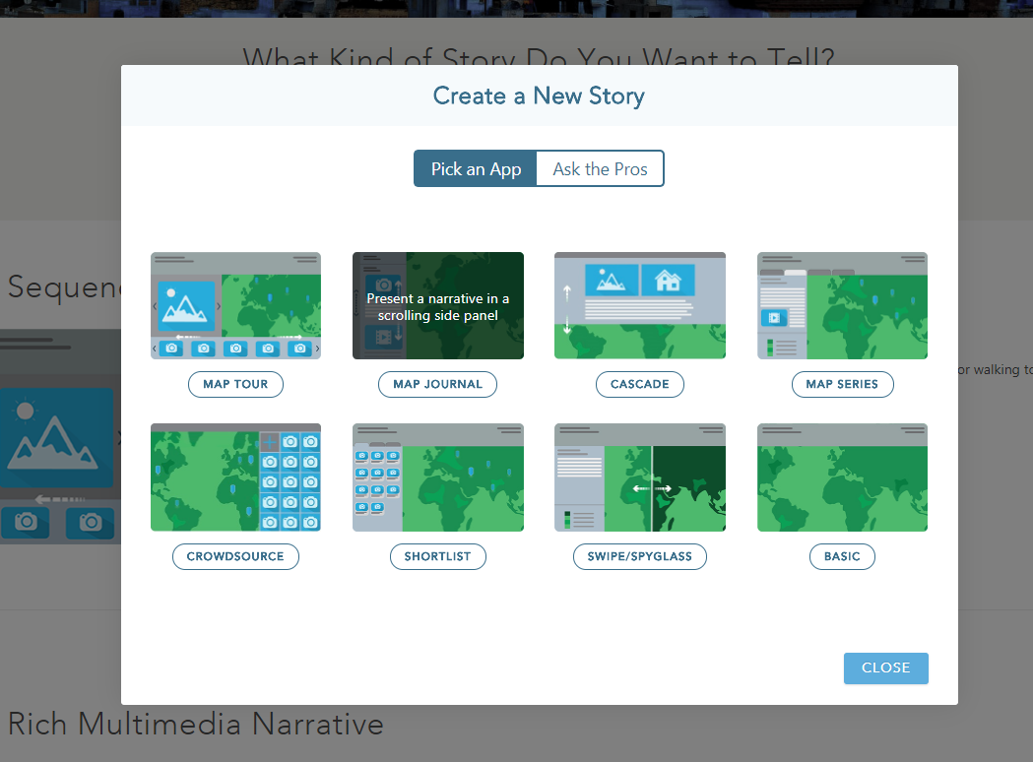
2. Explore your options

Slide 6
3. Gather your data
Text, images, video – anything that can be displayed on the web can be displayed in a story map
  Do you need historical data or imagery for purposes of context or comparison?
  What potential map themes will help make your point?
  Do you need to develop or refine a new map in ArcGIS desktop to then publish as a service?

Slide 7
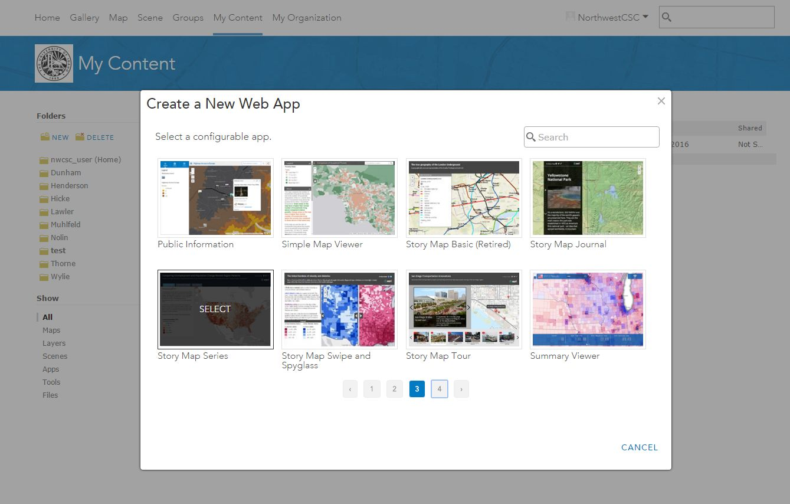
4. Build your app/map

Slide 8
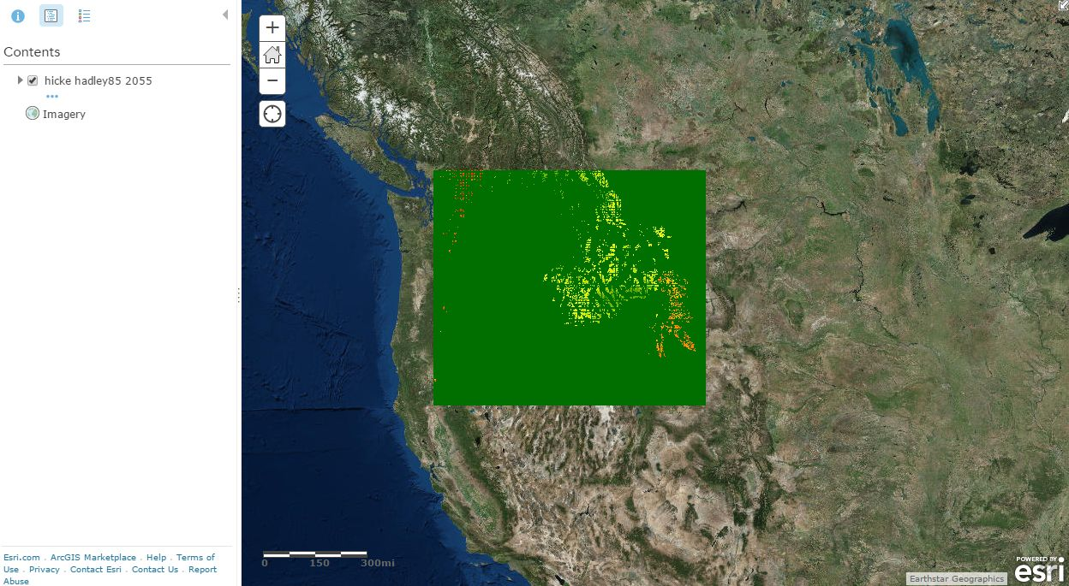
5. Test it out
Notes:
Northwest Climate Science Center Projects and Data Storefront. http://uidaho.maps.arcgis.com/apps/MapSeries/?appid=7f1b9dc9a184431b92575d5d3365e2f4

Slide 9
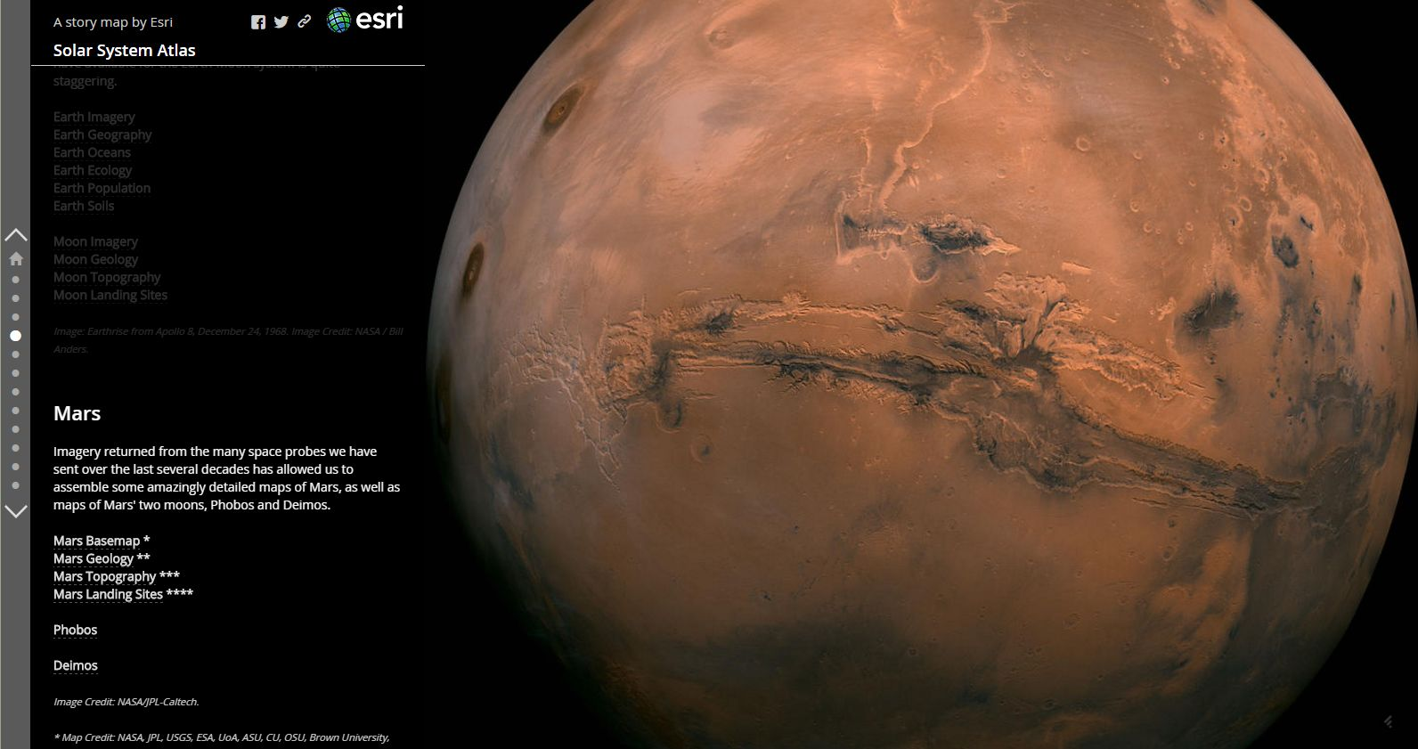
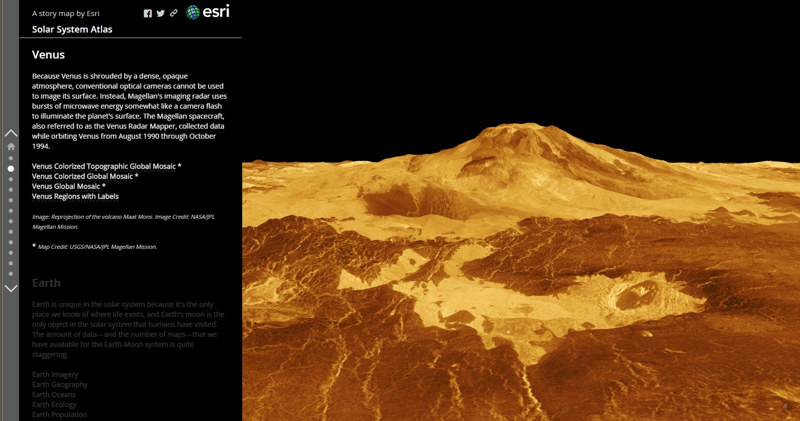
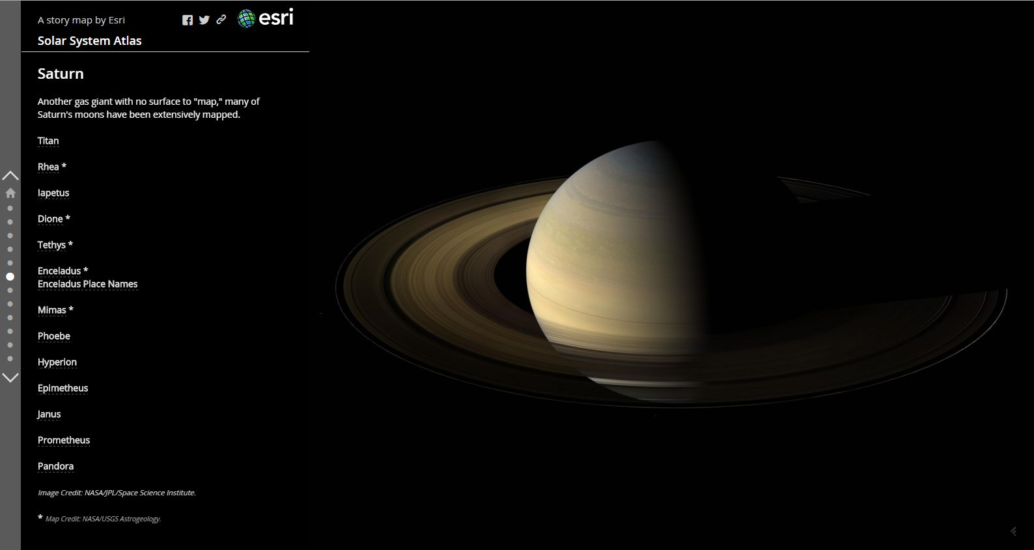
5. Dive in!
Notes:
Solar System Atlas. http://esripm.maps.arcgis.com/apps/MapJournal/?appid=f737586c543e48428b96df64057ebed0

Slide 10
Getting Started

Slide 11
ArcGIS Online (AGOL)
A web-based collaborative platform hosted by Esri that allows you to use, create, manage, store, document, and share maps, apps, and data.
https://arcgis.com

Slide 12
Story Maps
Ready-to-use app on AGOL platform
https://storymaps.arcgis.com/
ArcGIS Online
App
Story Maps
App

Slide 13
AGOL – Many Apps

Slide 14
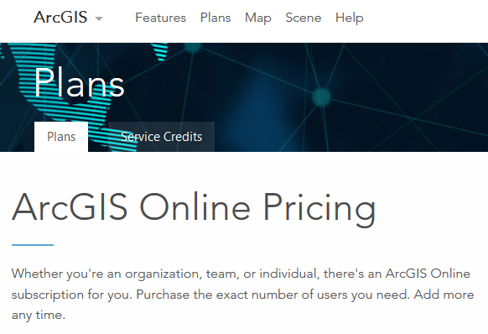
AGOL Subscriptions
Public account
  Noncommercial use at no cost with a free public account
Organizational account
Plans
  https://www.arcgis.com/features/plans/pricing.html

Slide 15

AGOL - Managing Items
Under “Content” tab
Create folders
Create/add/delete/share items
Link to item details (documentation, usage statistics, settings

Slide 16
AGOL - Make Maps & Add Items
Make Maps
  Map Viewer | Scene Viewer
Items you can add to AGOL
  Content > My Content > Add Item
    http://doc.arcgis.com/en/arcgis-online/reference/supported-items.htm
    1GB limit unless using ArcGIS Desktop/Pro

Slide 17
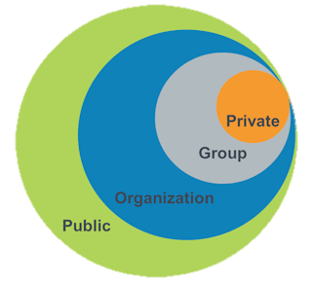
AGOL - Sharing Items
By default all items are ‘Private’
*
* Groups can include members of other AGOL organizations (federal, state, local, other academic institutions, etc.)
Image credit: Esri

Slide 18
AGOL - Groups
Under “Groups” tab
A collection of items usually related to a specific area of interest

Slide 19
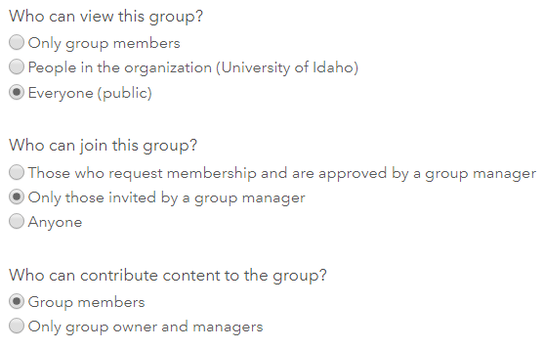
AGOL - Groups
Create a Group
  Title, summary, description, thumbnail

Slide 20
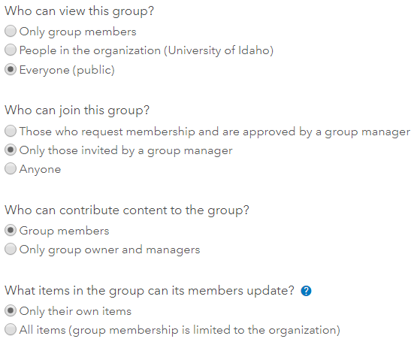
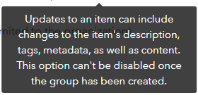
AGOL - Groups
Item Updates

Slide 21
AGOL - Spatial Analysis
is

Slide 22
AGOL - Service Credits
Service credits: currency for AGOL
How you use AGOL determines the number of service credits you consume
See service credits overview for more information

Slide 23
Demo: Creating a Story Map Tour from a CSV File

Slide 24
Making Web Maps

Slide 25
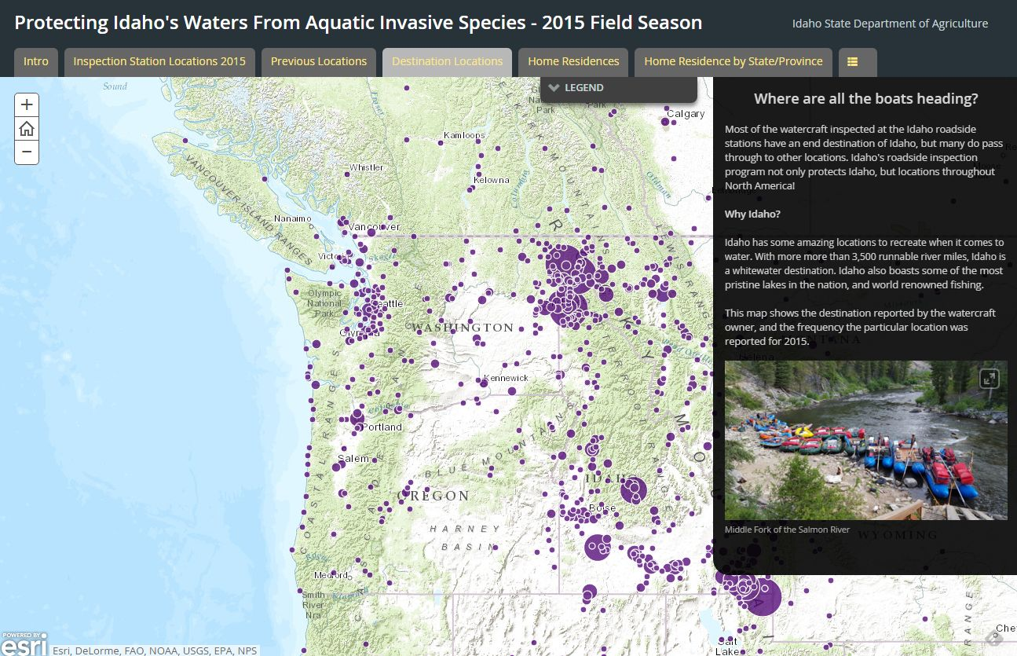
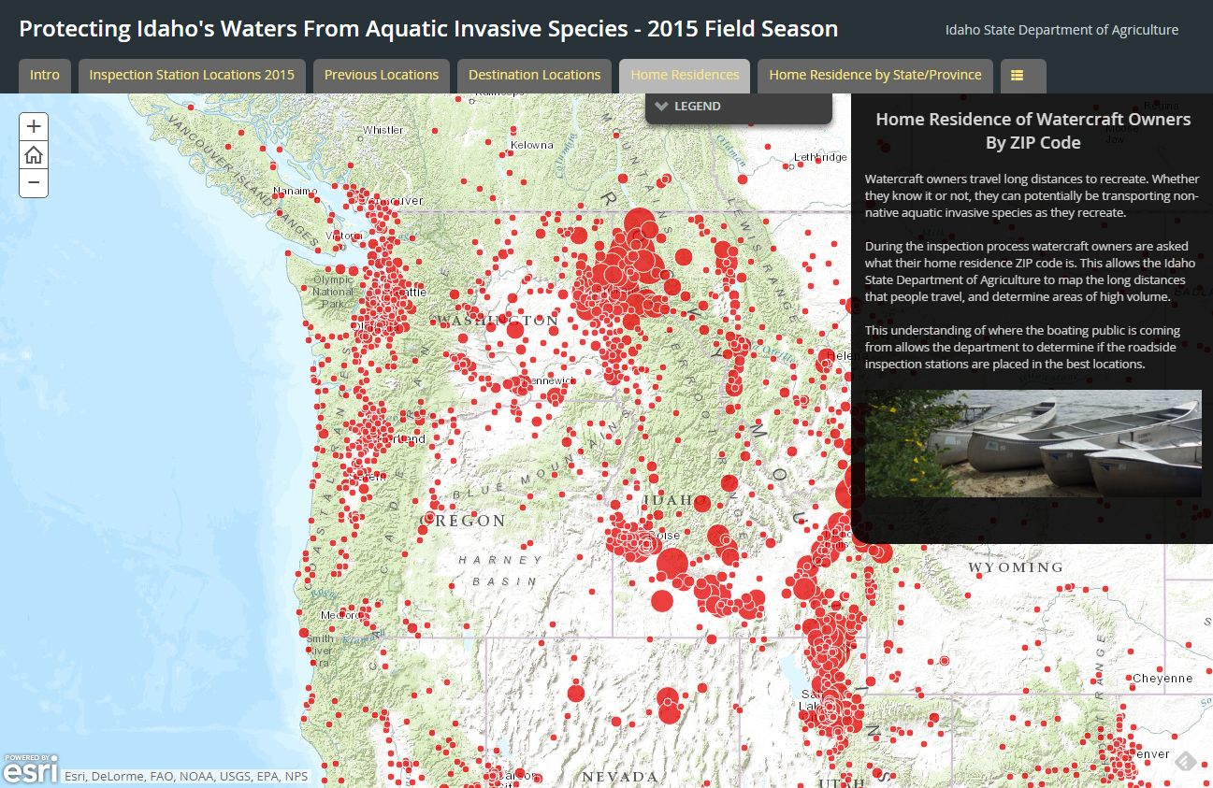
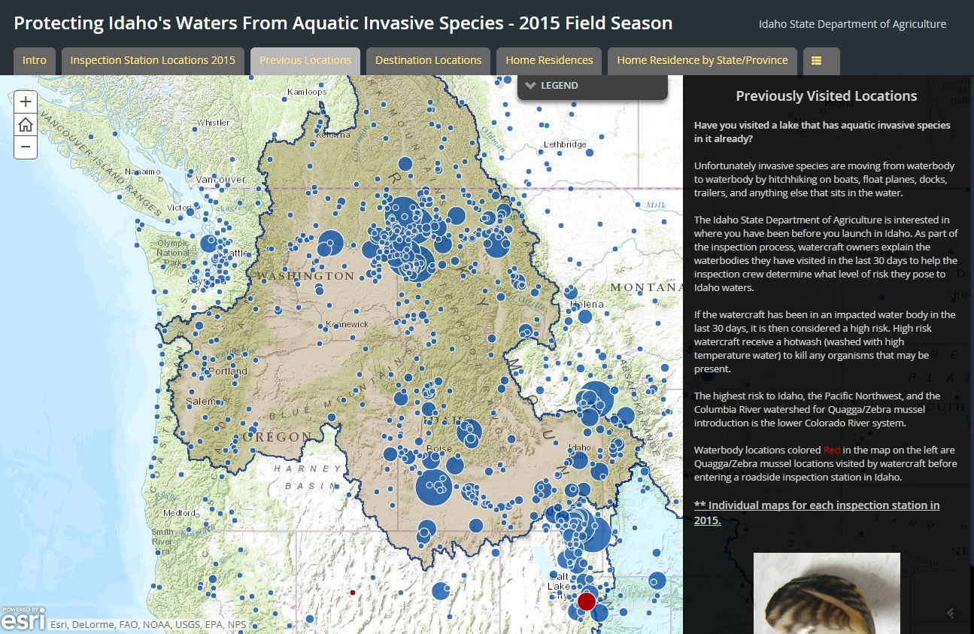
Make simple maps
Notes:
Protecting Idaho’s Waters From Aquatic Invasive Species. http://idaho.maps.arcgis.com/apps/MapSeries/index.html?appid=17e491a6685f4ad09b20f4ec9763e2f7

Slide 26
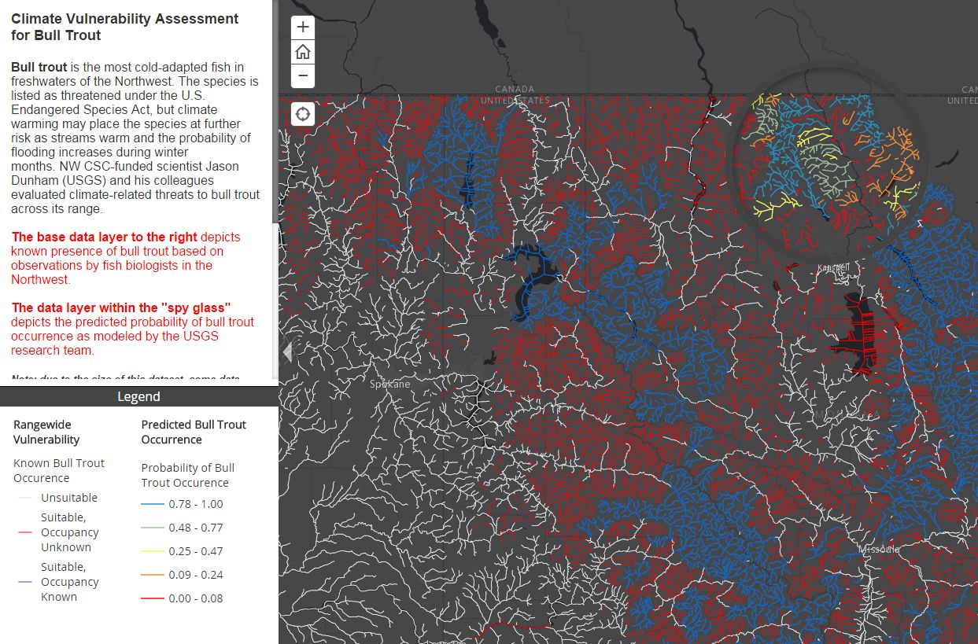
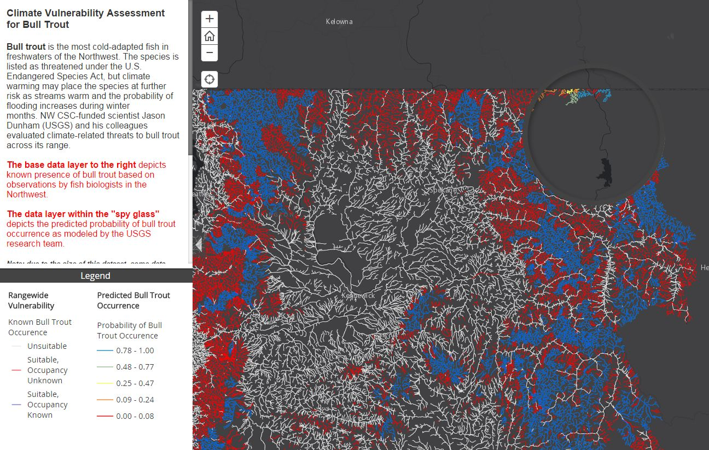
Make fast loading maps
Notes:
Northwest Climate Science Center Projects and Data Storefront. http://uidaho.maps.arcgis.com/apps/MapSeries/?appid=7f1b9dc9a184431b92575d5d3365e2f4

Slide 27
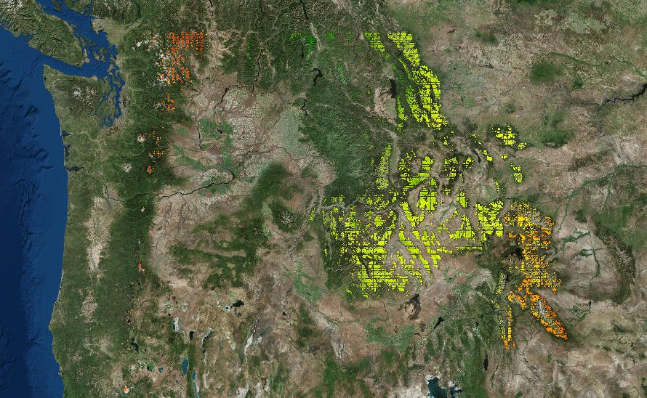
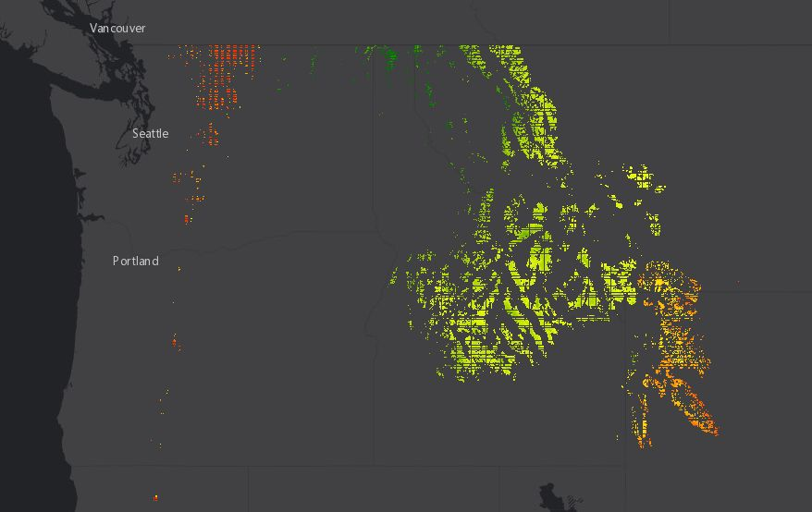
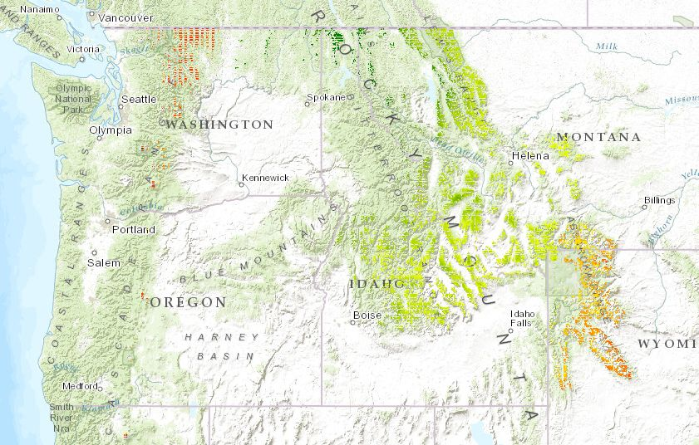
Choose your basemaps wisely
Notes:
Northwest Climate Science Center Projects and Data Storefront. http://uidaho.maps.arcgis.com/apps/MapSeries/?appid=7f1b9dc9a184431b92575d5d3365e2f4

Slide 28
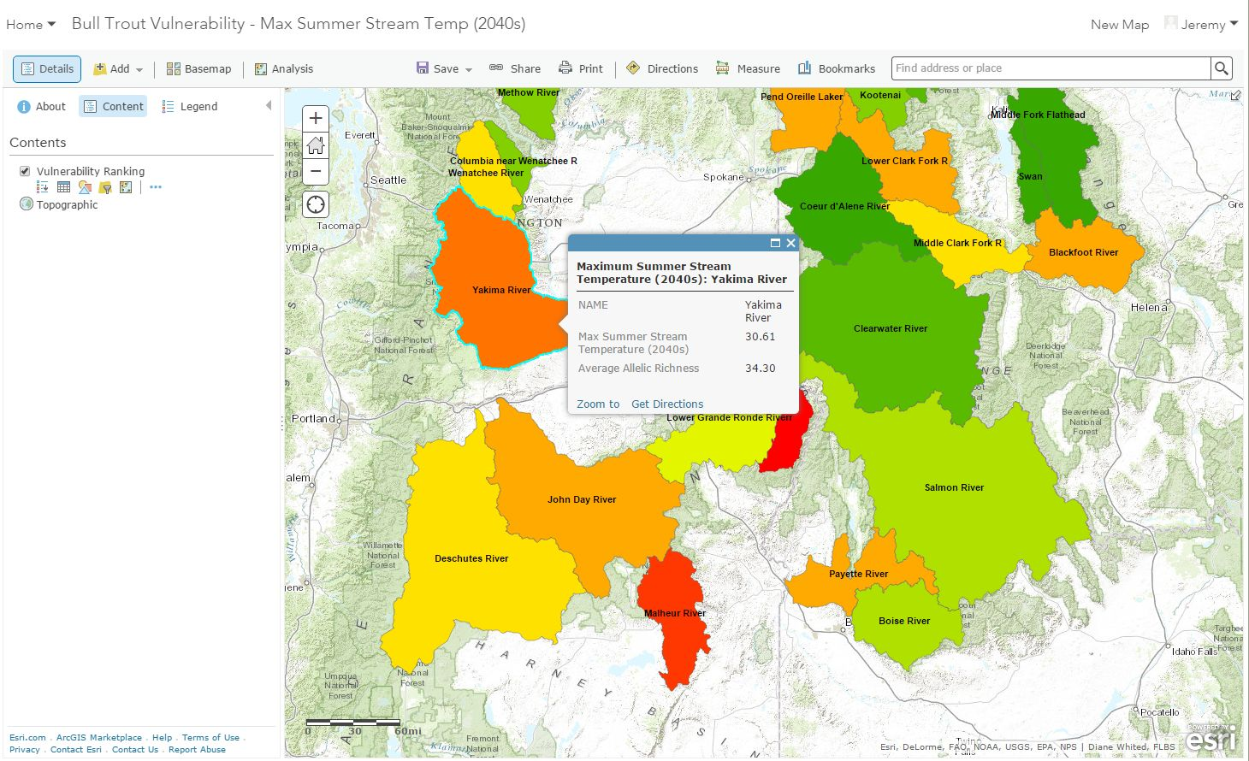
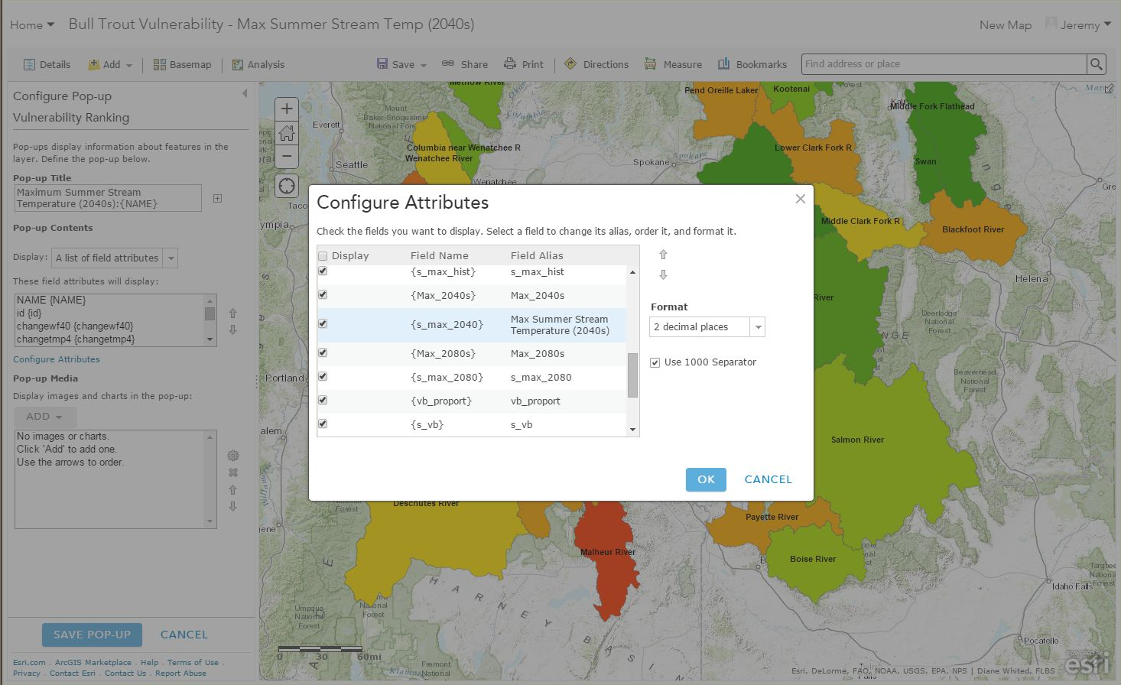
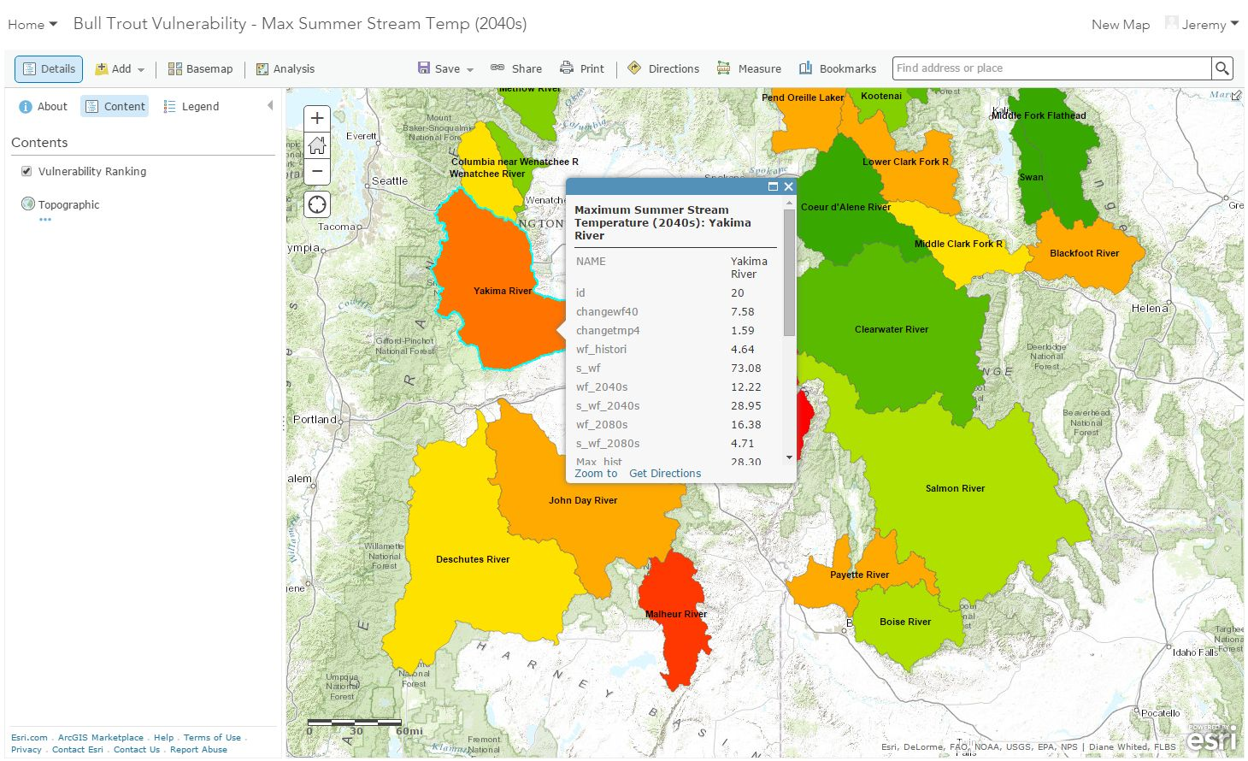
Configure your Pop-ups
Notes:
Northwest Climate Science Center Projects and Data Storefront. http://uidaho.maps.arcgis.com/apps/MapSeries/?appid=7f1b9dc9a184431b92575d5d3365e2f4

Slide 29
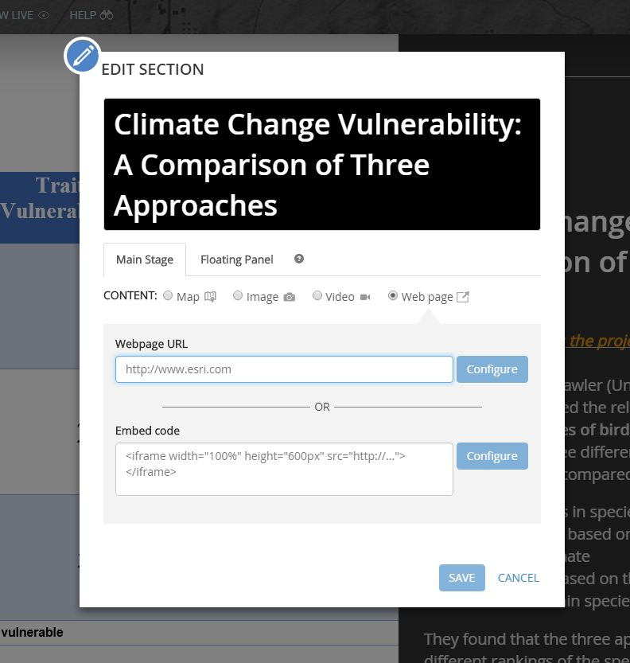
Put a website in a story map
(if you need to)
The url for an embedded storymap:
[story map ID]&embed
Example: USFS’s Stakeholder’s Report
Notes:
Northwest Climate Science Center Projects and Data Storefront. http://uidaho.maps.arcgis.com/apps/MapSeries/?appid=7f1b9dc9a184431b92575d5d3365e2f4

