Slide 1
Tech Session
Rangelands Partnership Annual Meeting
May 19, 2018
Moscow, ID

Slide 2
Overview
Save vs Publish button – discussion and result
How to find YOUR metadata
DLIO
State site
State information needs to be added as DLIO to appear in GR and RW
What the search tool actually searches in GR, RW, State

Slide 3
Save and Publish button
We listened to your request and asked for both buttons, but to add a Publish button is technically difficult at this stage.
With the Save button:
System is built to handle partial work – can easily save and return later
New items don’t show up until the next day
Other tools available, (such as notepad, email, word) to put work into if it concerns you to have a partial record out there.
The chances of someone actually viewing a partially completed record overnight is slim.

Slide 4
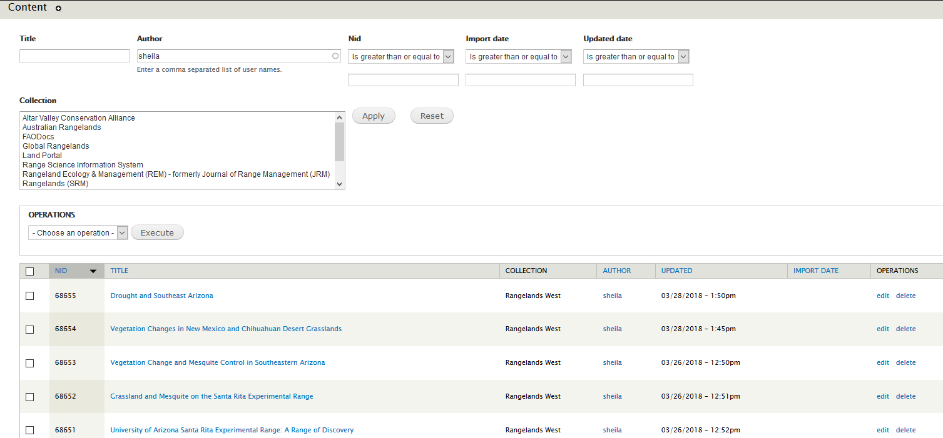
How to find YOUR metadata
DLIO’s
From login, manage DLIO’s

Slide 5
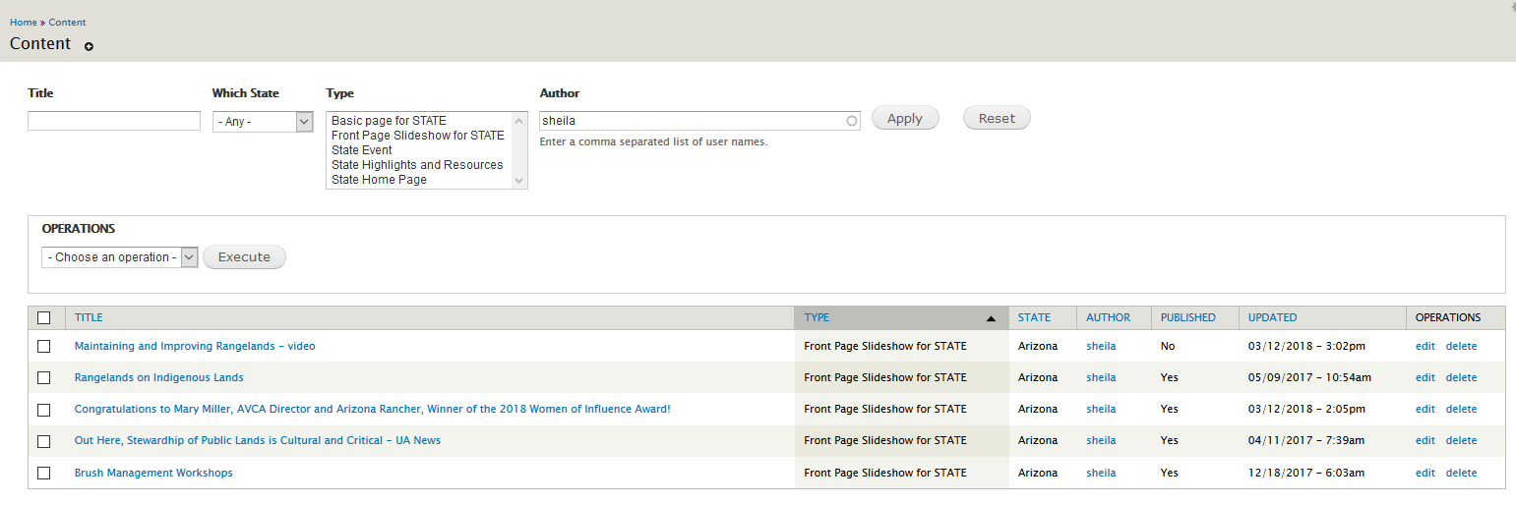
How to find YOUR state content
State information
From login, edit existing content

Slide 6
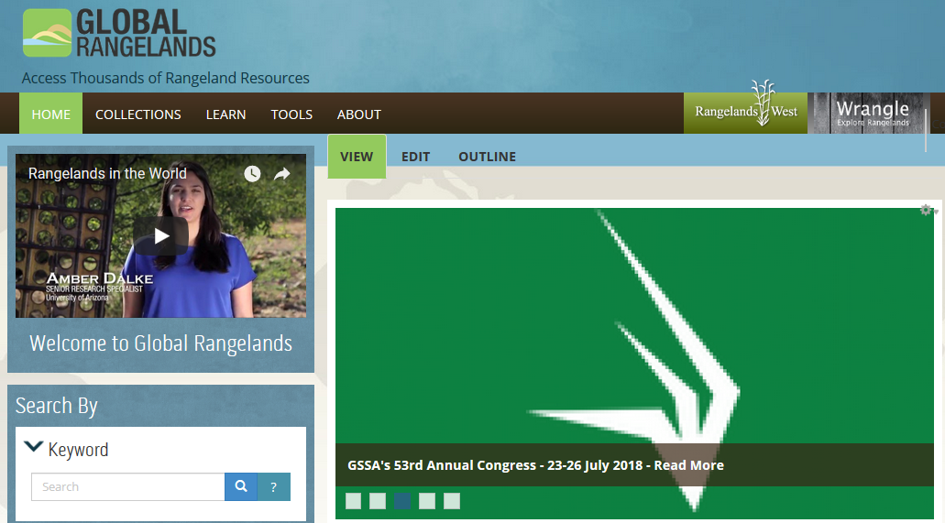
State information into GR database
Must create a DLIO for every resource from your state site that if you want it findable from GR or RW search boxes

Slide 7
Search tool – what is searched?
Global
No filters
Rangelands West
Searching within these collections
Rangelands West
SRM Abstracts
Rangelands
RSIS (coming)
Altar Valley (coming)
Annual meeting abstracts (coming)
State
Searches all collections, but filters by state name

Slide 8
Let’s work!

