Slide 1
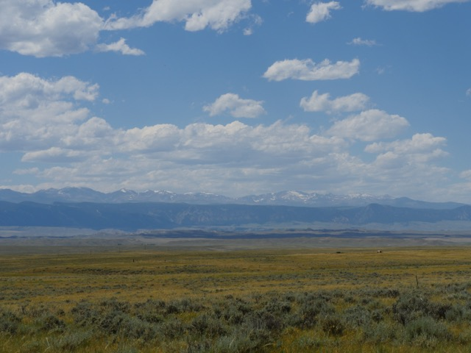
Greetings from the Rangelands Partnership
Access Thousands of Rangeland Resources

Slide 2
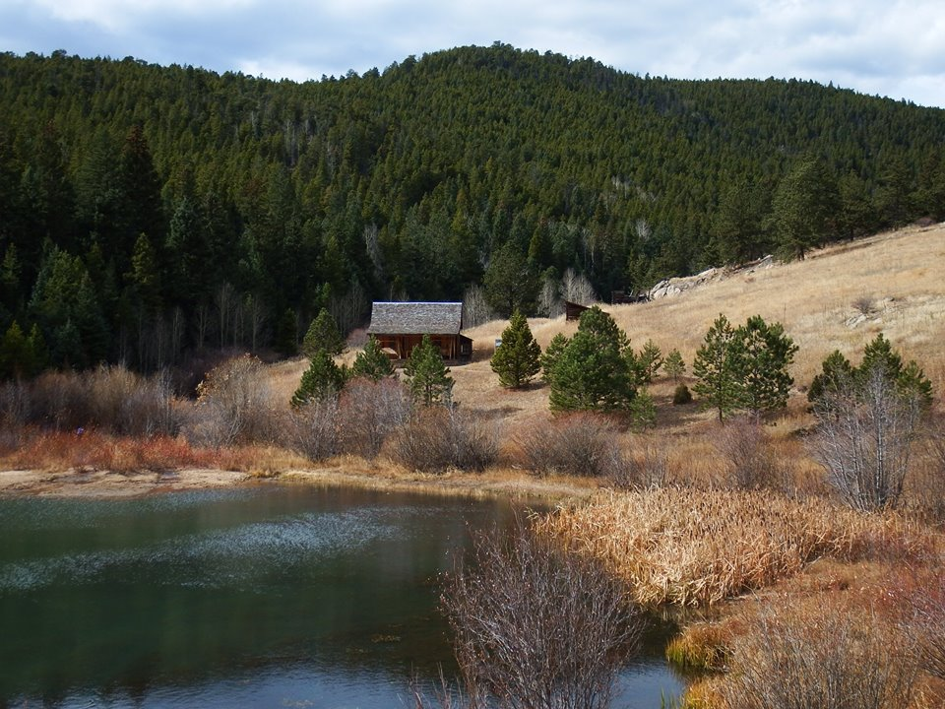
History of the Rangelands Partnership

Slide 3
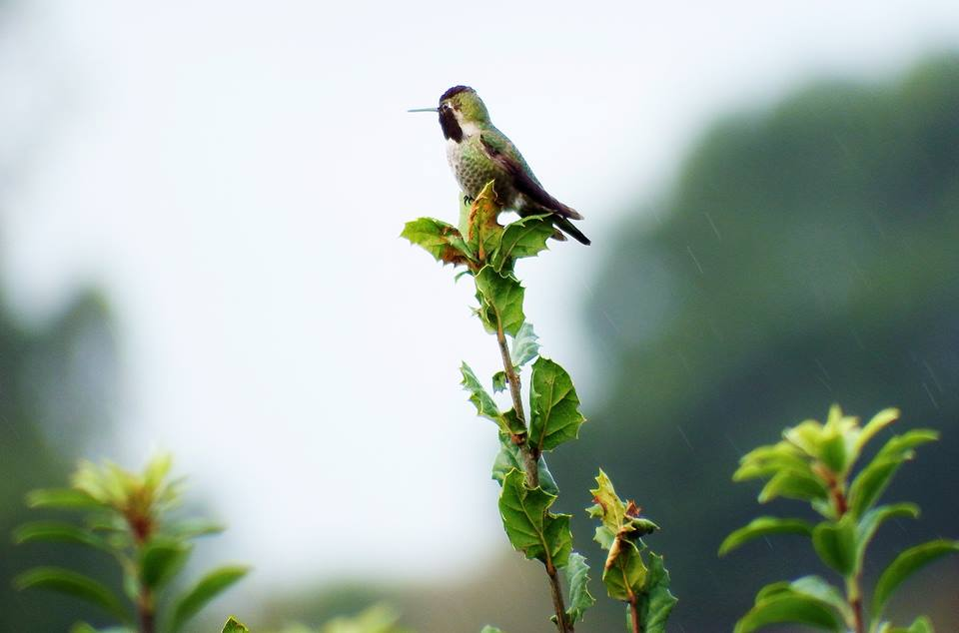
Objectives
History
Provide digital access to reviewed information and data applicable to rangeland management decision making
Create user-driven tools and interfaces for research, education, and extension
Facilitate understanding of sustainable rangeland management processes

Slide 4
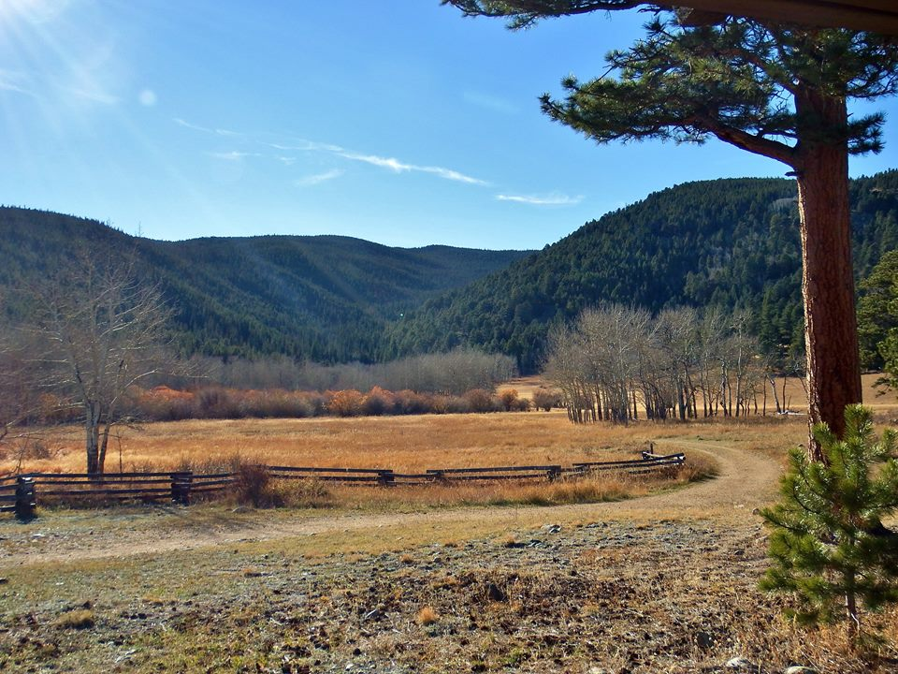
Version 1:
Managing Rangelands
In 1995, University of Arizona librarians and rangeland specialists had an idea to create an online resource to provide Arizonans with quick access to evaluated information.
The first version offered topics in rangeland ecology and management. This homepage continued until 2001.
History

Slide 5
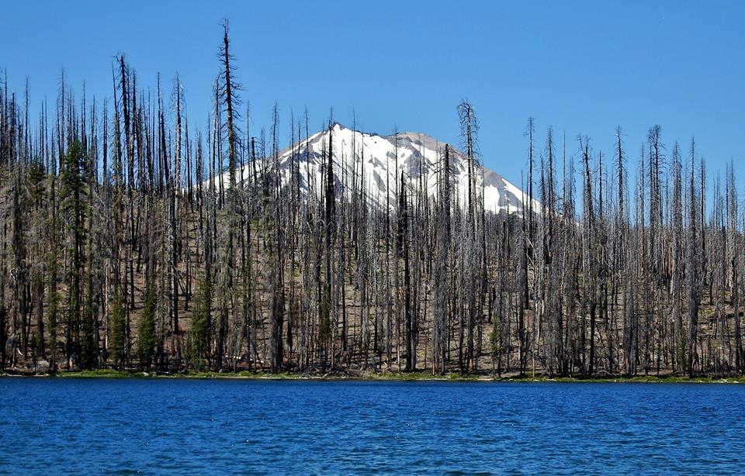
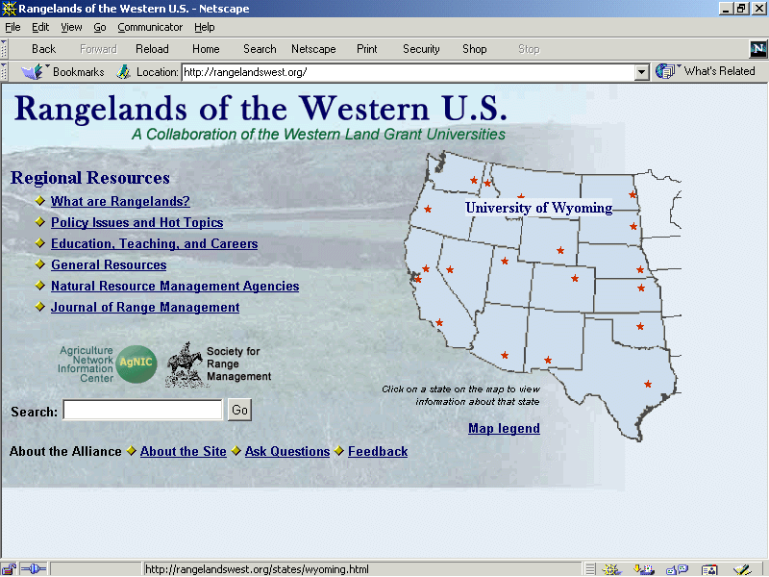
Version 2:
Rangelands of the Western U.S.
By 2002, the need for rangeland information beyond Arizona led to a partnership of 19 LGUs involving rangelands specialists and librarians (now The Rangelands Partnership).
“Managing Rangelands” was redesigned to include the Western U.S. and the website was renamed “Rangelands of the Western U.S.” with the URL rangelandswest.org.
History

Slide 6
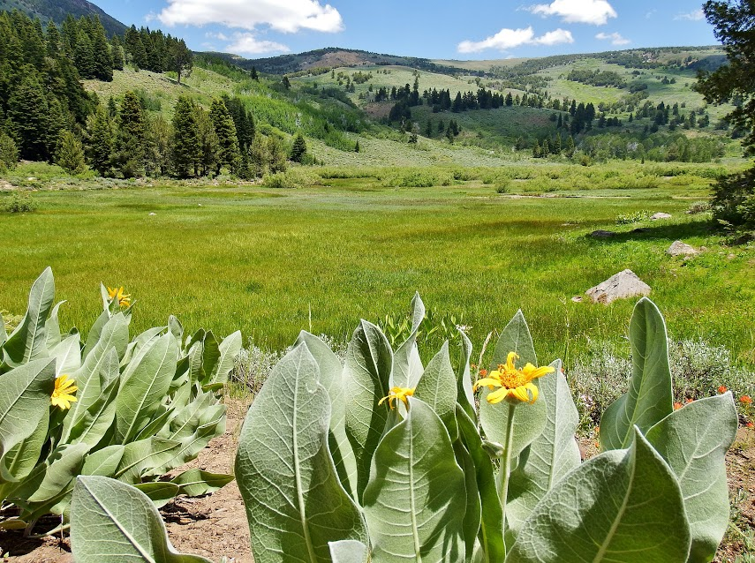
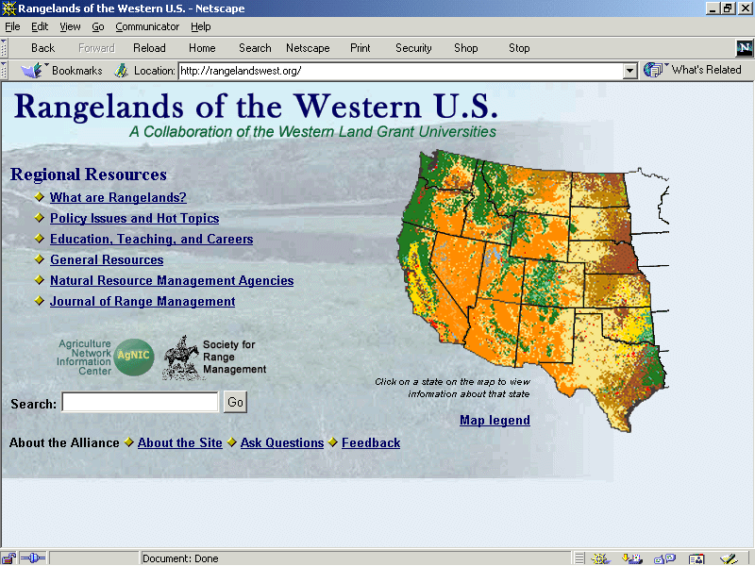
Version 2 Updates:
Rangelands of the Western U.S.
Between 2002 and 2006, the homepage received several graphic upgrades including this clickable map feature that would lead users to local-level state resources.
History

Slide 7
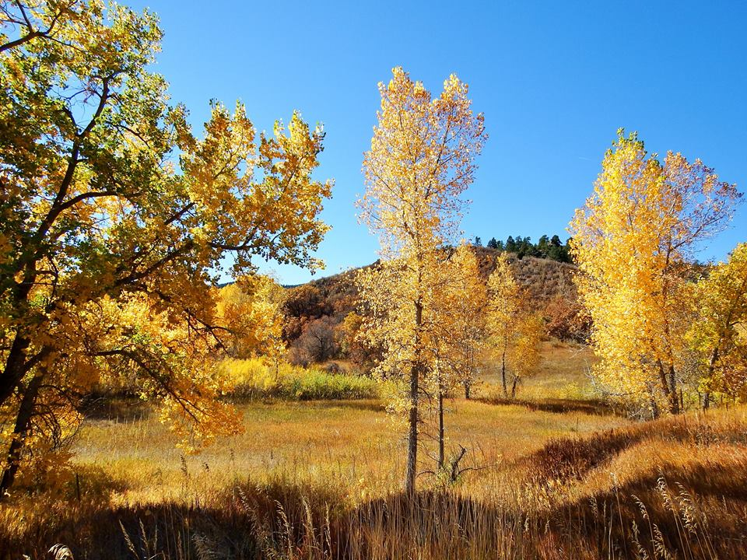
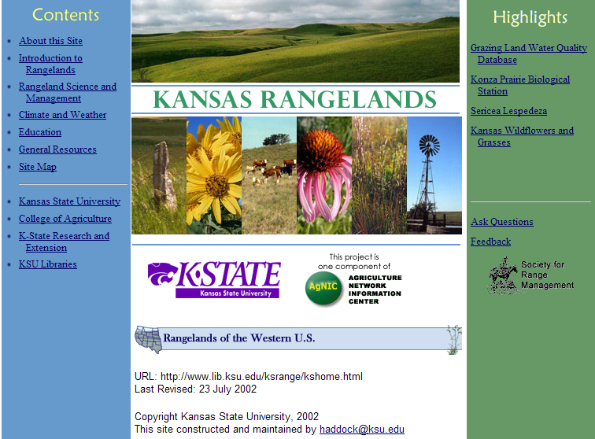
Introduction of
State-level Resources
In 2002, local-level state templates were available to LGU Partners. These customizable websites allowed state curators to select the most appropriate rangeland information to share with constituents.
History

Slide 8
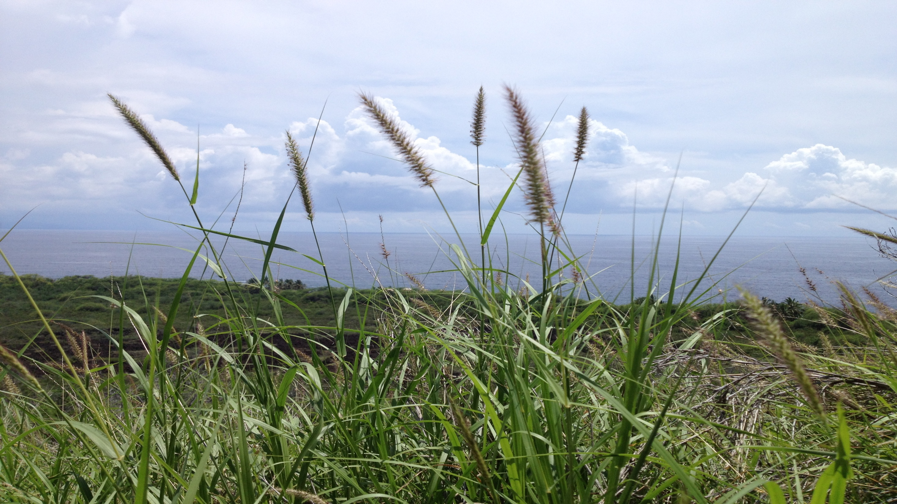
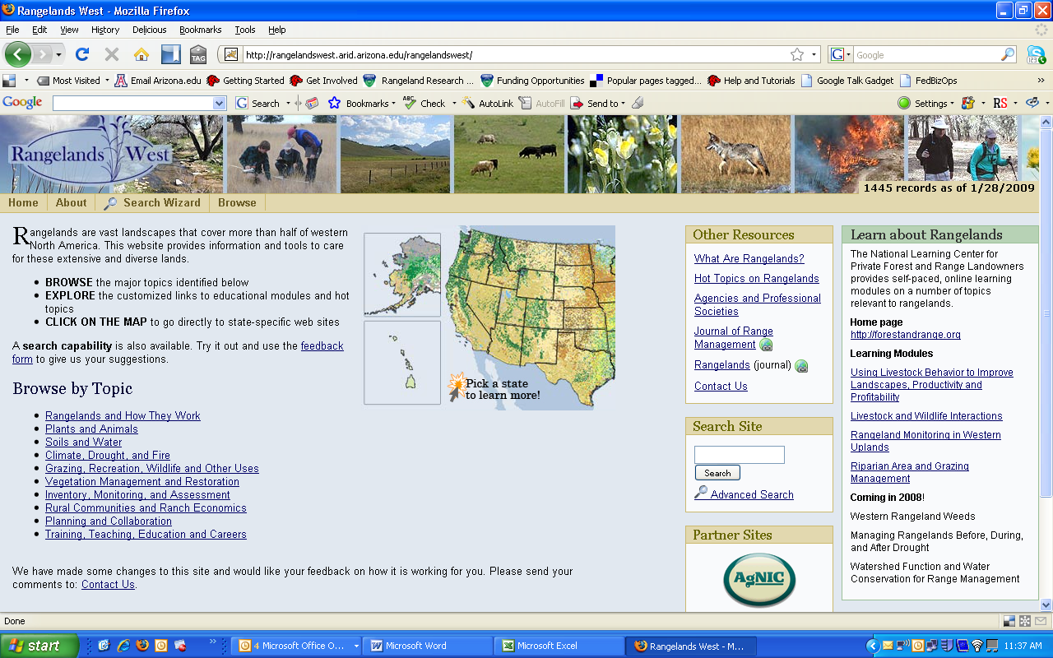
Version 3: Rangelands West
History

Slide 9
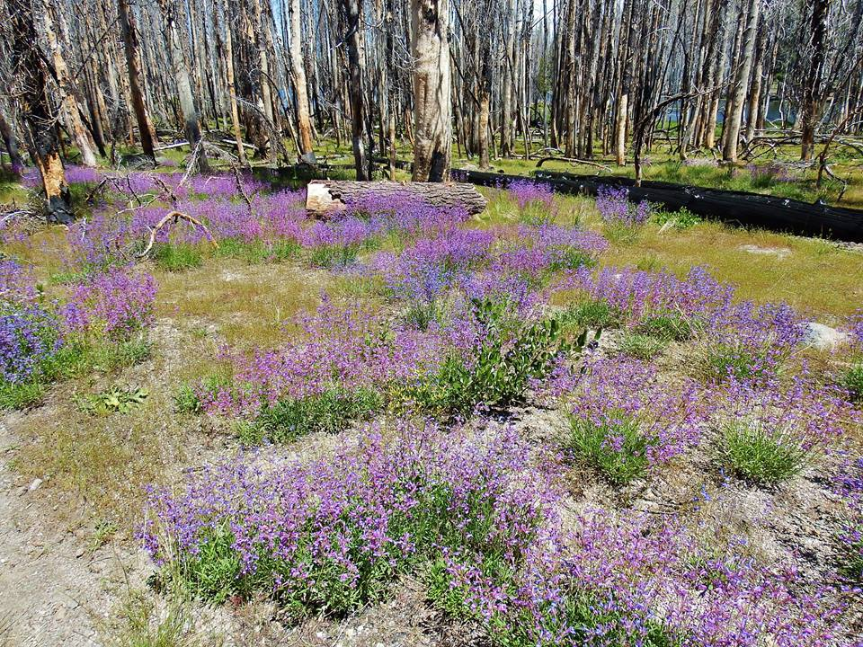
History
In 2008, the Rangelands West redesign introduced Browse by Topics. This allowed users to easily view information based on their area of interest.

Slide 10
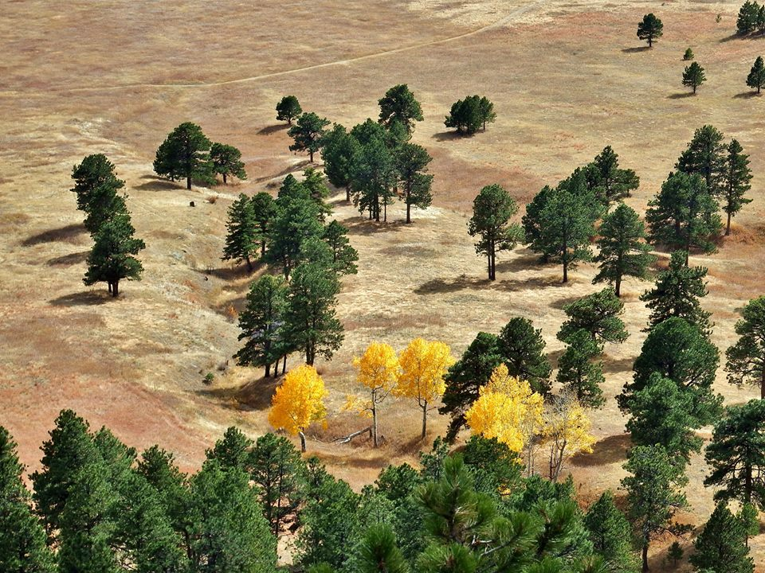
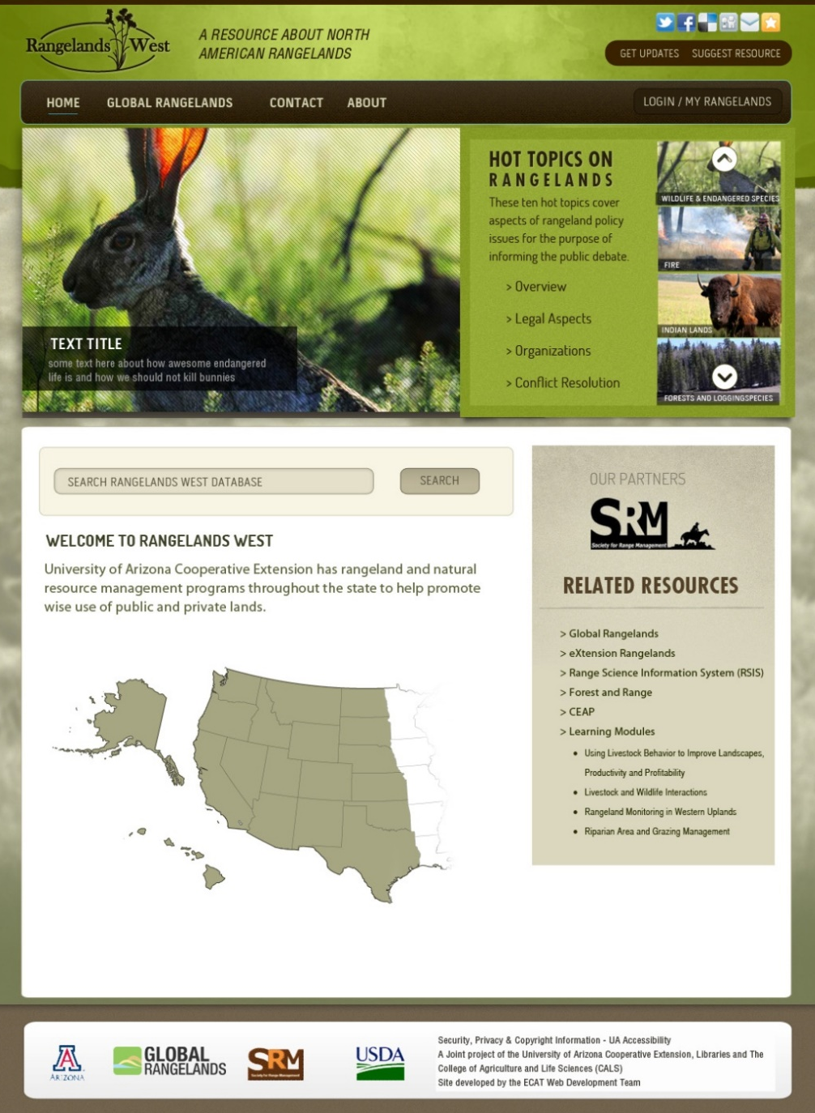
History
Version 4: Rangelands West
Website Redesign
A grant from USDA-eXtension provided the opportunity to identify stakeholder social media and web preferences, and to optimize and coordinate related websites. The information gained from the ‘eXtension’ optimization grant led to a full redesign of all websites.

Slide 11
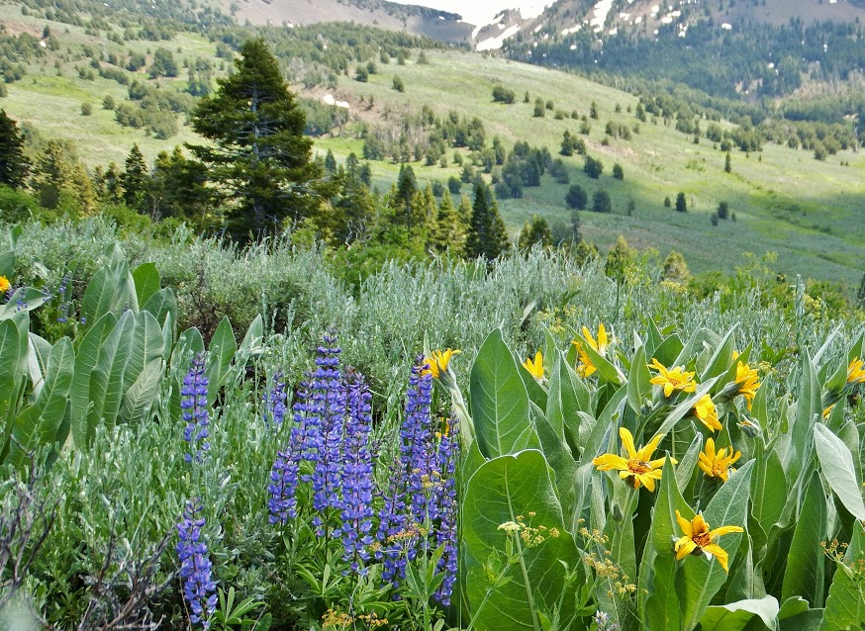
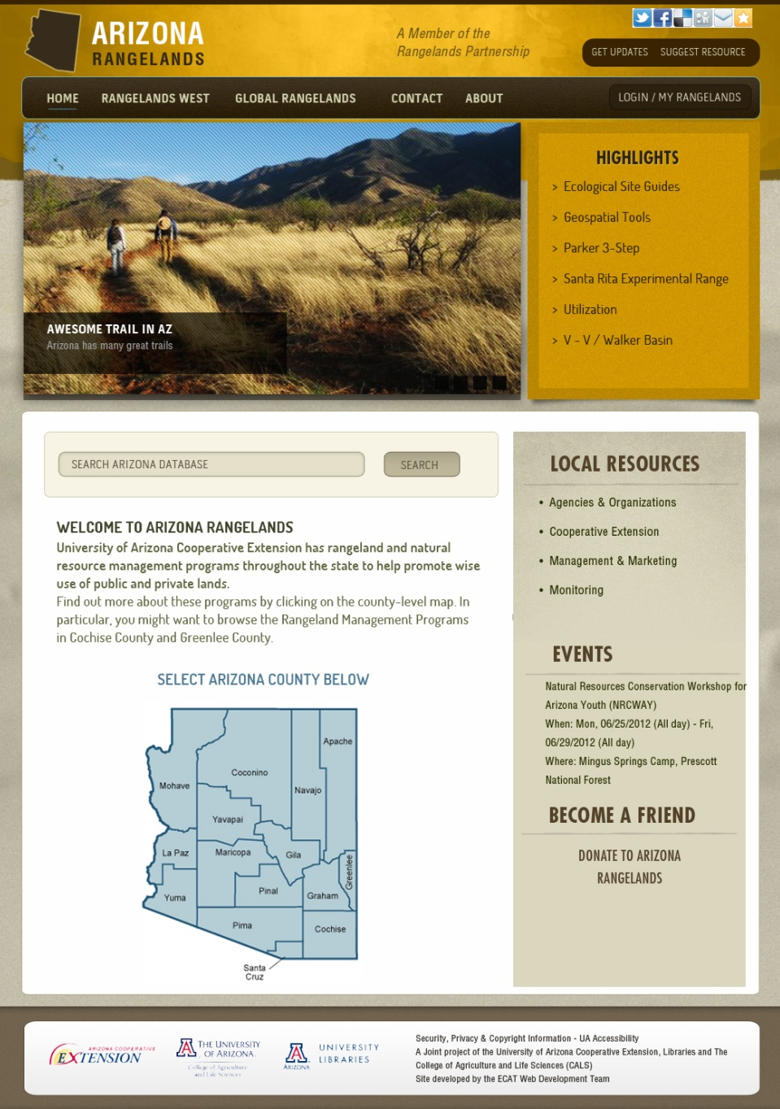
History
Version 4:
State-level Resources
Partners were able to use a Rangelands West template (Arizona) or a LibGuide approach (Nevada) to state websites

Slide 12
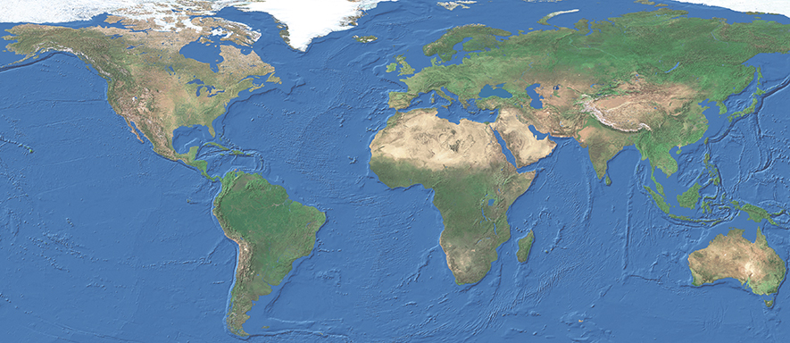
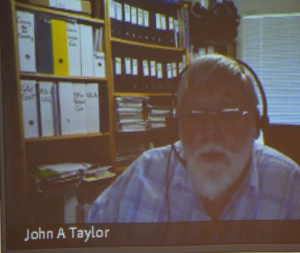
Going Global
In 2010, the Rangelands West Partnership received a USDA International Science and Education grant to expand to a global presence. Collaborating with FAO, Rangelands Australia, and Southern Africa (GSSA), led to the development of the “GlobalRangelands.org”
website and database.
History

Slide 13
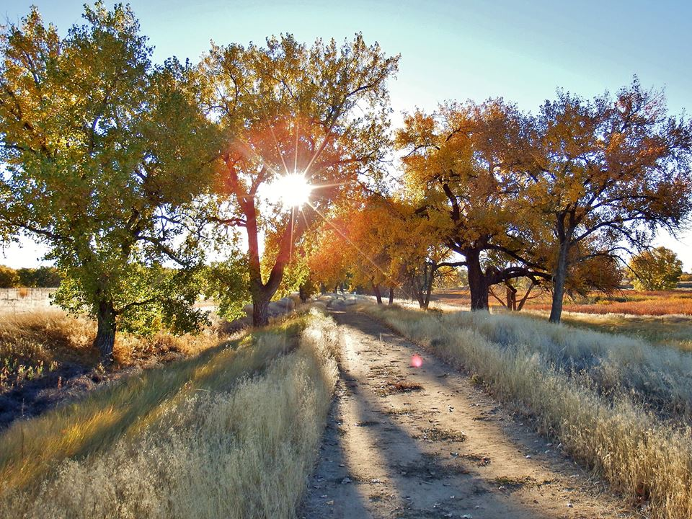
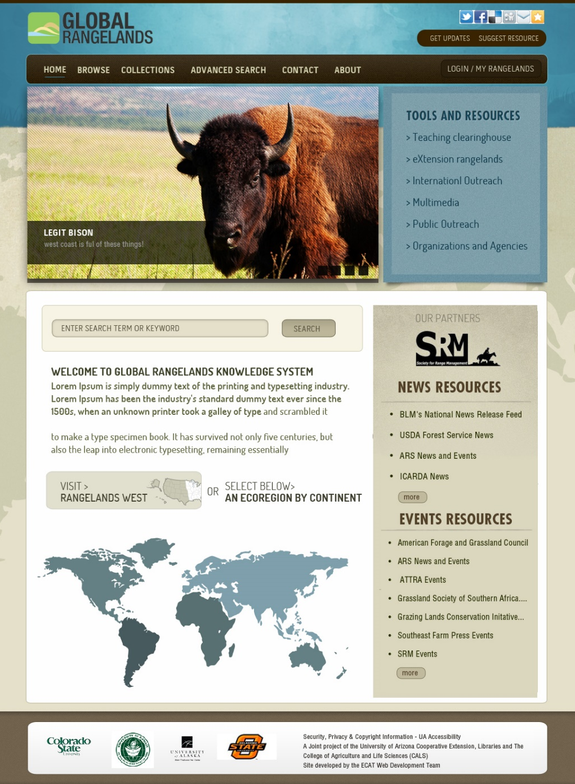
Global Rangelands
History
Global Rangelands was launched in 2011 and quickly grew to include more than 20,000 resources emanating from rangelands organizations around the world.

Slide 14
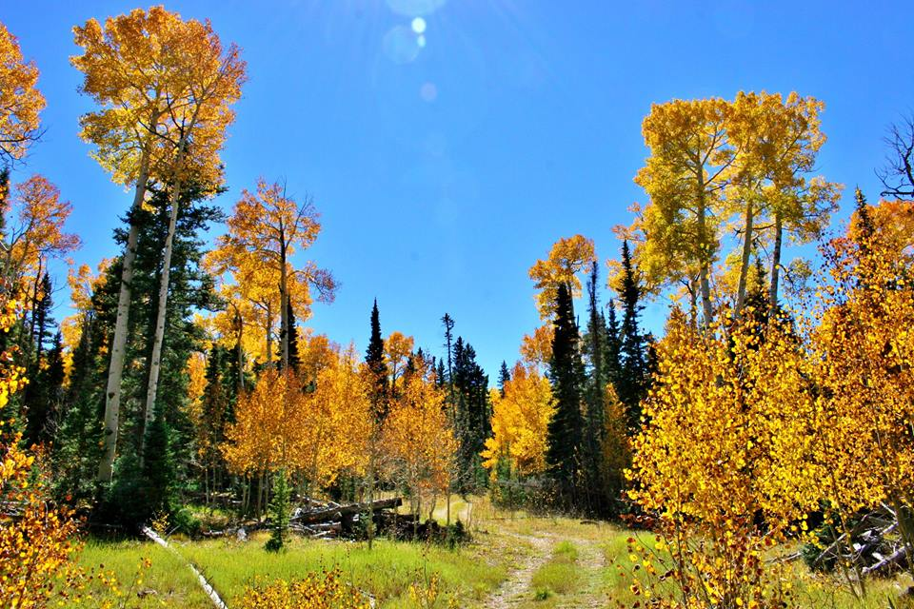
Collaboration

Slide 15
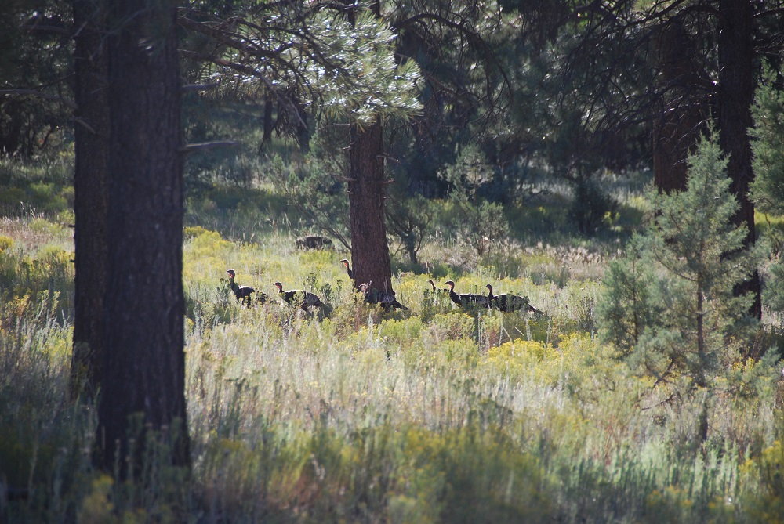
Contributors and Collaborators
Collaboration

Slide 16
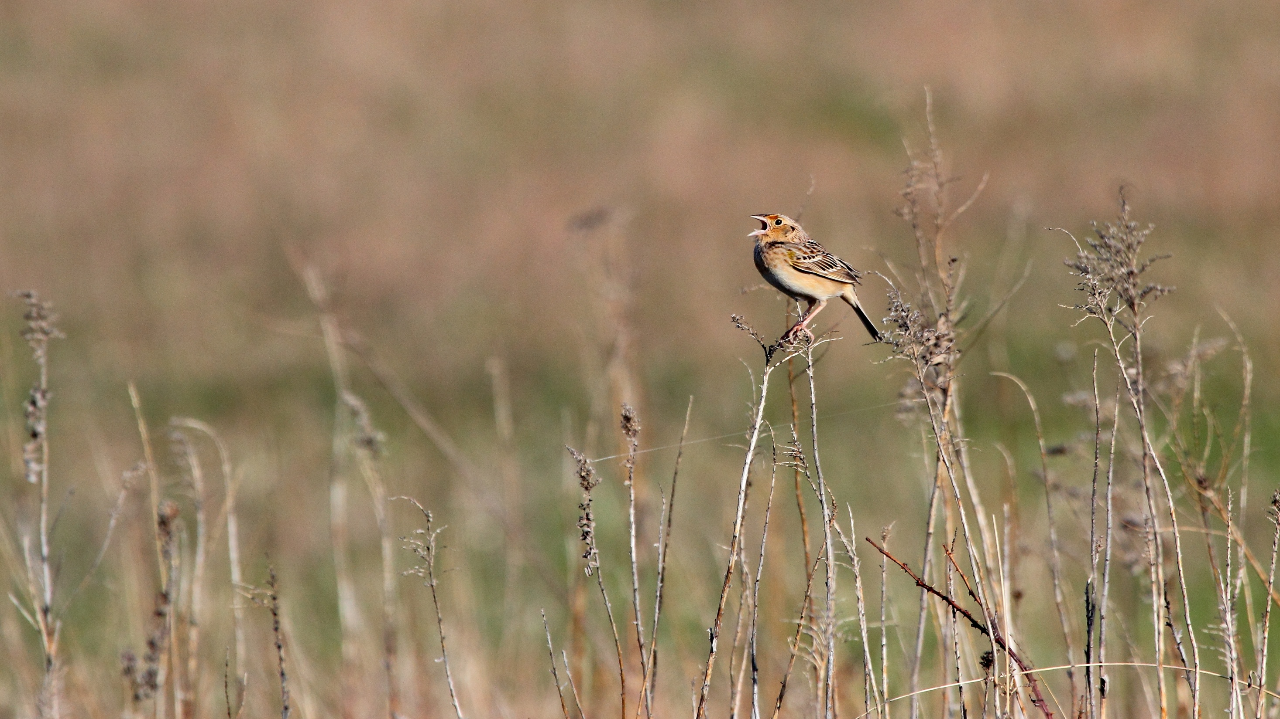
Rangelands Partnership Participating Universities
Collaboration

Slide 17
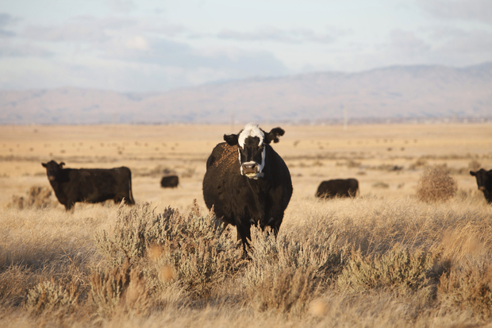
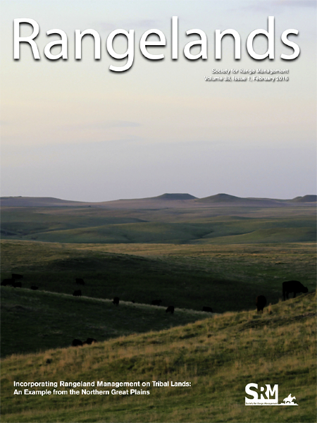
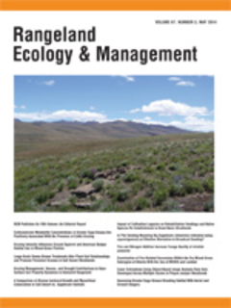
Collaboration
Cooperative Agreement with the Society for Range Management
since 1996

Slide 18
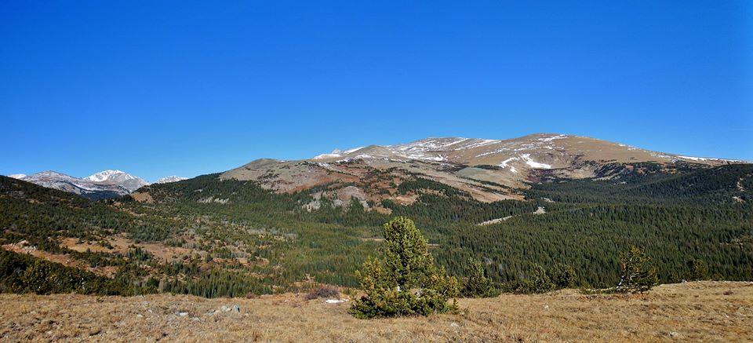
Explore the Websites

Slide 19
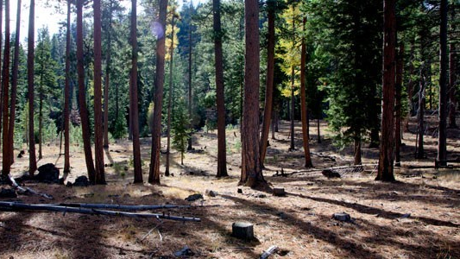
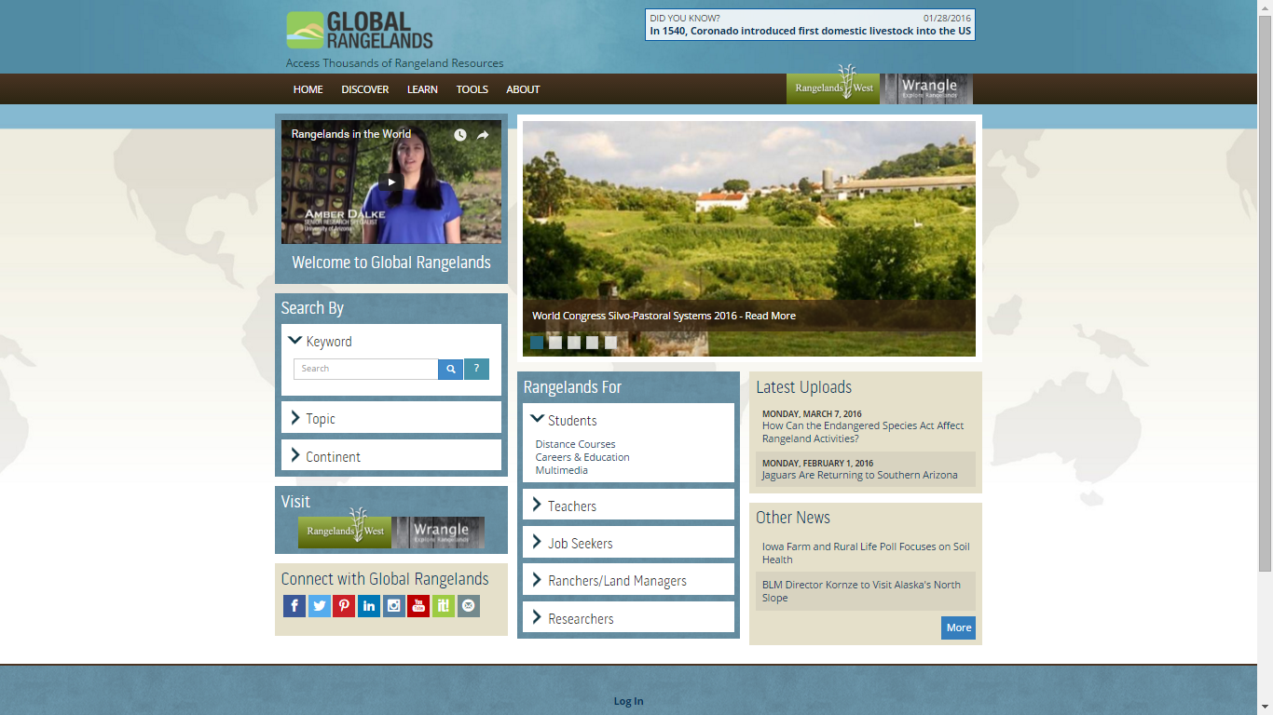
Explore Global Rangelands
Global Rangelands offers an easy-to-use interface for searching the resource database, learning about upcoming events, and accessing tools and educational materials for students, teachers, ranchers and land managers.
Explore the Websites

Slide 20
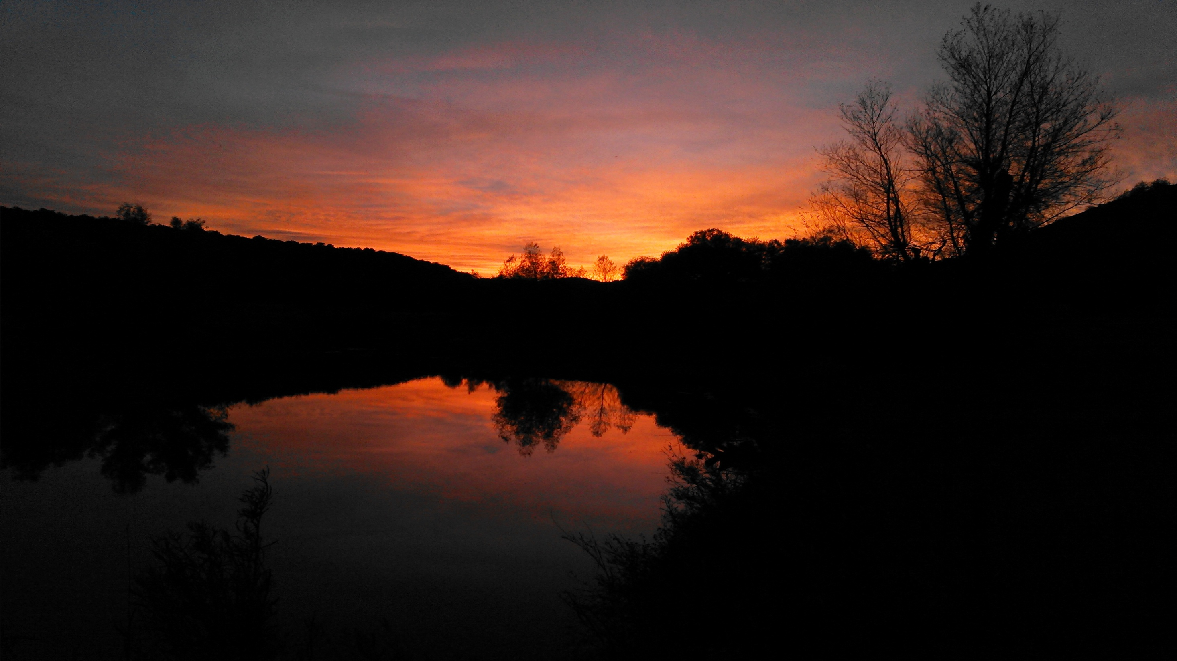
Explore the Websites
Explore by Topic
Find documents, web pages, tools, and other resources organized into
six overarching areas
Rangelands in the World
Uses of Range and Pasture Lands
Rangeland Ecology
Maintaining and Improving Rangelands
Large Landscape Conservation
Human and Economic Dimensions
Rangelands on Indigenous Lands

Slide 21
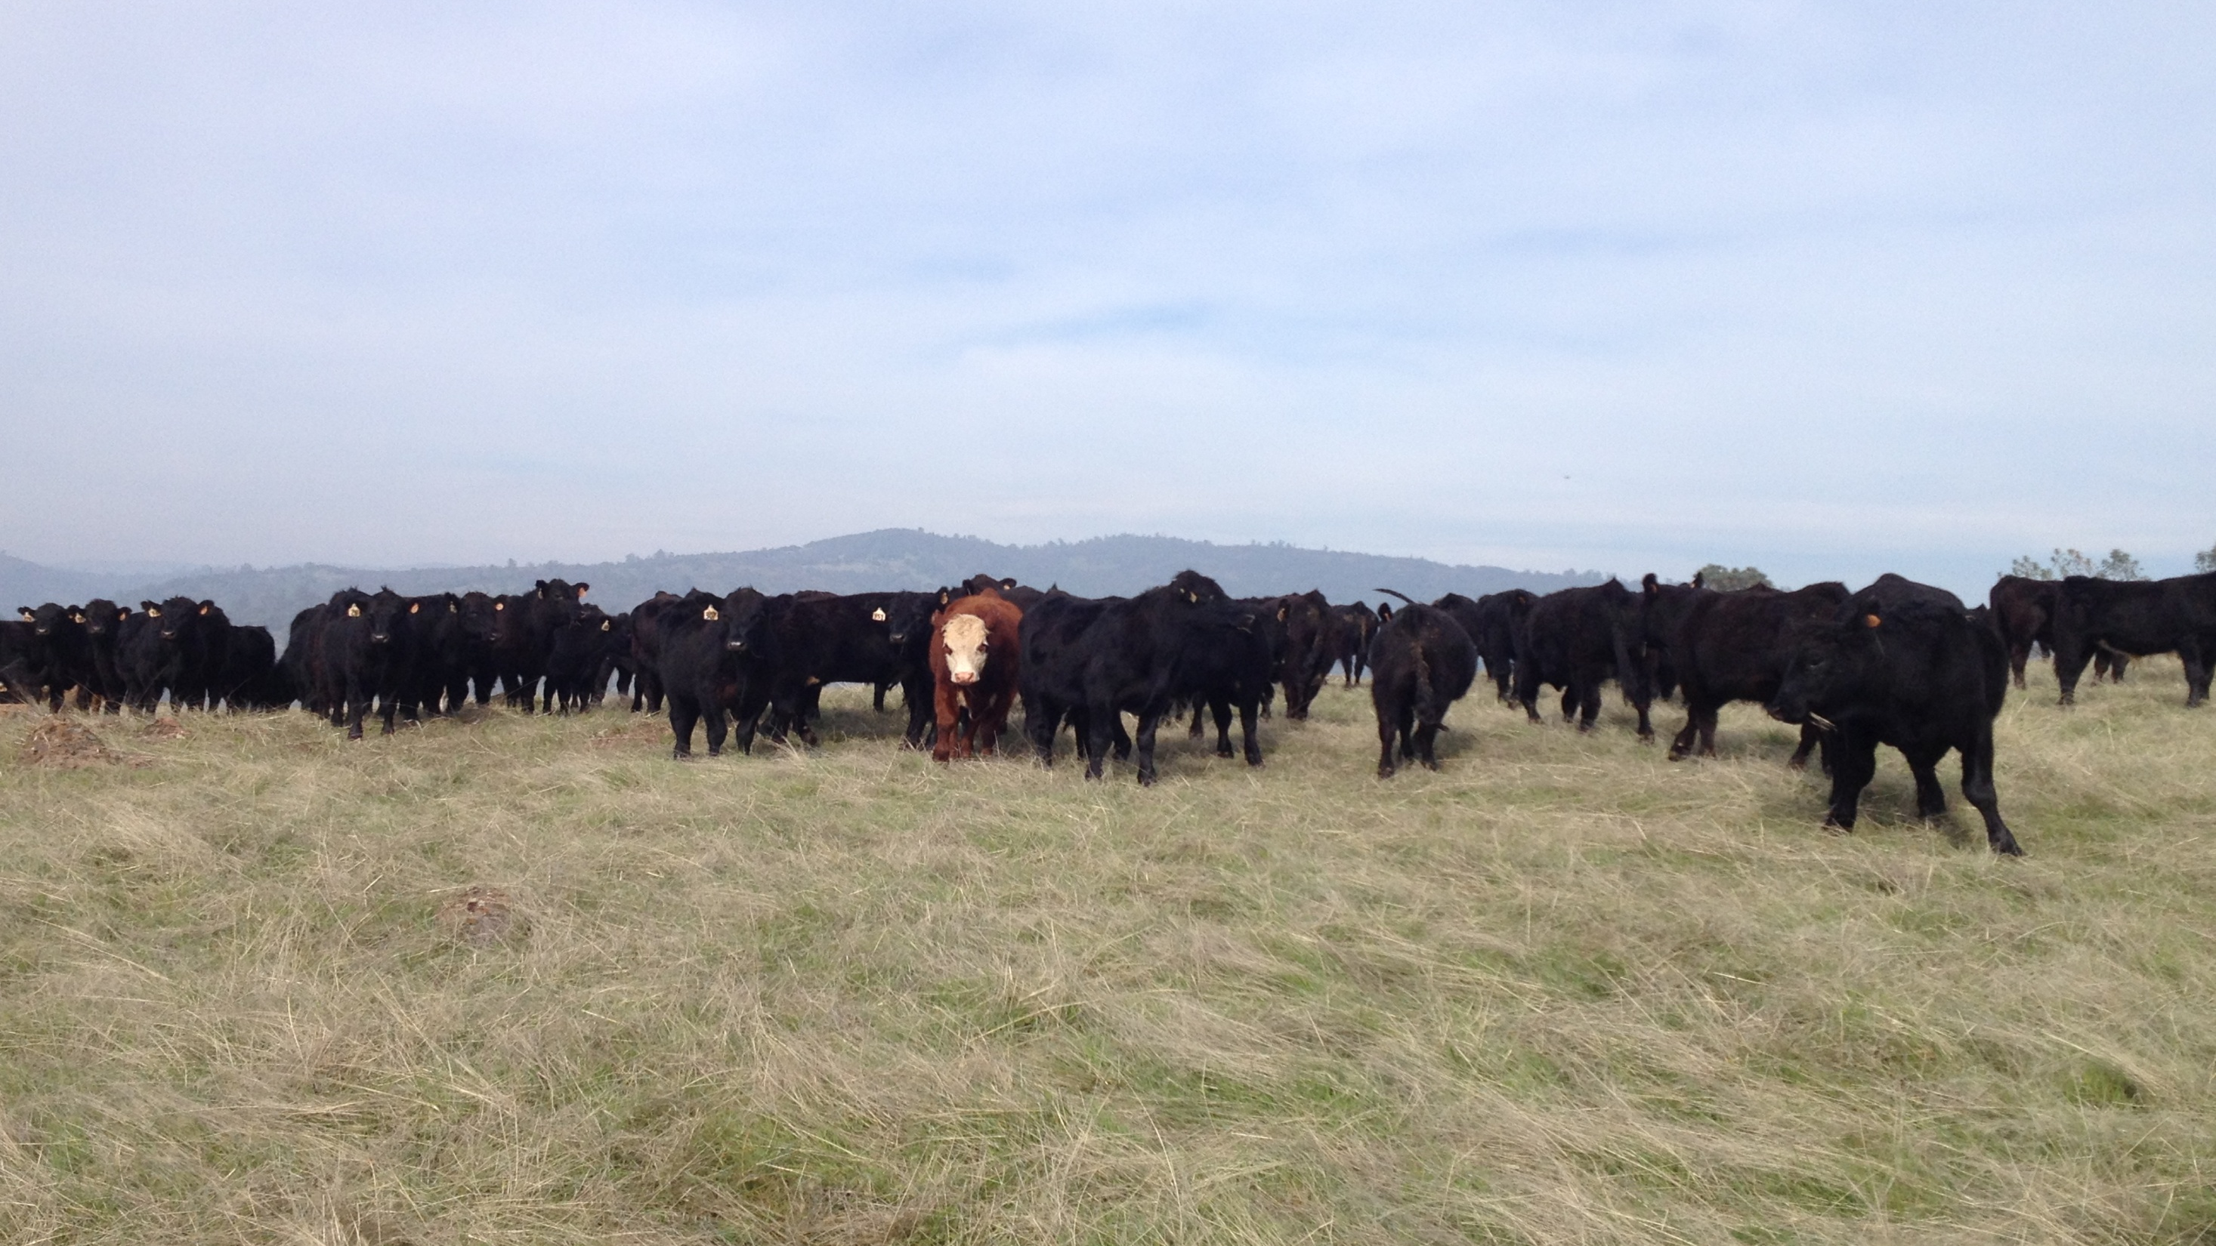
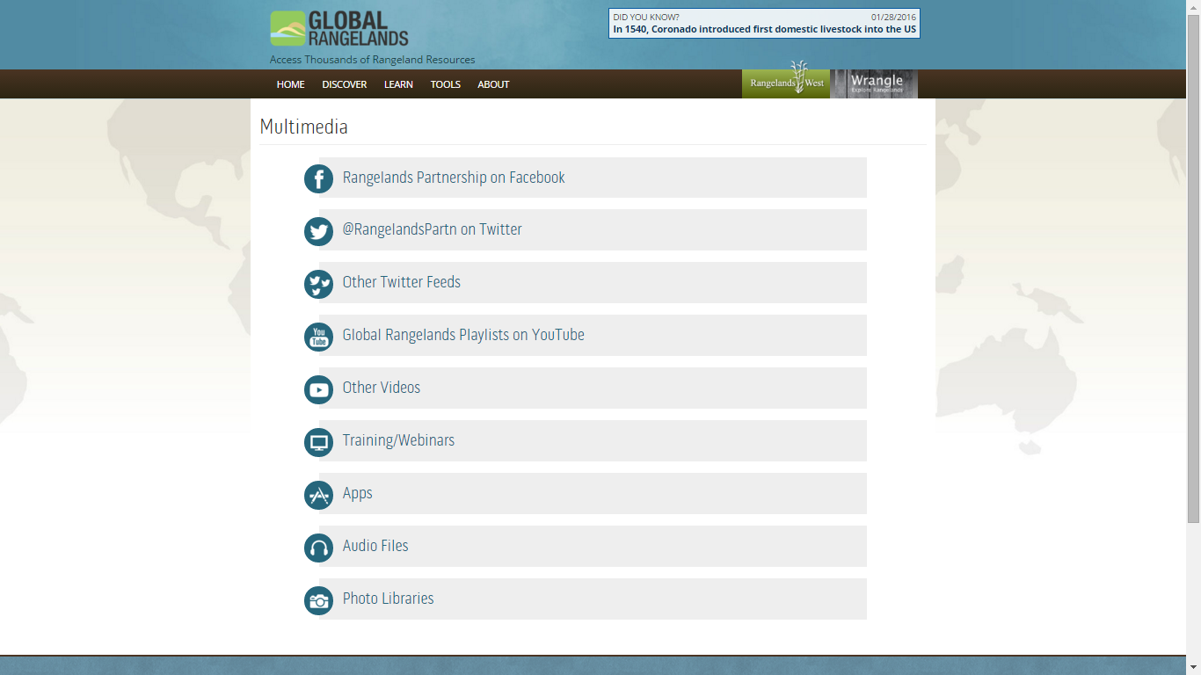
Explore the Websites
Explore Multimedia resources including access to the Global Rangelands social media outlets, trainings and webinars, mobile apps, podcasts/audio files, and other resources that are helpful to anyone interested in rangelands ecology and management.

Slide 22
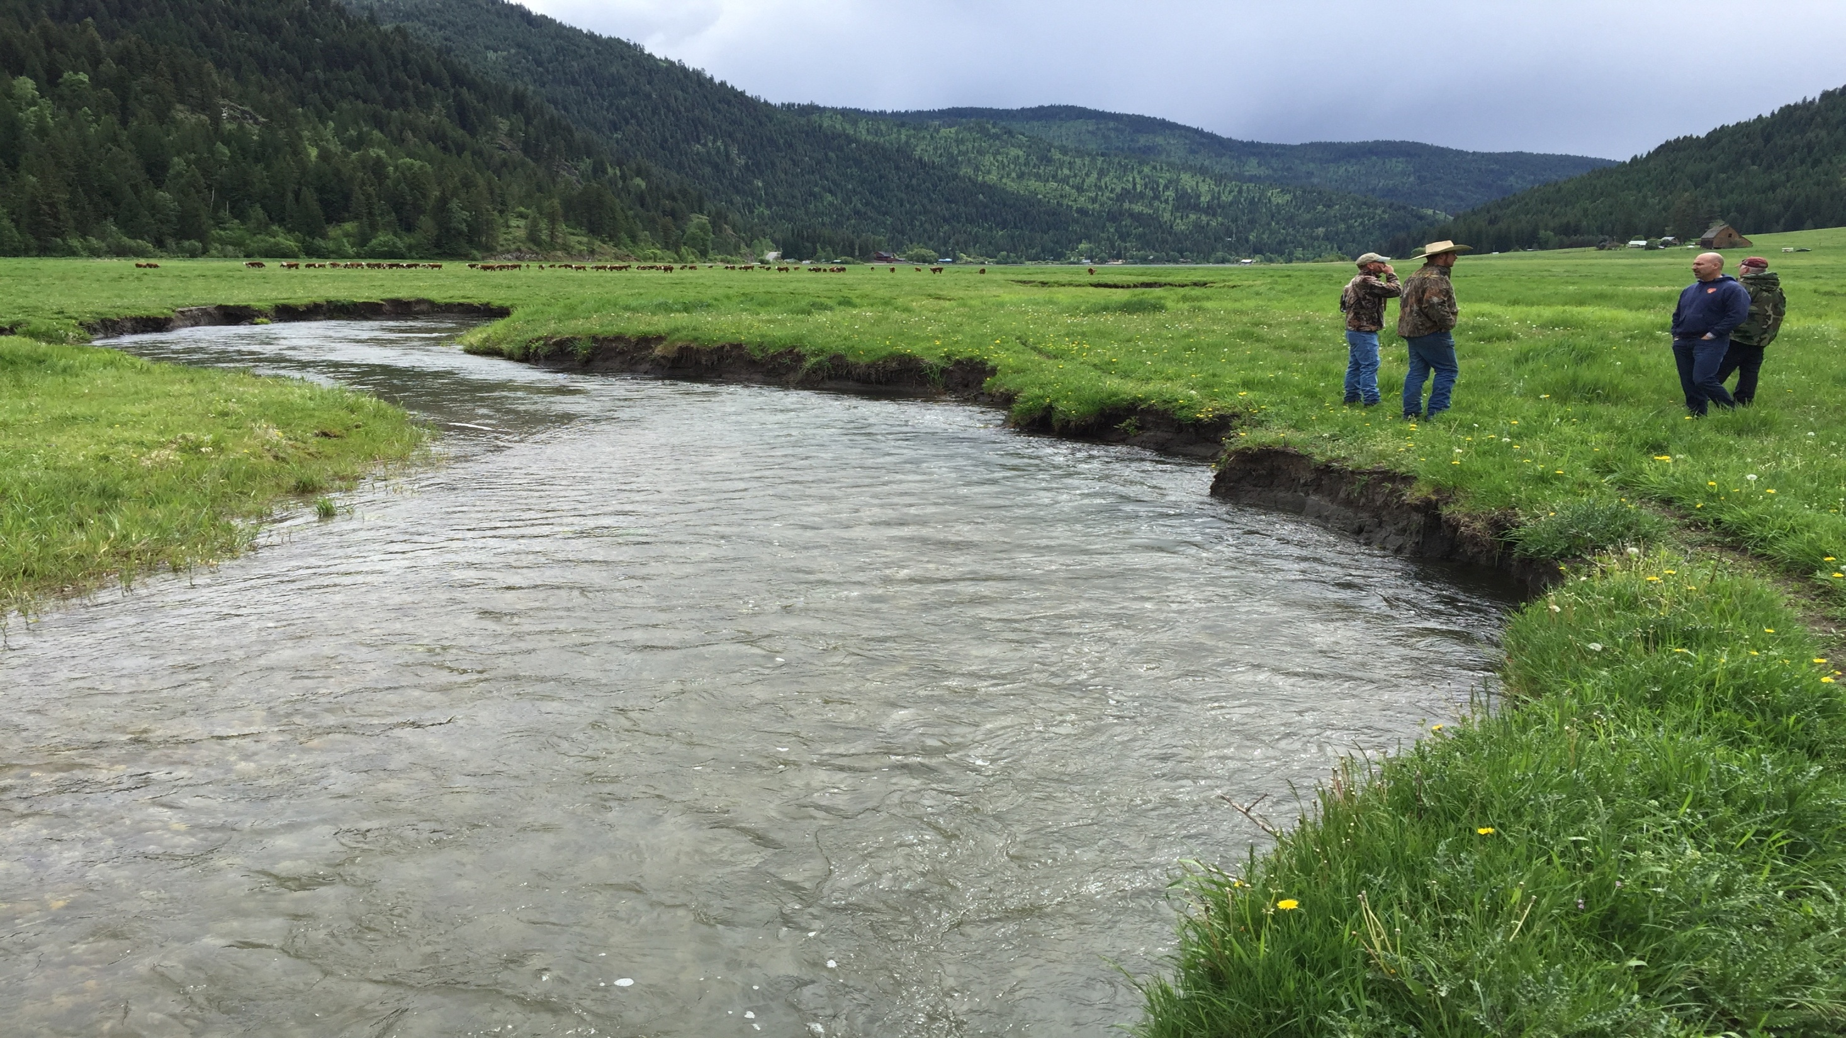
Explore Rangelands West
Access rangeland resources specific to the United States on Rangelands West.
Explore the Websites

Slide 23
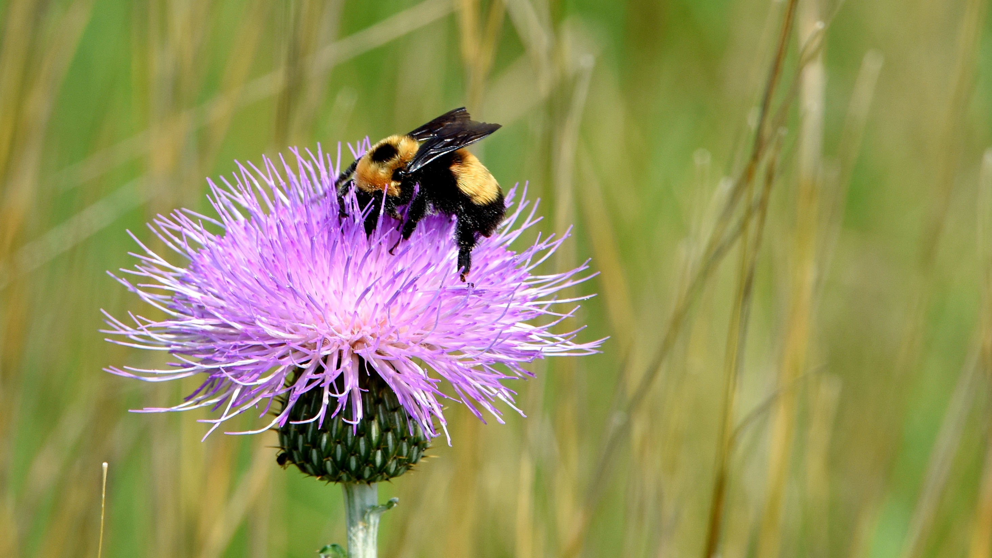
Explore the Websites
Explore
Trending Topics including wolf reintroduction, sage grouse,
wild horses & burros,
and much more!

Slide 24
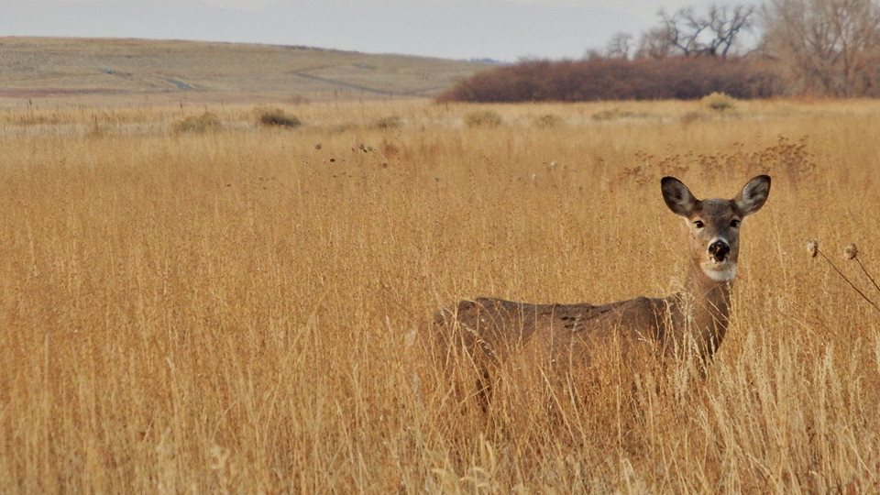
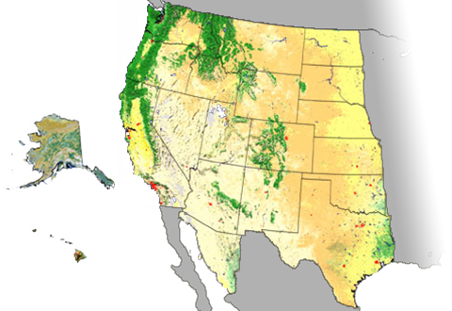
Explore the Websites
Explore by State
Geographic rangeland resources provide regionally significant information and opportunities for regional collaboration.

Slide 25
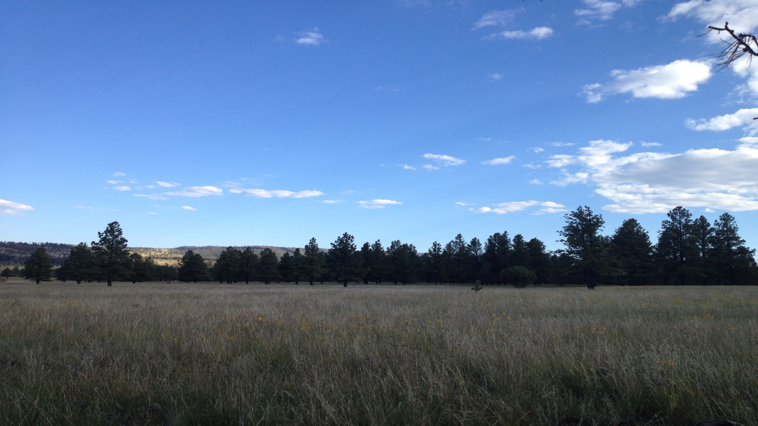
Explore the Websites
Arizona Rangelands gives stakeholders access to upcoming events and key local resources.

Slide 26
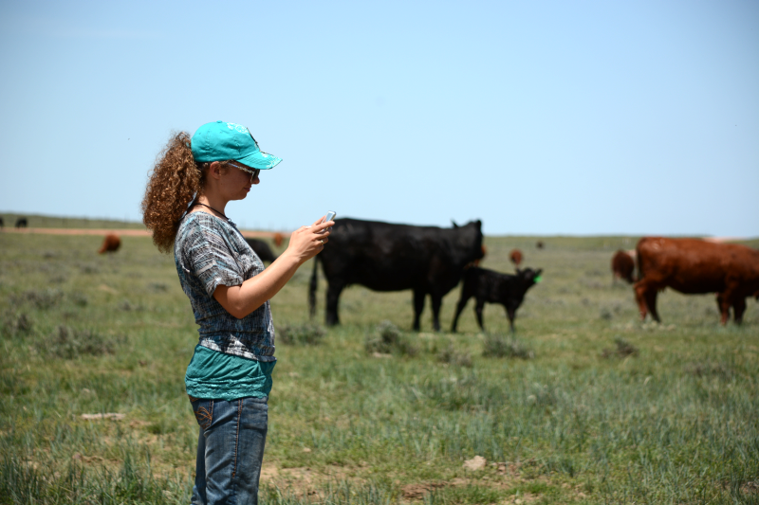
Explore the Websites
Mobile-friendly and
tablet-friendly capabilities

Slide 27
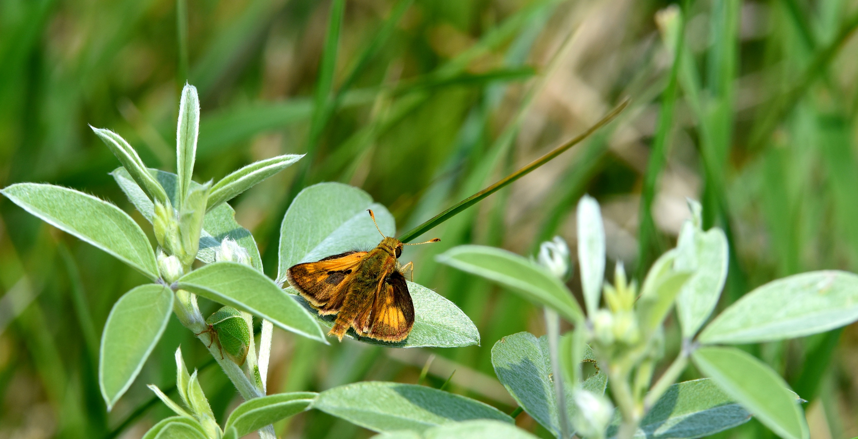
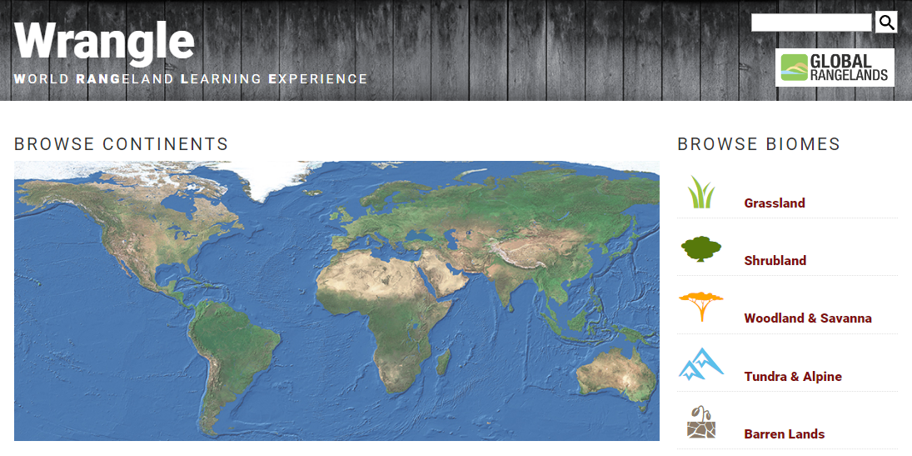
Explore the Websites
Explore Wrangle for an interactive global rangeland learning experience.
The website highlights videos, maps, and high quality images, called gigapans.

Slide 28
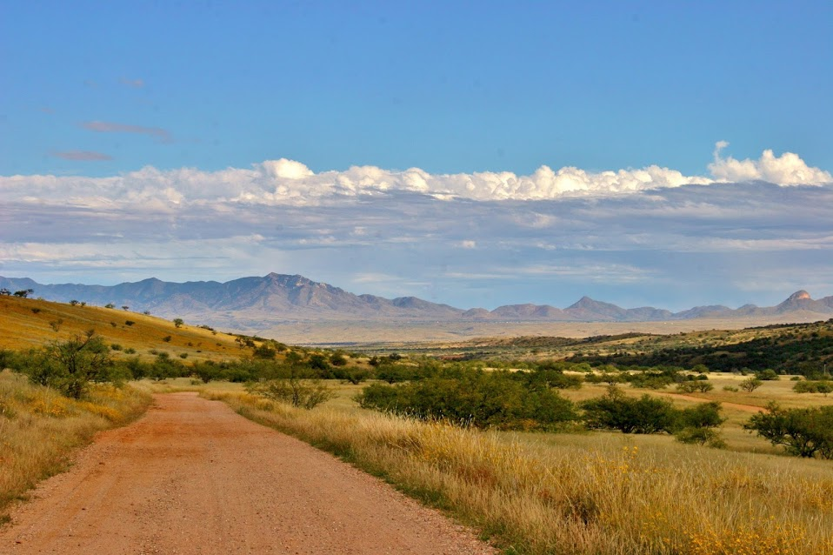
Social Media

Slide 29
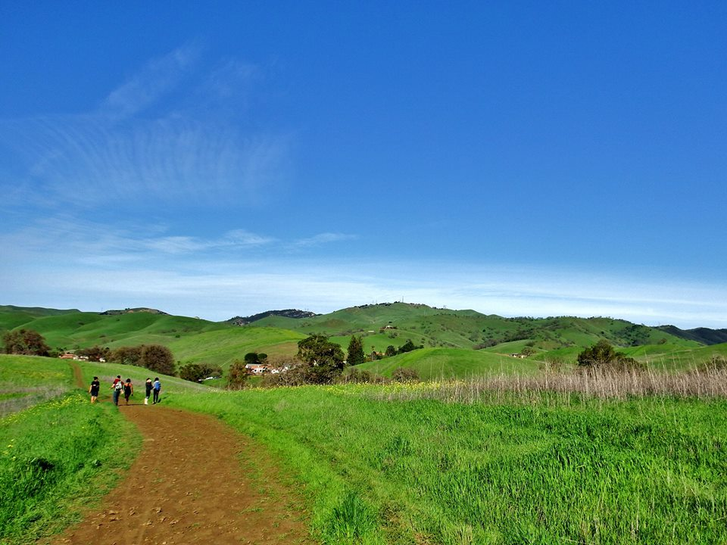
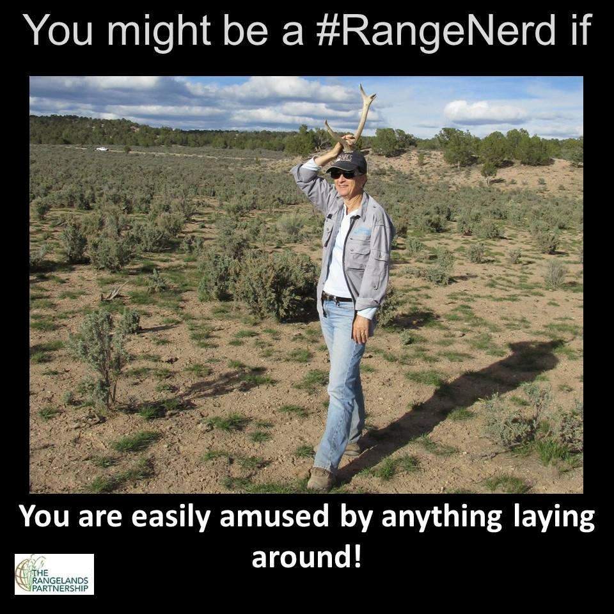
Social Media
Follow the #RangeNerd campaign

Slide 30
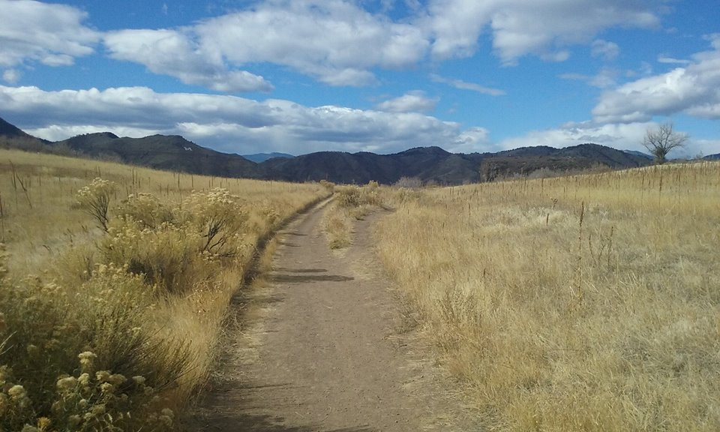
Social Media
Facebook Usage

Slide 31
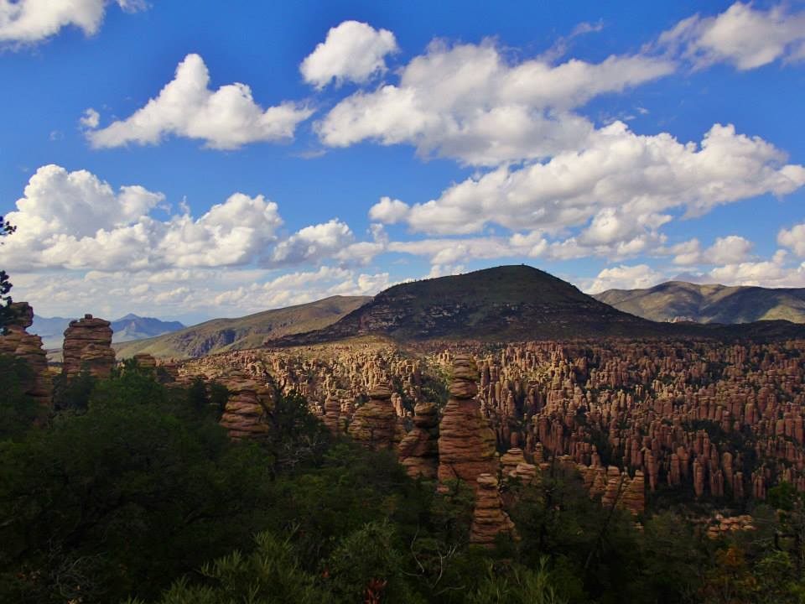
Social Media
127 videos in 16 playlists
22 followers – NEW!
5 boards and 124 pins
249 followers (up from 49 followers in 2015)

Slide 32
The Rangelands Partnership

Slide 33
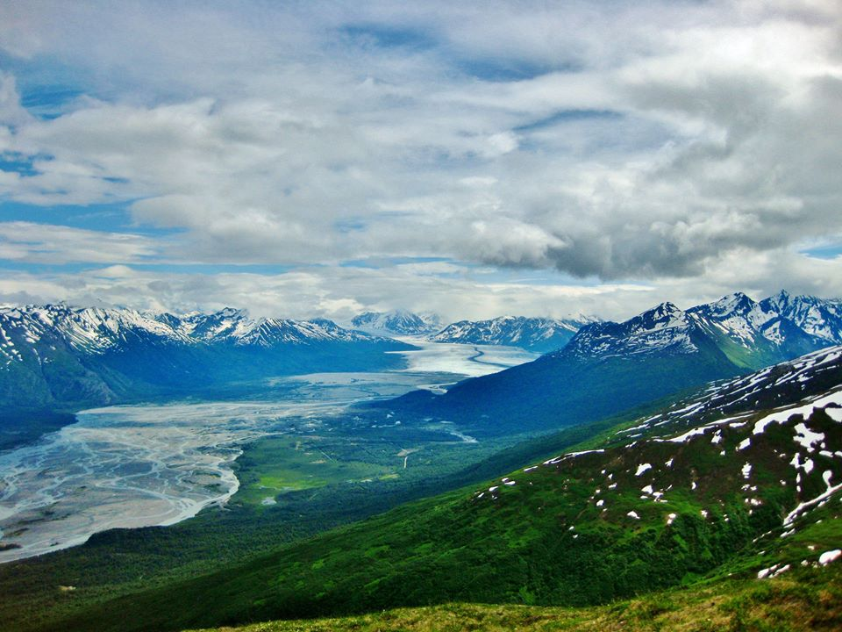
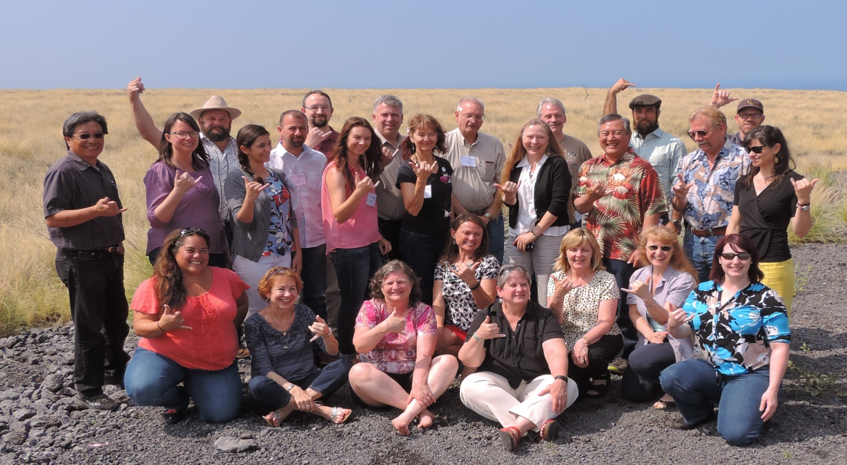
The Rangelands Partnership
The annual Partnership meetings allow for networking, organizing, planning for the future, and improving productivity.

Slide 34
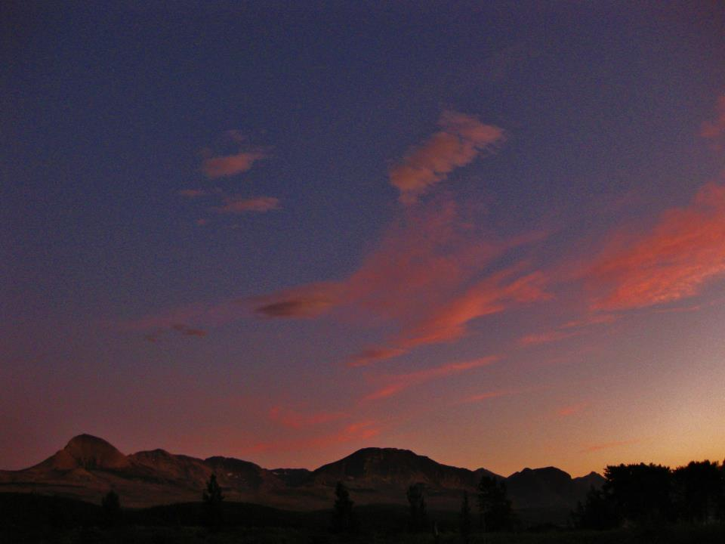
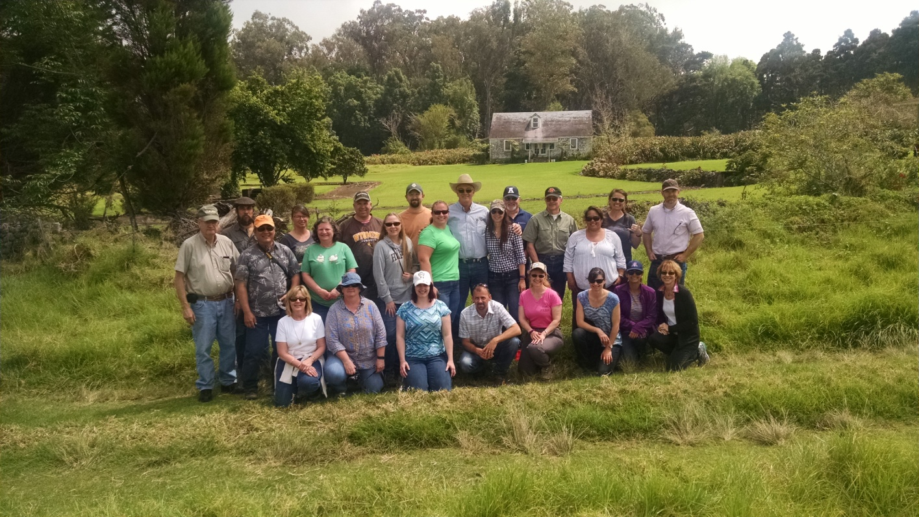
The Rangelands Partnership
The Rangelands Partnership meetings
include tours of local ecosystems
Parker Ranch after the
2016 meeting in Kona, HI
White Sands National Monument prior to the 2015 meeting in Las Cruses, NM

Slide 35
The Rangelands Partnership
2015-2016 Rangelands Partnership
Executive Committee
Chair: Nicole Juve
North Dakota State University
Secretary-Treasure: Jeremy Kenyon
University of Idaho
Co-chair: Lovina Englund
University of Idaho

Slide 36
The Rangelands Partnership
Members of the Rangelands Partnership highlight rangeland resources on the websites through poster sessions and during the yearly Trade Show at the national Society for Range Management meeting.

Slide 37
Selected Publications
Hutchinson, B. and G. Ruyle. 2013. Rangeland Management at Your Finger Tips: Introducing three new websites. The Rimrock Report Vol. 6, No. 1, pages 1-3.
Hutchinson, B.S., J. Pfander, J. Tanaka, and J. Clark. 2011. Rangelands West/Global Rangelands, eXtension Rangelands, and the Range Science Information System: A Suite of New Web Resources. Rangelands Vol. 33, Issue 4.
Hutchinson, B.S., J.L. Pfander, and G. Ruyle. Collaborative Initiatives to Deliver Agricultural Information. Convergence and Collaboration of Campus Information Services. Edited by Peter Hernon and Ronald R. Powell. Westport, Conn: Libraries Unlimited, 2008. 177-197.
Henzel, J. and B. Hutchinson. 2006. Using Web Services to Promote Library-Extension Collaboration. Library Hi Tech 24 (1): 126-141.
Jones, D.E., G. Ruyle, and B. Hutchinson. 2003. Rangelands of the Western U.S.: Outreach Using the AgNIC Model. The Reference Librarian 82:125-140.
Hutchinson, B. and G. Ruyle. 2003. Partnering for Better Management of Western Rangelands: Using Web Technologies to Get the Word Out. Journal of Agricultural and Food Information 4(3):75-89.
The Rangelands Partnership

Slide 38
The Rangelands Partnership
In 2016, members of the Rangelands Partner participated in a Wikipedia edit-a-thon to raise awareness and ensure accuracy of rangeland resources online

Slide 39
The Rangelands Partnership
In 2016, Rangelands Partnership members earned awards at the national SRM meeting in Corpus Christi, TX
Dr. Laurie Abbott (Fellow), Lovina Englund (Outstanding Young Range Professional), and Dr. Amy Ganguli (Early Career Undergraduate Teaching Award)

Slide 40
The Rangelands Partnership
In 2012, Rangelands Partner
and U of A Professor
Dr. George Ruyle
was selected as the first
Marley Endowed Chair
for Sustainable Rangeland Stewardship at the University of Arizona

Slide 41
The Rangelands Partnership
Three members of the Rangelands Partners received an Honorary Membership Award at the 2016 USAIN meeting in Gainesville, FL. The award is in recognition of their outstanding work in the field of agricultural information, specifically in the development and support of the Rangelands Partnership.
Dr. John Tanaka (University of Wyoming)
was present to receive the honor
Dr. Karen Launchbaugh (University of Idaho)
Dr. George Ruyle (University of Arizona)

Slide 42
The Rangelands Partnership
In 2016, Rangelands Partner and CSU Professor
Dr. Maria Fernández-Giménez received the Order of the Polar Star from the government
of Mongolia

Slide 43
International Year of Rangelands and Pastoralism Initiative
The Rangelands Partnership
In 2016, many organizations, including the Rangelands Partnership, began working together to gain support for a United Nations designated International Year of Rangelands and Pastoralism. Events are occurring around the world in attempts to move the initiative forward and raise awareness about rangelands and the people that maintain them.

Slide 44
Grants

Slide 45
Grants
In 2016, the Rangelands Partnership was selected to review and update the 2012-2016 Renewable Resources Extension Act Strategic Plan

Slide 46
Grants
In 2014, the Rangelands Partnership received a RREA NFF grant to create videos including introductory clips, oral histories, and theme videos

Slide 47
Grants
In 2010, members of the Rangelands Partnership were awarded a Higher Education Challenge Grant to create resources for students and teachers

Slide 48
Other Grants Received
Multistate Research Project under the Western Extension and Research Administrative Committee (WERA 1008) (2005; reconfirmed 2011 & 2016)
NIFA-eXtension Optimization grant (2013)
Western Sustainable Agriculture Research and Education (WSARE) professional development grant (2005)
USDA Telecommunications grant (1996)
General Services Administration grant (1995)
Grants
In 2008, the Rangelands Partnership received an eXtension Rangelands Stewardship Community of Practice grant to gain an understanding of users’ social media and web interests and needs.

Slide 49
globralrangelands.org
rangelandswest.org

