Slide 1
Development and Evolution of Rangelands West Content and Structure

Slide 2
Overview
Introduction
Content evolution and development v1, v2 and v3
What worked and didn’t work
Considerations for v4

Slide 3
Web Projects
Electronic gateways
Launching platforms

Slide 4
Objectives for Content Development
provide electronic access to reviewed information and data, applicable to rangeland management decision making
create databases and interfaces that bring this information to users
facilitate understanding of rangeland management processes

Slide 5
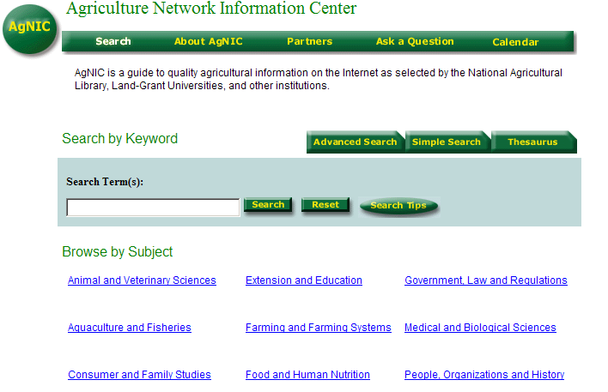
http://www.agnic.org/

Slide 6
Version 1: Western Rangelands

Slide 7
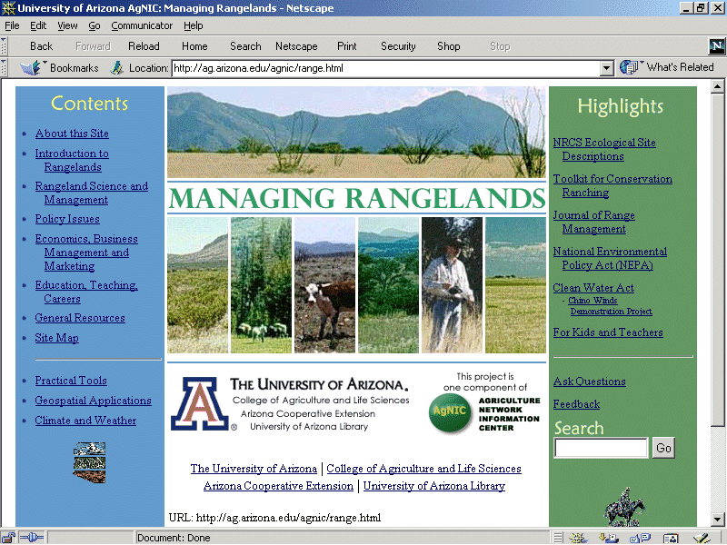

Slide 11
Version 2: Rangelands of the Western US

Slide 13
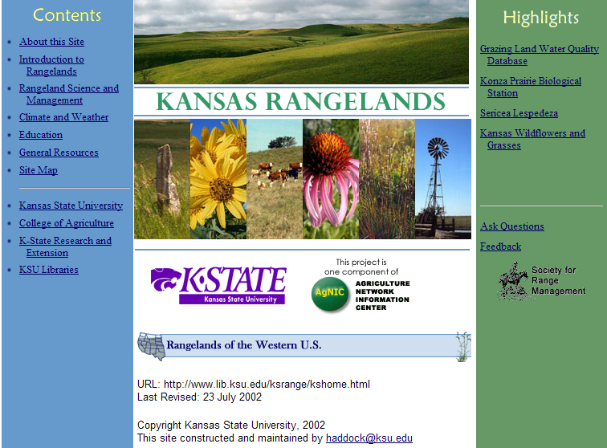

Slide 14
Content Groups (2005)
Grazing Management
Invasive Species Management
Inventory and Monitoring
Landscape Planning
Prescribed Fire
Rangeland Restoration
Watersheds, Water Quality and Riparian
Wildlife Habitat and Endangered Species

Slide 15
Version 3: Rangelands West

Slide 17
Version 3: Rangelands West
Browse by Topic
Rangelands and How They Work
Plants and Animals
Soils and Water
Climate, Drought, and Fire
Grazing, Recreation, Wildlife and Other Uses
Vegetation Management and Restoration
Inventory, Monitoring, and Assessment
Rural Communities and Ranch Economics
Planning and Collaboration
Training, Teaching, Education and Careers

Slide 18
Populating the New Categories
Metadata issues
Putting links in the right place
Managing a big group of contributors

Slide 19
Populating the New Categories
Content groups developed scope notes
Data entry form created for placing content on the website

Slide 20
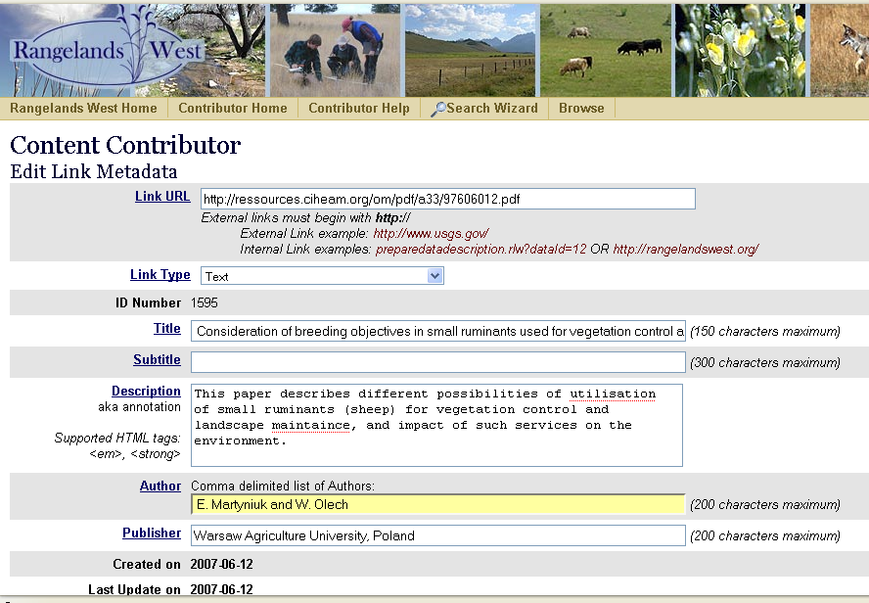

Slide 21
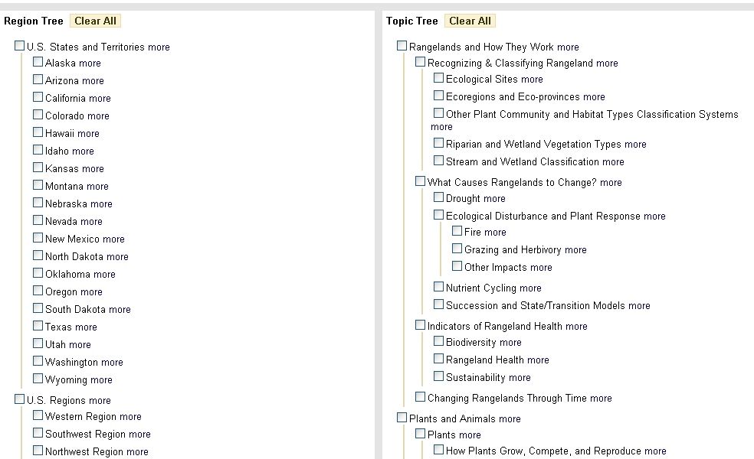
Data Entry Screen – Topic Tree

Slide 22
Overview of what worked
original AgNIC components
interdisciplinary collaboration
interactive application modules
state sites
dedicated individuals
the partnership

Slide 23
and didn’t work
faculty development of original content
committee approach to content development
link contribution process

Slide 24
Considerations for Version 4
Content Improvements
continue to develop scope notes/description fields in the topic outlines
location specific information and analysis
enhancements based on identified user needs
focus on developing a full-text repository with multiple partners
offer interactive user tools

Slide 25
Considerations for Version 4
Technical Improvements
develop problem reporting/solution system
refine data entry process
greatly improve the ability to search across multiple online resources and data sets (federated search)

Slide 26
Western Rangelands Partnership

