Slide 1
From Local to Global: Launching the New Rangelands West Portals and Database
XIV IAALD World Congress 2013
Cornell University
July 22, 2013

Slide 2
Rangelands Partnership
Began in 1995 as an AgNIC / University of Arizona Libraries project partnering with UA CALS rangelands specialists
Invited Western Land Grant Universities (LGUs) to join in a Western Rangelands Partnership in 2001
Now officially includes 19 LGUs with international participation from Australia, Mexico, and FAO

Slide 3
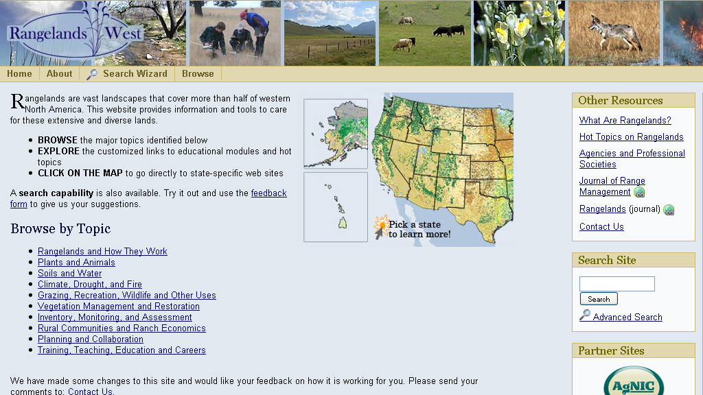
Rangelands West: Archival Repository for SRM Journals

Slide 4
Recognized Need to Change and Evolve…and gain new resources
Conducted needs assessment (focus groups) and developed business plan
Purpose: to guide development of a technical requirements for total redesign
Key Recommendations from Needs Assessment :
Update content frequently
Fast and relevant searches
Libraries of documents & images
Location-specific information
Tools to foster interaction/networking
Searchable directory of experts
Revenue generation
Grants
Partner contributions
Sponsorships

Slide 5
USDA International Science Education Program Grant – 2010
University of Arizona
University of California, Davis
University of Idaho
Rangelands Australia
Food and Agriculture Organization of the United Nations
Other Signatories
eXtension
GSSA

Slide 6
Proposal Objectives
Redesign Rangelands West portal to host repository of global rangelands full-text and evaluated resources
Establish partnerships with key organizations/associations around the world as contributors to “Global Rangelands”
Upload and create infrastructure to provide faster and more user-friendly access to content
Create customized search interface (faceted search) and implement social networking applications
Develop two multimedia learning modules (overview & Australia)
Create synthesis papers on international outreach/Extension practice for natural resources management

Slide 7
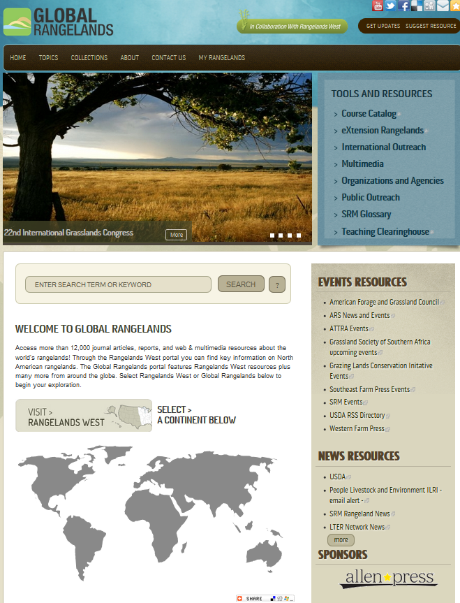
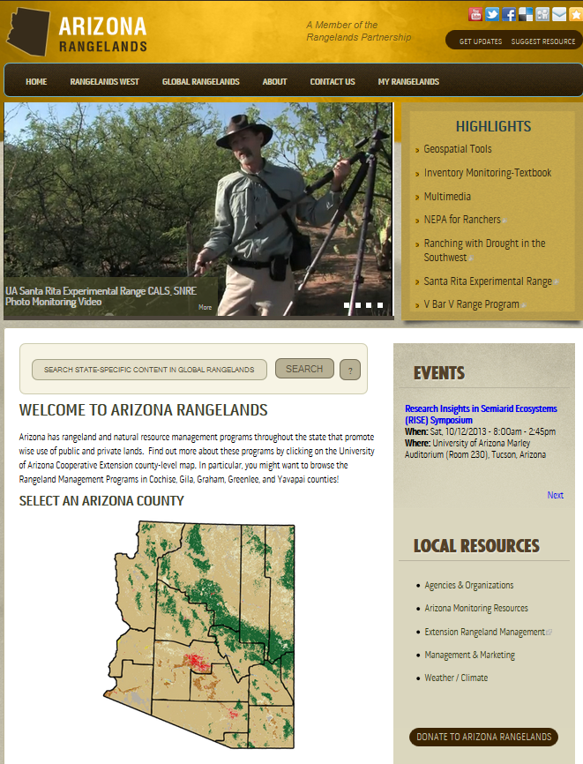
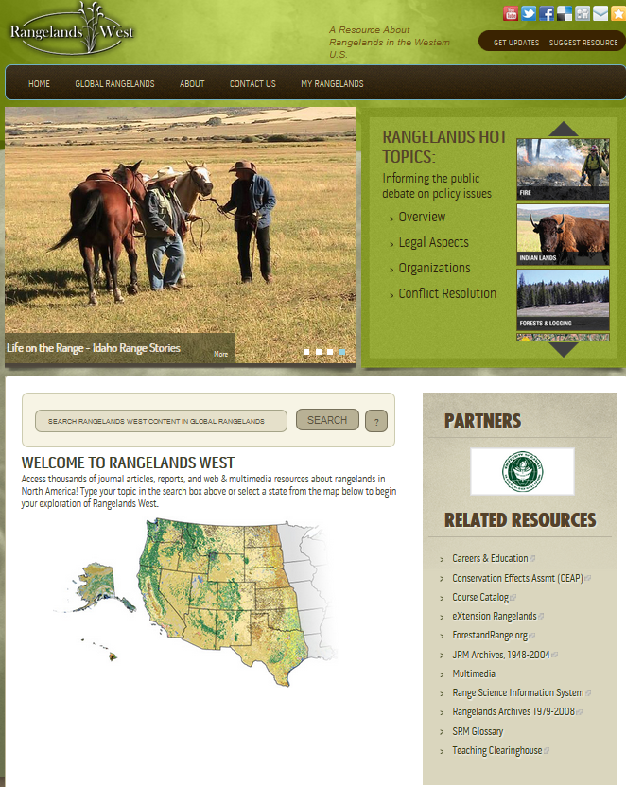
Result: Three New Portals, New Functionality, and New Local Sites

Slide 8
Tools and Resources
Multimedia
Global Rangelands YouTube Channel and Playlists
Climate
Domestic and Wild Animals of Rangelands
Economics Associated with Rangelands
Fire
Invasive Species
Planning and Collaboration
Public Outreach
Uses of Range and Pasturelands
Vegetation Management and Restoration
Vegetation Monitoring
Also includes:
Audio Files
Images
International Outreach
A resource on global extension practice involving participatory approaches and the use of Information and Communication Technologies (ICTs)
Find out more about:
International Extension Practices
Case Study Profiles
Organizations
Multimedia Resources
Use of ICTs (Information Communication Technologies)

Slide 9
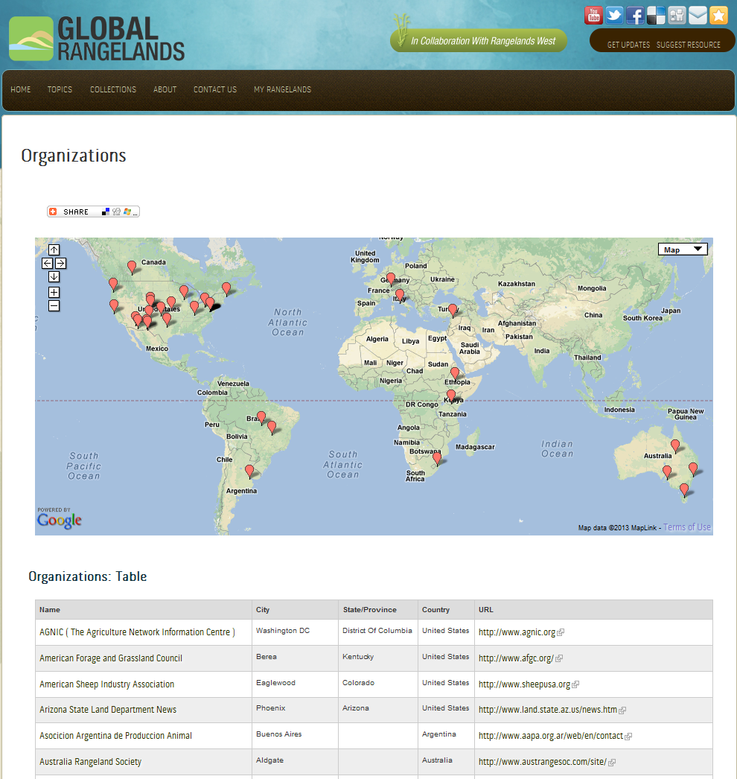
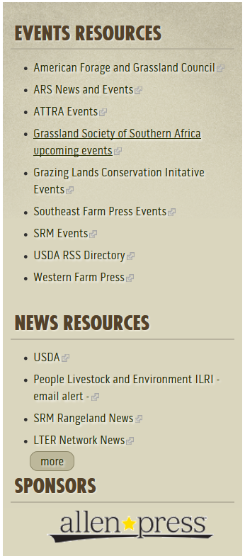

Slide 10
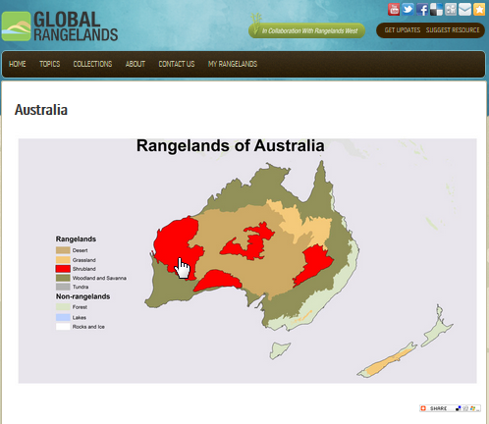

Slide 11
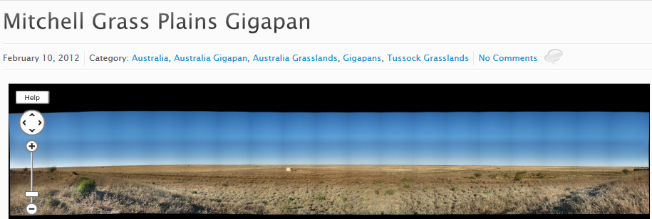

Slide 12
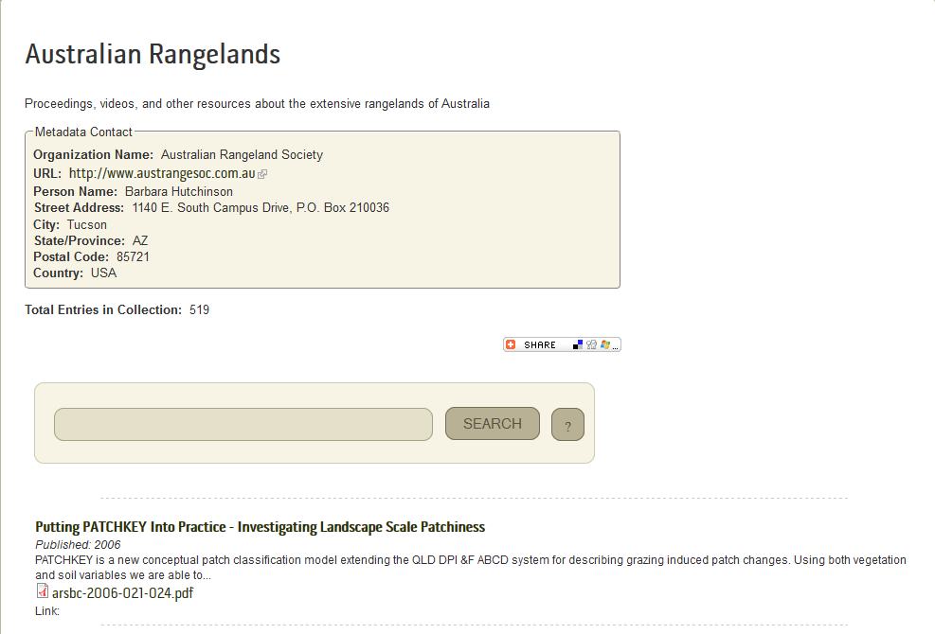
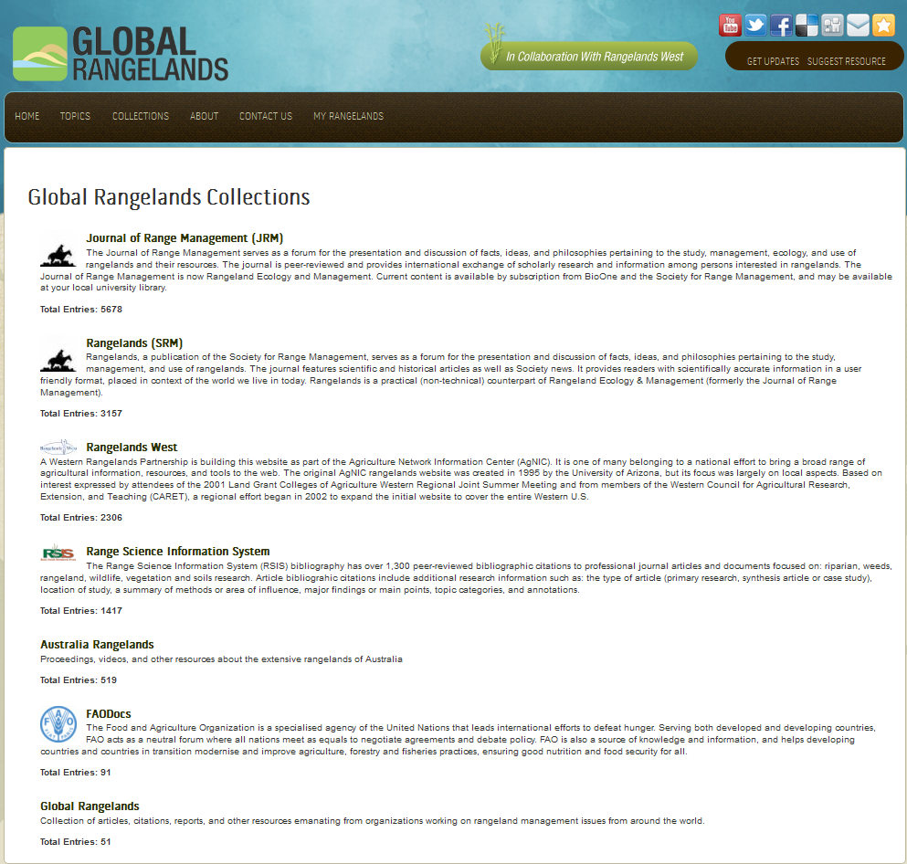
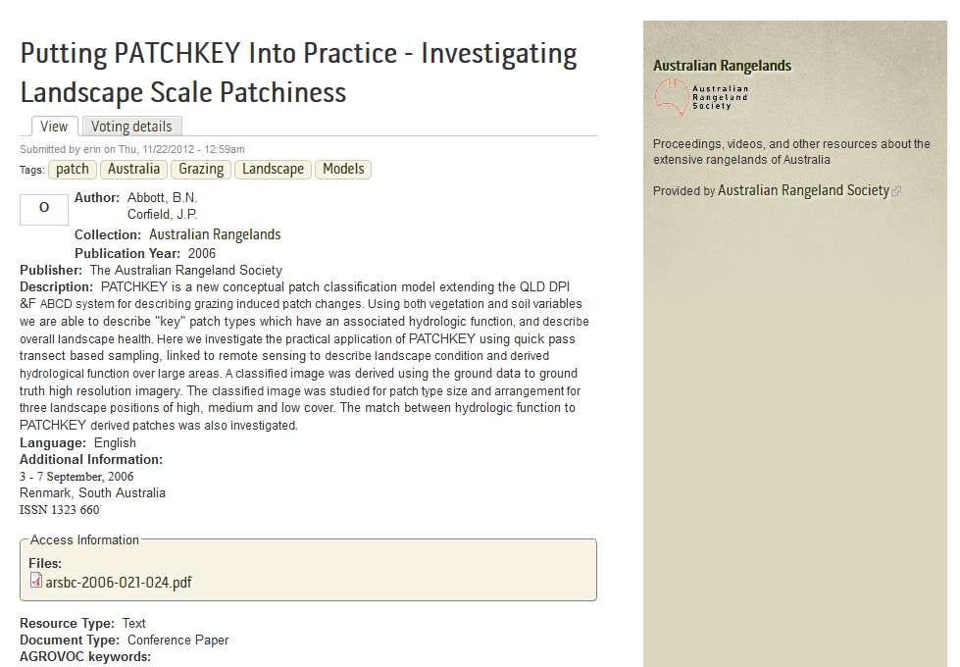
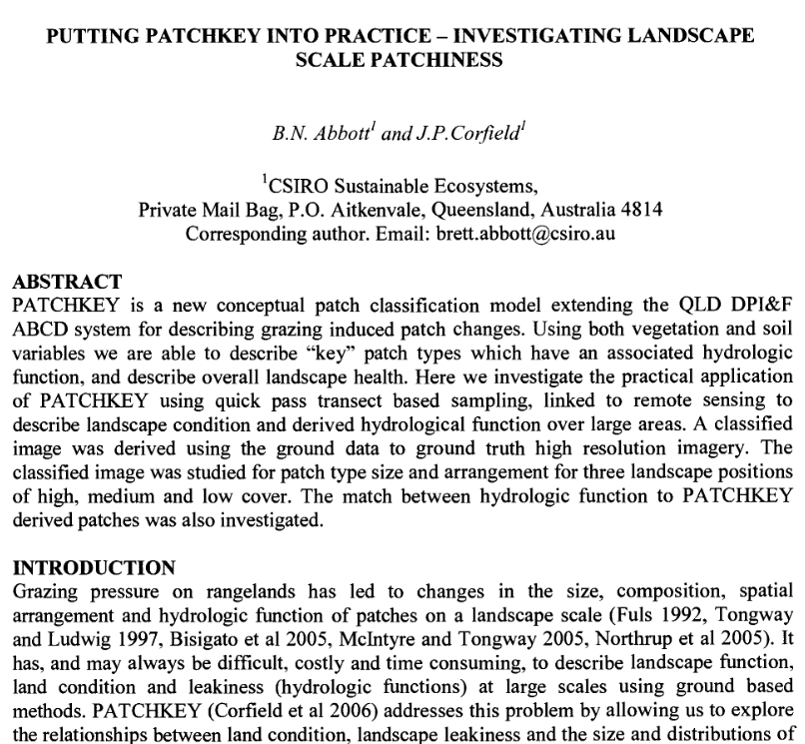

Slide 13
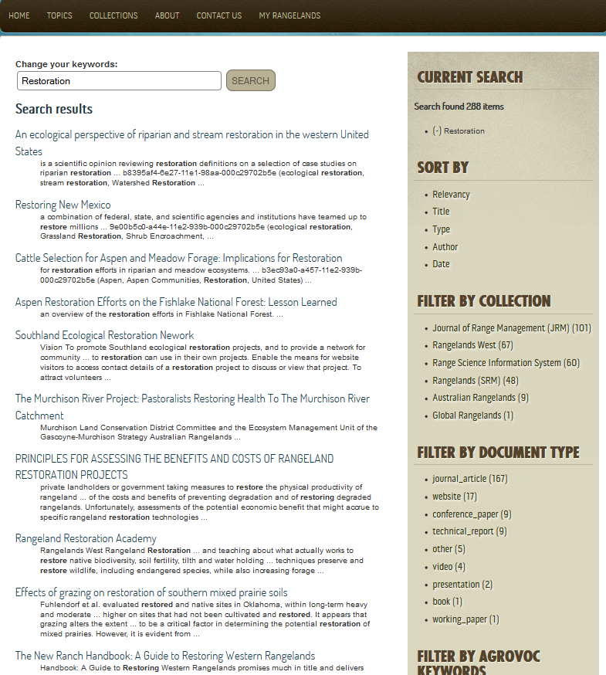
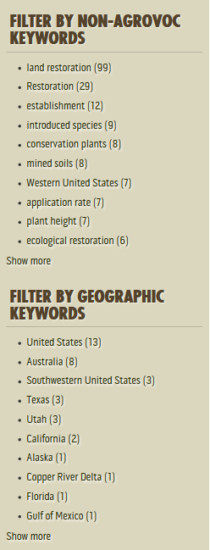
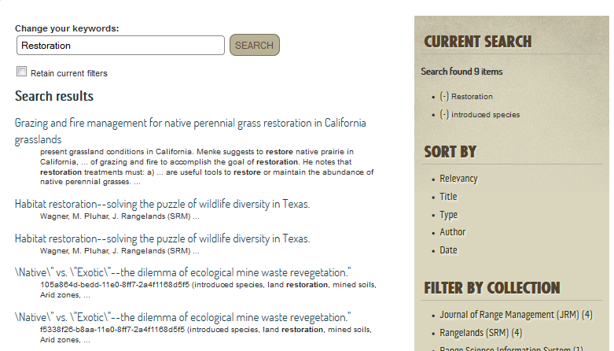
Faceted Search Capabilities: some Amazon and Google-like functions

Slide 14
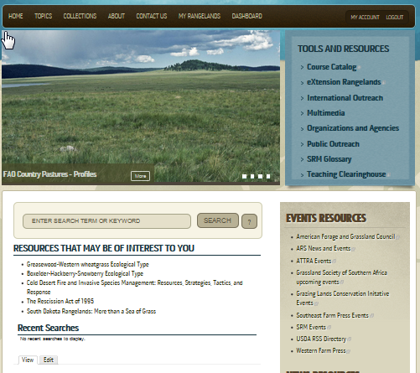
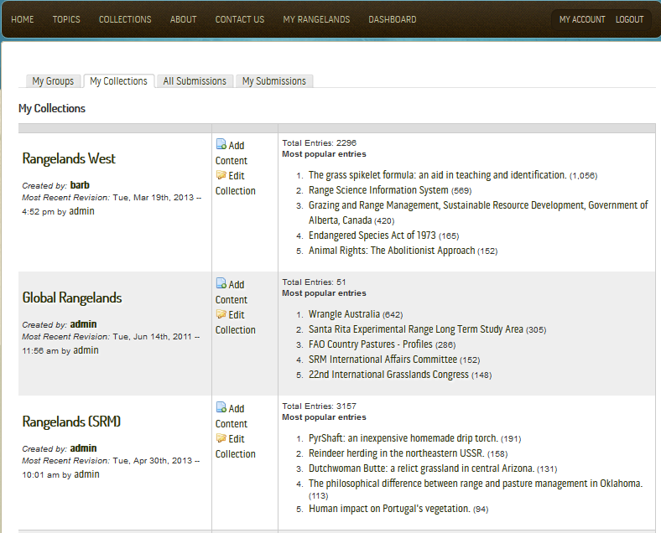
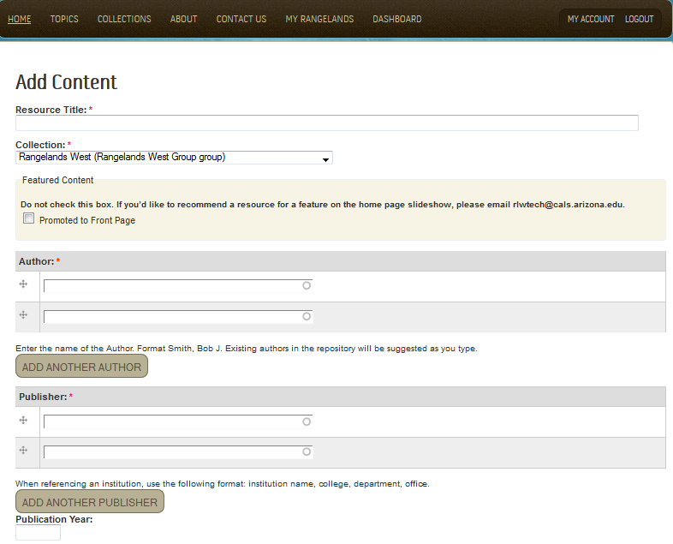
Join “My Rangelands”

Slide 15
Content submission: the resource is indexed against AGROVOC terms
All contents can be indexed with AGROVOC terms, also automatically
Current search term
AGROVOC is a controlled vocabulary maintained by FAO and several partners. It covers areas pertaining to agriculture.
To date, AGROVOC contains over 32,000 concepts
Narrow your search
AGROVOC web services

Slide 16
Leveraging AGROVOC
Controlled vocabulary
To always use the same terms for the same concepts
Web services
To integrate AGROVOC in the submission workflow: controlled terms are automatically suggested when tagging --> only terms that are in AGROVOC can be used
Automatic indexing services
To aggregate relevant contents from other sources (e.g. via RSS feeds or page scraping) and automatically tag them with AGROVOC terms
Wide usage --> greater potential for sharing
To seamlessly integrate contents from other information services that use AGROVOC (see the FAODoc collection in the portal)
To make contents from Global Rangelands re-usable by services using AGROVOC
Mapping to other thesauri (NALT, CAAT, Eurovoc)
To integrate and search contents originally tagged with other thesauri

Slide 17
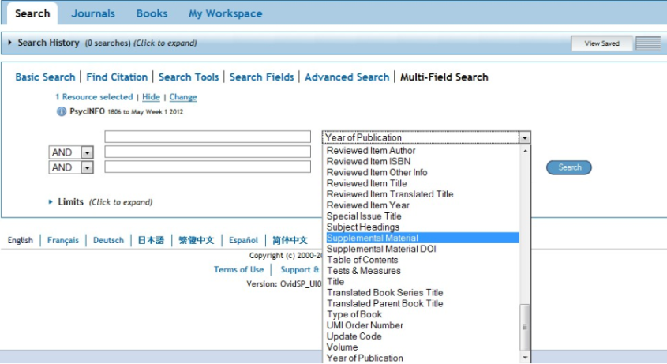
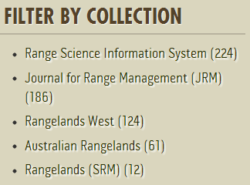
Global Rangelands, Phase II
New Features
Advanced Searching
Faceted “Browsing”
Mobile Responsive design
Search box on each Collection page
EndNote/RefWorks export of content
Improvements
Increase Google Search Ranking
Browse Authors by Letter
Send welcome email when people sign up for “My Rangelands”
Change Global Rangelands front page slideshow to redirect to any URL, not just content within the database.
Print-friendly pages

Slide 18
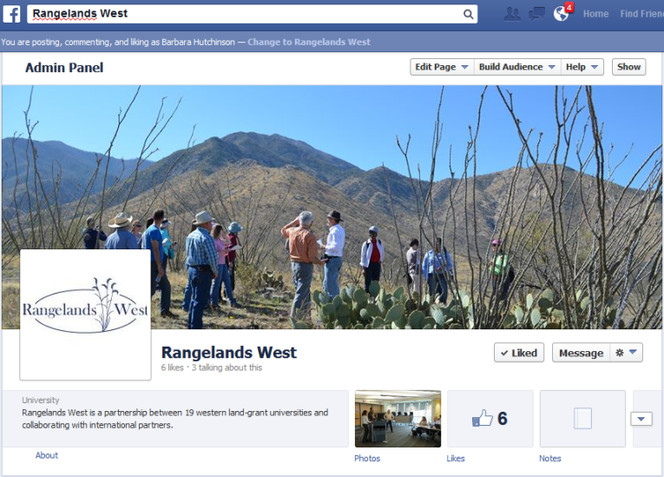
Rangelands West, Phase II
Improvements
Ability to add five slideshow features to home page
Create secondary page showing all future events
Ingest RSS feed of upcoming events
User Interface
Search results template matches RangelandsWest/State site
“Go back” to State/RLW homepage from search results
New Sites
Additional State sites (templates)
Facebook and Google+ “sites”
Harvest from new sources
SRM Journals, Australian Rangelands

Slide 19
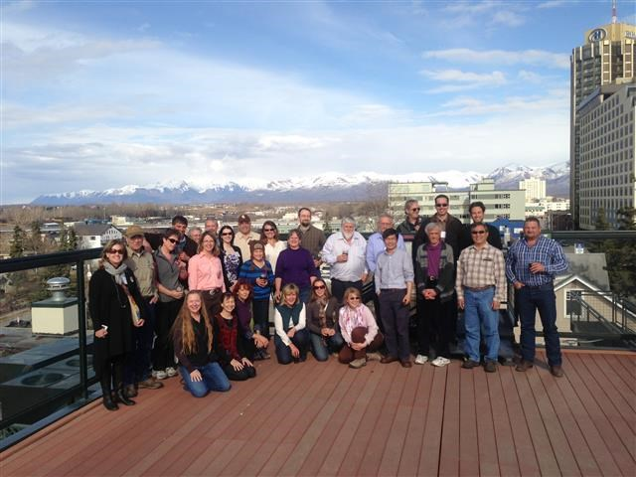
THANK YOU! Questions?
Please “Like Us” (Rangelands West) on Facebook!

