Slide 1
AgNIC Rangelands: A Collaborative Effort
Jeanne L. Pfander
13th Biennial USAIN Conference
April 30, 2012, Minneapolis, MN

Slide 2
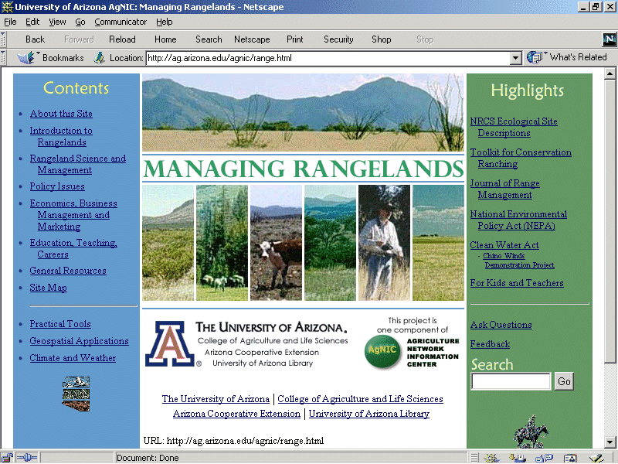
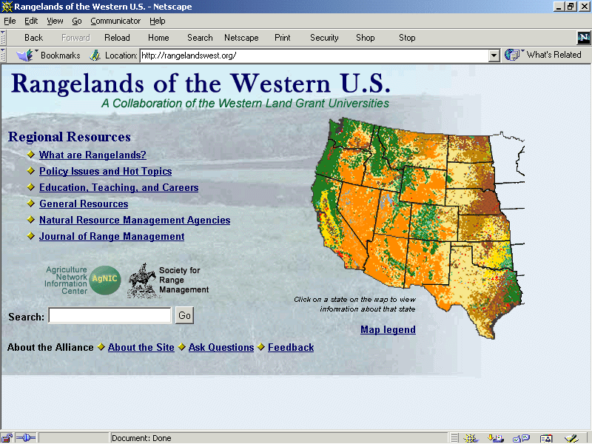
AgNIC Rangelands: The Early Years
Arizona AgNIC “Managing Rangelands” (1995 - 2001)
AgNIC Rangelands: Rangelands West (2002+)
Notes:
Began in 1995 as part of the Agriculture Network Information Center (AgNIC)
Topic: Rangeland science & management
Naturally interdisciplinary
Relevance to broad natural resource interests in Arizona & elsewhere
Involves current political, social, & environmental issues
From the outset, the UA AgNIC rangelands effort has been one of partnerships and collaboration – both internal and external.
College of Agriculture and Life Sciences
Arid Lands Information Center
Rangeland and Forest Resources Program & School of Renewable Natural Resource
Network Support Group
Cooperative Extension Programs
Arizona Remote Sensing Center
University of Arizona Library
External: NRCS, NASA/Raytheon, AZ Common Ground RT, CSREES
In 1995, the University of Arizona was one of the original AgNIC members, choosing rangeland management as our topic. From the beginning it has been a collaborative effort, with contributions of staff and funding from both the Library and the College of Agriculture and Life Sciences.
However, in recognition of the fact that rangelands are vast landscapes that don’t stop at political boundaries, following a preliminary meeting held in 2001, the Rangelands West Partnership was formed, bringing together librarians, rangeland specialists and IT professionals from 19 western U.S. states.
We are working to develop a web portal to provide information and tools useful for sustainable rangeland management.
This presentation will report on recent progress made on the Rangelands West graphic design, technical architecture and international partnerships.

Slide 3
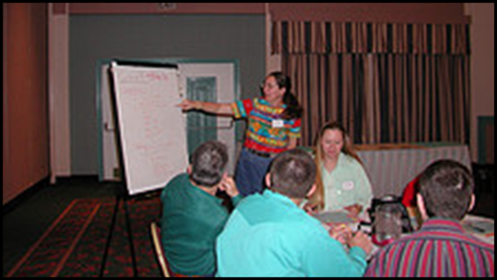
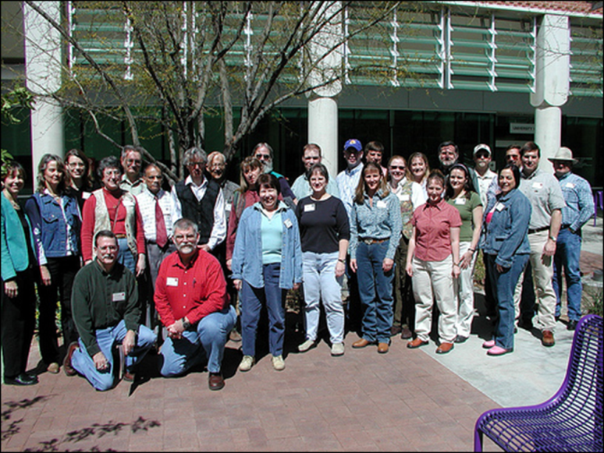
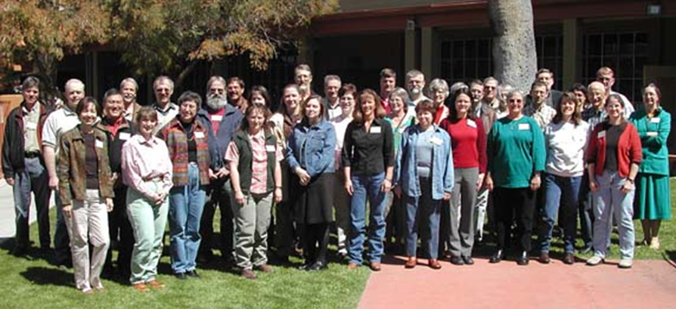
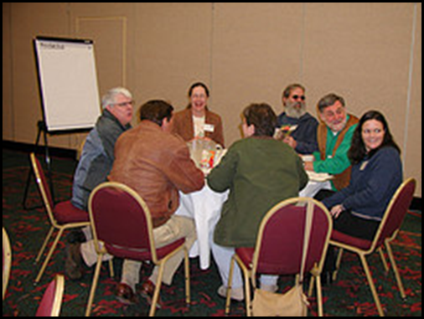

Slide 4
First elected Rangelands West Partnership Executive Committee (2007/08):
Chair: Karen Launchbaugh
Vice Chair: Carla Casler
Secretary: Norm Harris
2008/09
Chair: Carla Casler Vice Chair: Norm Harris
Secretary: Amy Shannon
2009/10
Chair: Norm Harris
Vice Chair: Amy Shannon
Secretary: Mark Thorne
2010/11
Chair: Amy Shannon Vice Chair: Mark Thorne
Secretary: Jeanne Pfander
2011/12
Chair: Mark Thorne
Vice Chair: Jeanne Pfander Secretary: Rachel Mealor
2012/13
Chair: Jeanne Pfander
Vice Chair: Rachel Mealor
Secretary: David Kruger

Slide 5
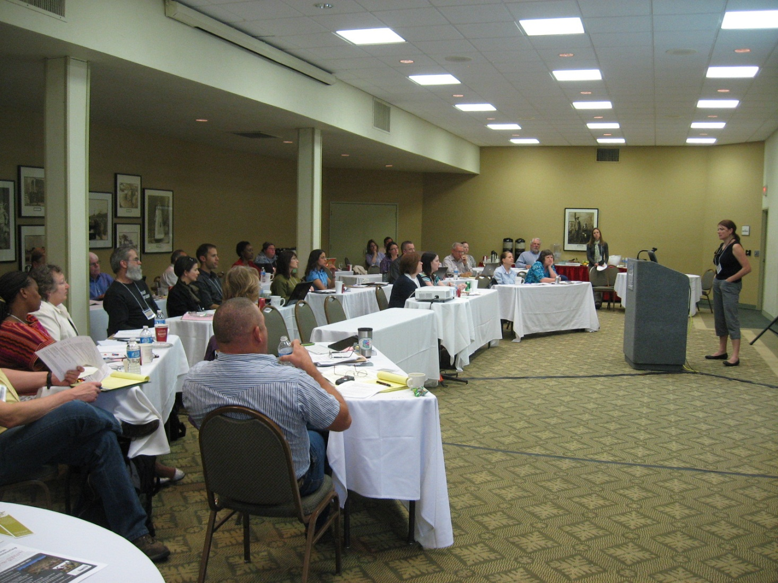
2
0
1
2

Slide 6
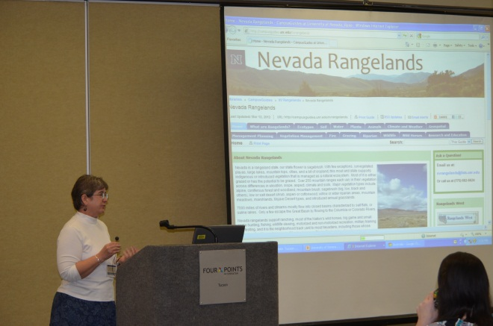
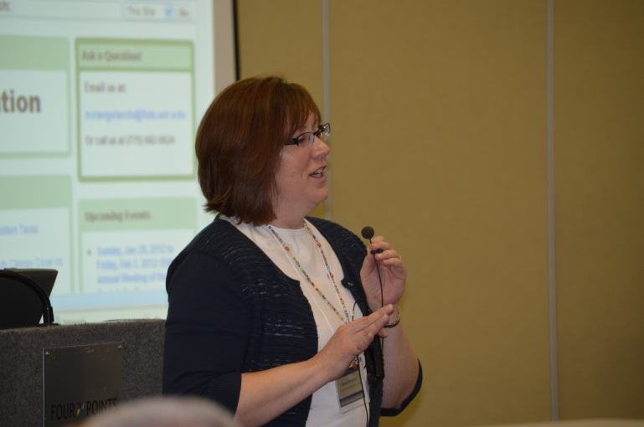
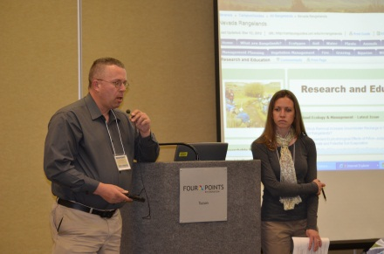
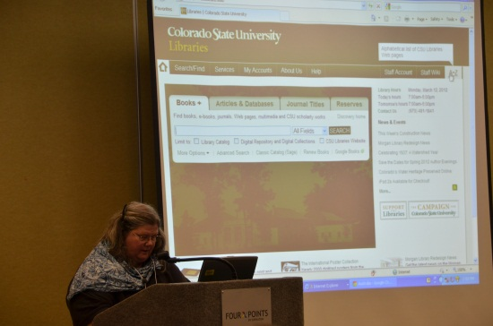
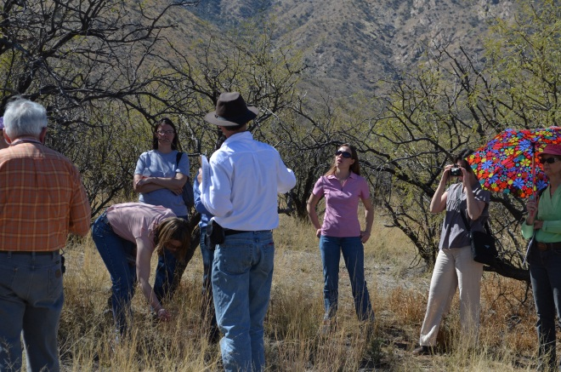
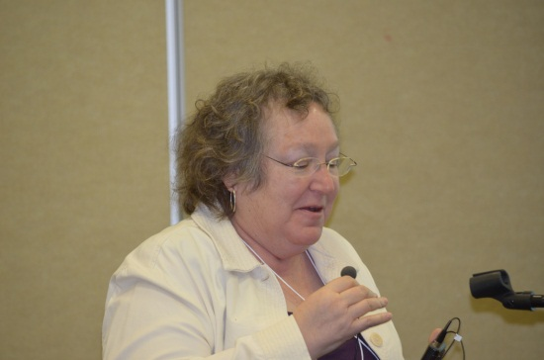
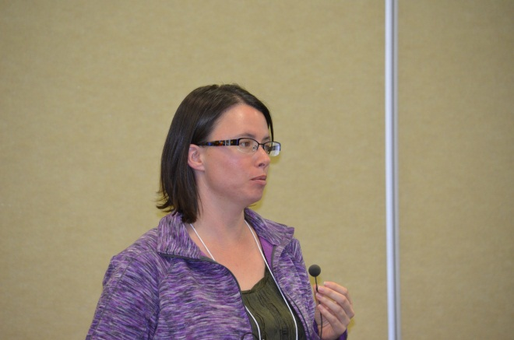
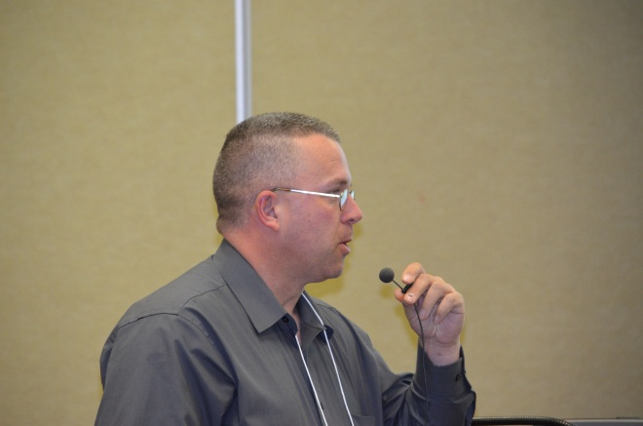
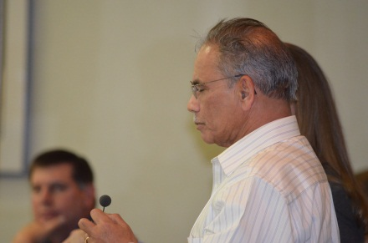

Slide 7
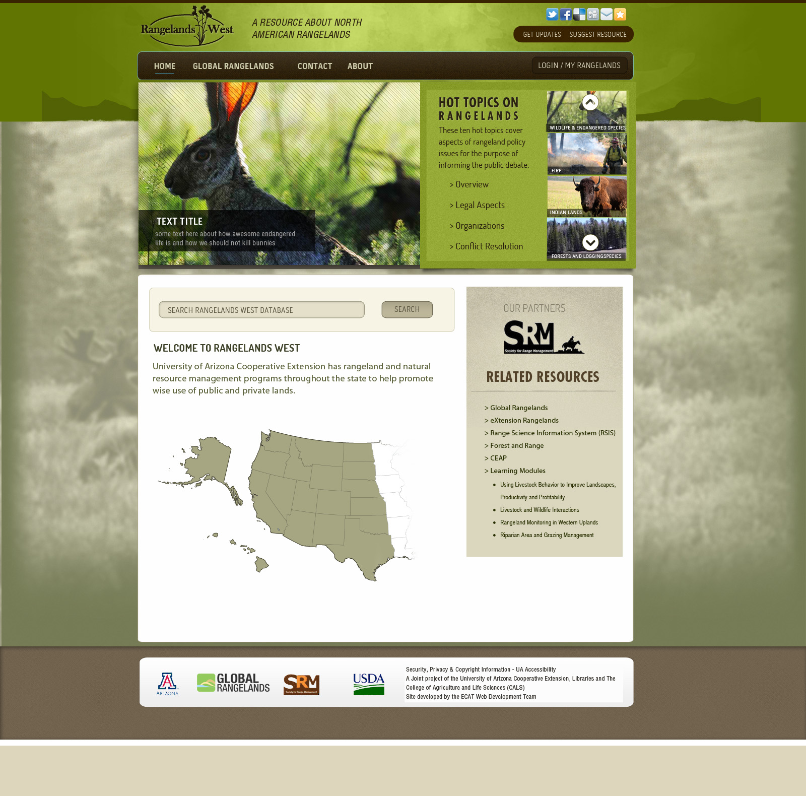

Slide 8
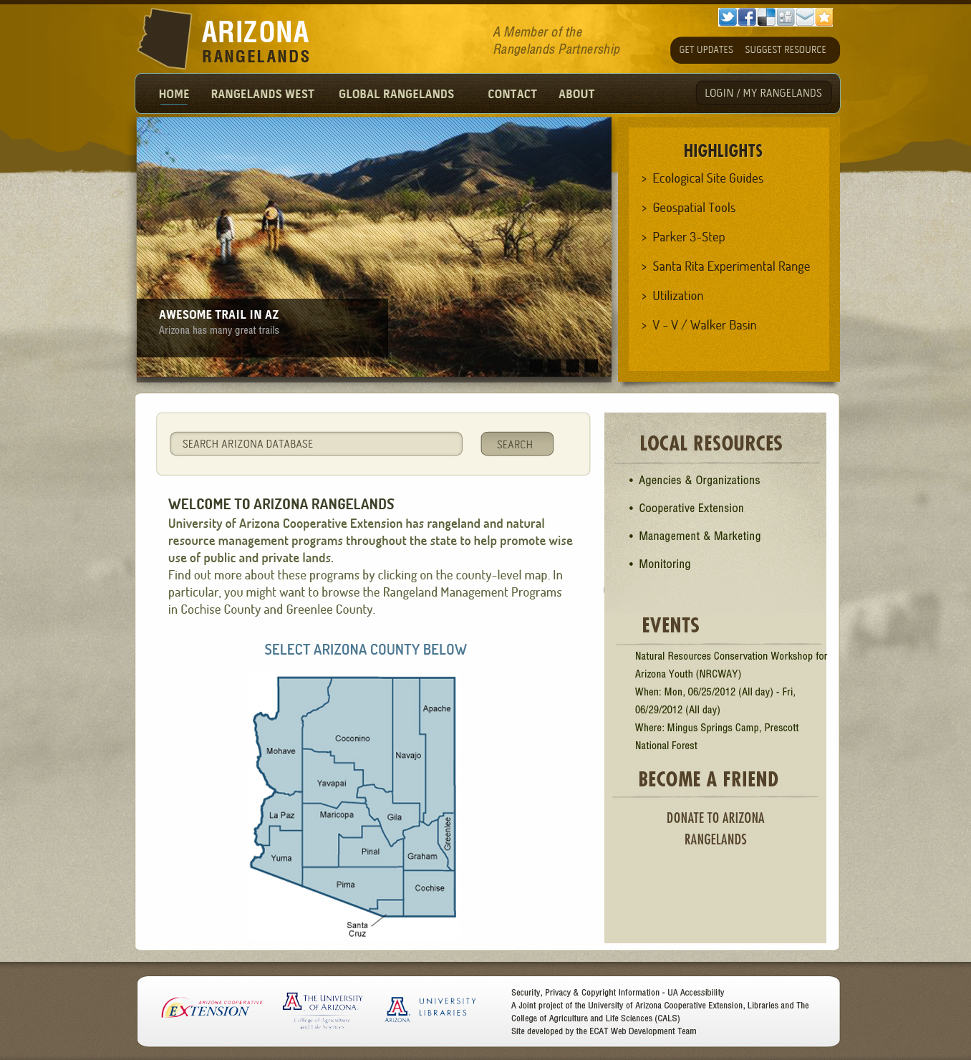
Notes:
Template available. Others using LibGuides.

Slide 9
Notes:
LibGuides approach for state sites

Slide 10
Going Global
Rangelands Australia
Food and Agriculture Organization of the United Nations
University of Arizona
UC-Davis
University of Idaho
Other Signatories
eXtension
GSSA (South Africa)
Coming soon:
Mexico
Canada
Notes:
A collaboration involving members of the Rangelands West Partnership (University of Arizona, University of California-Davis, and University of Idaho), the Food and Agriculture Organization of the United Nations (FAO), and Rangelands Australia (RA),
The purpose is to provide access to international resources on all aspects of sustainable rangeland management through the development of a “Global Rangelands.org” portal and database, including the integration of a redesigned and expanded version of the current “RangelandsWest.org” portal, as well as linked state Rangelands sites. Also involved is the establishment of appropriate linkages to the eXtension Rangelands website.
Following objectives were stated in the USDA National Institute of Food and Agriculture (NIFA) International Science and Education (ISE) proposal:
enhancing the technical architecture of Rangelands West to host a fully searchable international repository of full-text articles, documents, images, and teaching and outreach materials on rangeland management topics;
(2) establishing and strengthening a partnership of key institutions, organizations, and associations as the first phase for a broader international collaboration including the Grassland Society of South Africa (GSSA) and the Australian Rangeland Society (ARS);
uploading full-text content/metadata to the repository and providing customized applications to facilitate expanded knowledge of international work in rangeland research, teaching, and extension;
(4) creating and providing access to two multi-media learning modules on global rangelands;
(5) identifying, creating, and disseminating synthesis documents on aspects of international outreach practices relevant to rangeland management that will provide opportunities for enhanced Extension programming in the US; and
(6) creating a customized search interface that improves access to critical information and encourages direct user engagement in the development of the Rangelands West – Global Knowledge System.

Slide 11
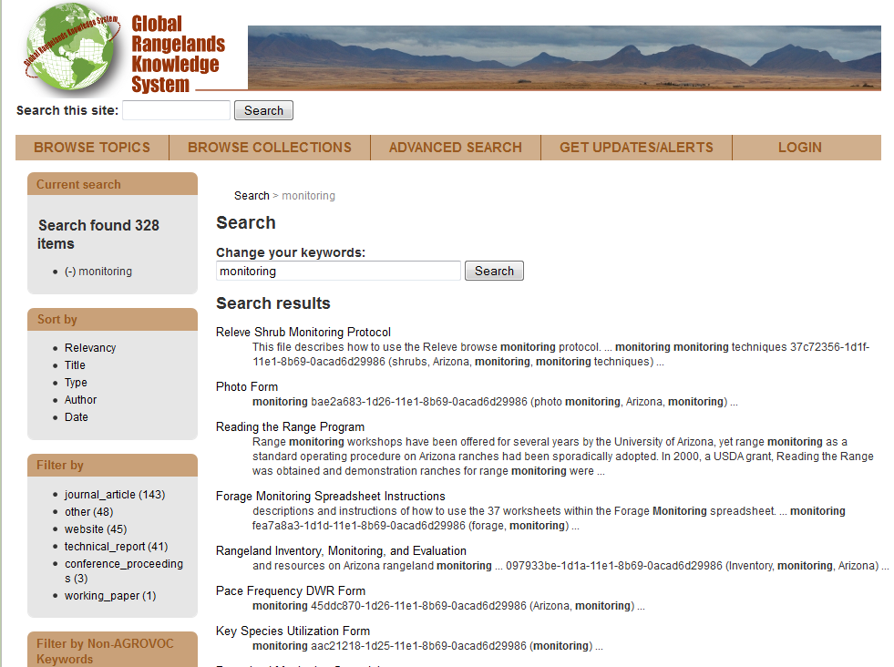

Slide 12
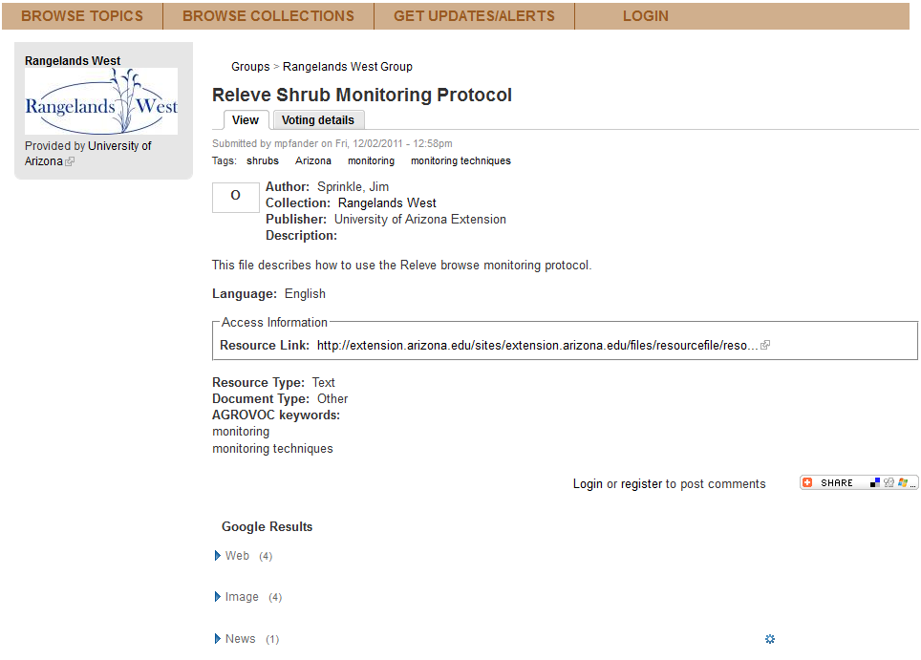
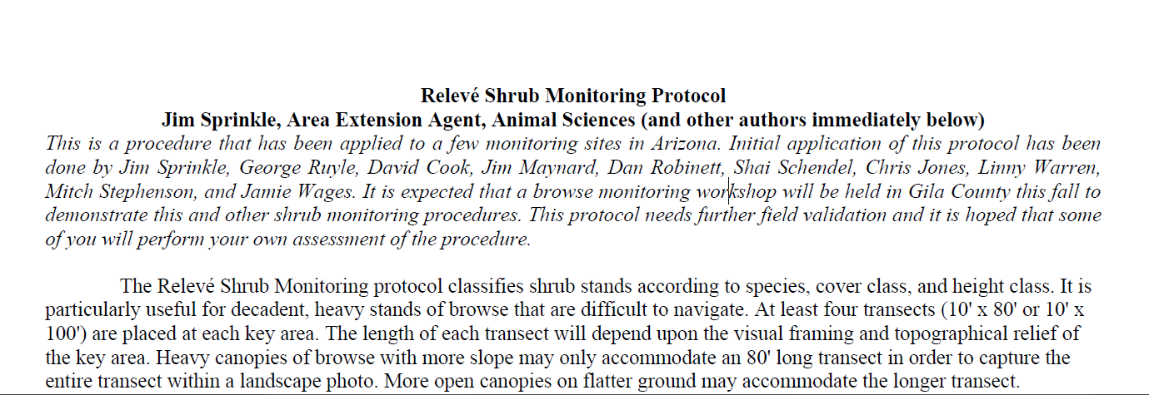

Slide 13
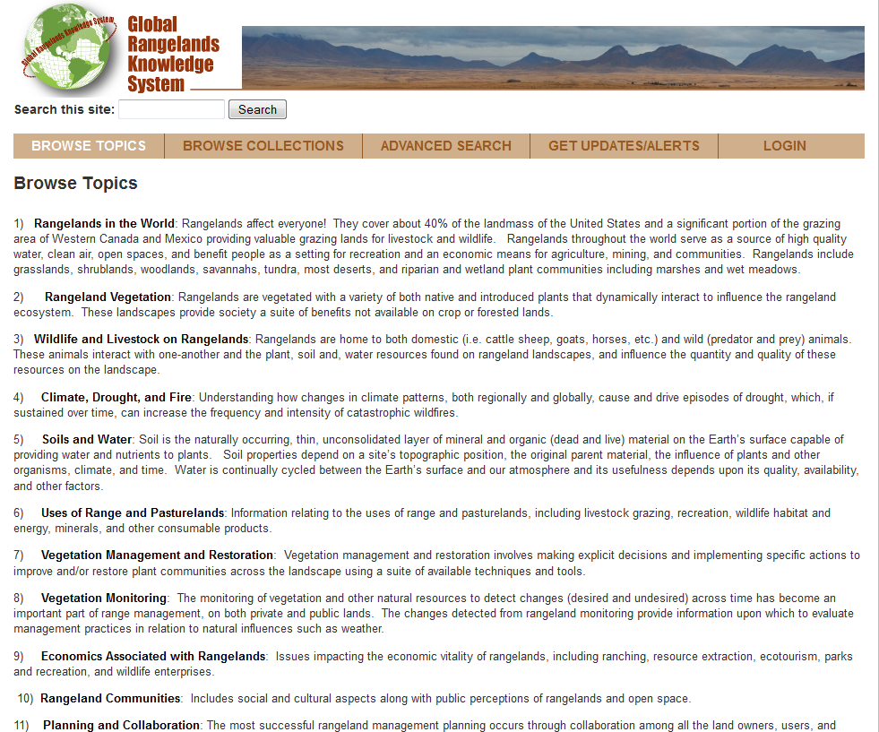

Slide 14
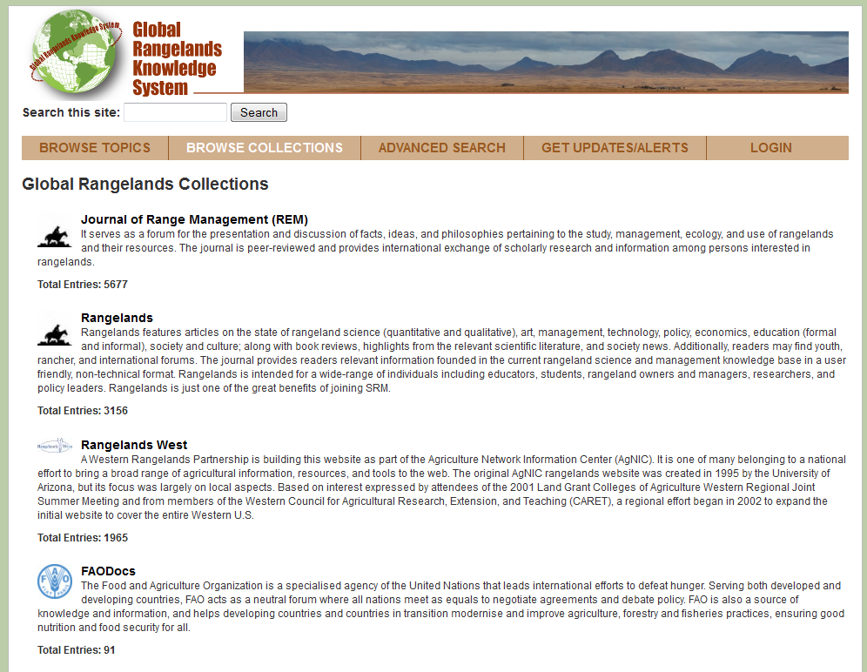

Slide 15
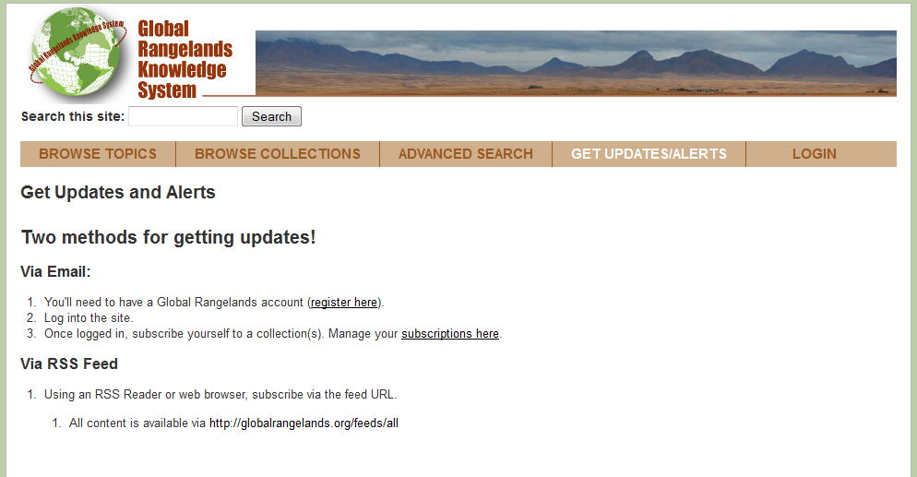
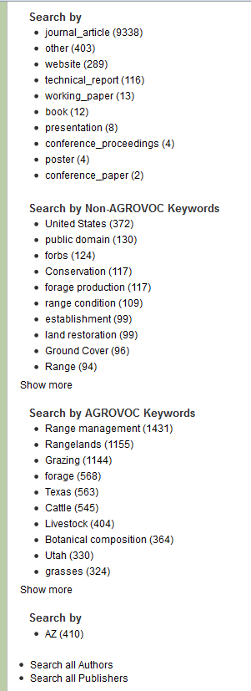
Advanced Search
Updates and Alerts

Slide 16
