Slide 1
Rangeland Partnership 2020—Idah0 report
April hulet and Jeremy kenyon

Slide 2
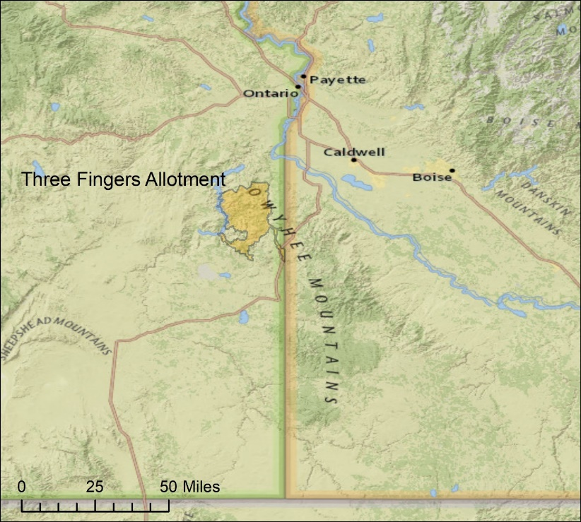
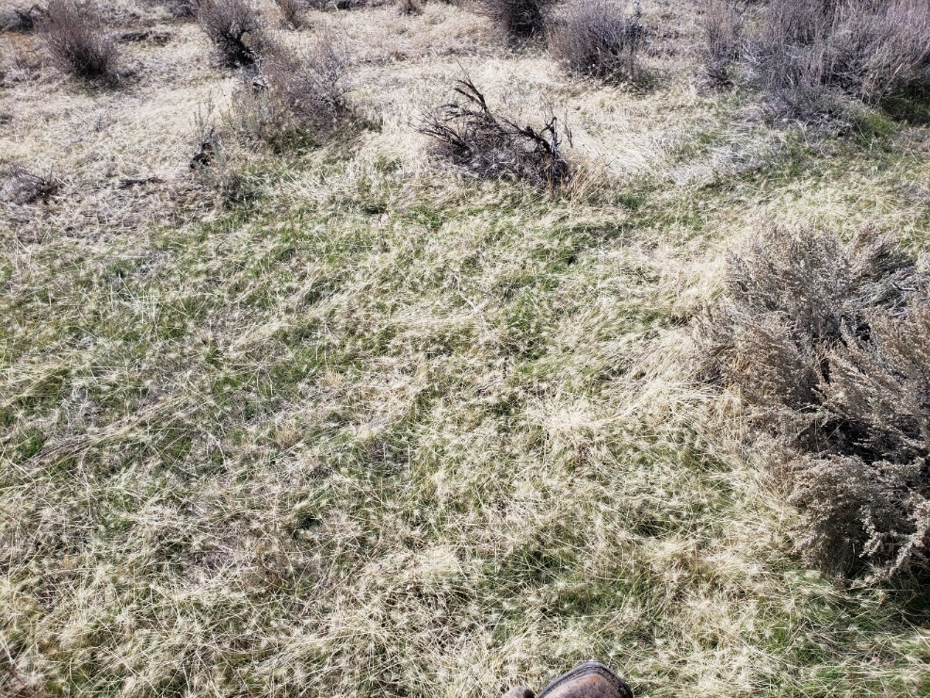
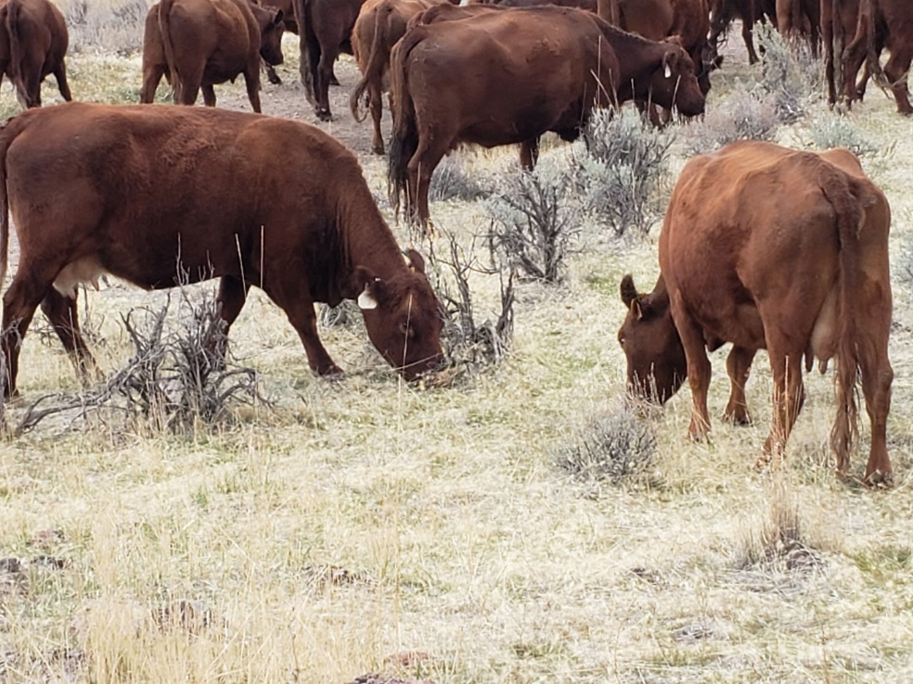
Research:
Dormant Season Grazing as a Means to Reduce the Negative Impacts of Medusahead and Promote Perennial Vegetation in the Sagebrush Steppe
William Price, April Hulet, Sergio Arispe, Scott Jensen, and Eva Strand
Study Site: Three Fingers Allotment (56,170 ha) in Southeast Oregon.
Newly germinated medusahead in October 2019.
Cattle grazing medusahead in October 2019.
Partners: Oregon State University, Boise State University, University of Nevada-Reno, BLM Vale District
Notes:
This research explores the potential of dormant season grazing as a means of reducing the negative impacts of medusahead while promoting recovery of perennial vegetation, and the impact of defoliation across a range of phenologic stages on the production and viability of medusahead seed. Baseline data was collected in 2018, study will continue until 2028.

Slide 3
Extension:
Dormant Season Grazing as a Means to Reduce the Negative Impacts of Medusahead and Promote Perennial Vegetation in the Sagebrush Steppe
Google Earth Pro/GIS Hybrid Course: Enhancing Rangeland Awareness
Map your ranch or public rangeland
Use mapping technologies
Assess range health (Threat-Based Land Management and Photo Monitoring)
More Details, visit:
https://media.oregonstate.edu/media/t/1_6gdnidrg
https://catalog.extension.oregonstate.edu/sites/catalog/files/project/pdf/pnw722.pdf
Partners: Oregon State University, Boise State University, University of Nevada-Reno, BLM Vale District
Notes:
In addition to the research, this grant also supports a Google Earth Pro/GIS Hybrid Course. This course is seven week with 4, face-to-face meetings and 3 online sections. Boise State University is working on a Google Earth Engine tool to estimate biomass on a landscape level that will be incorporated into the course.

Slide 4
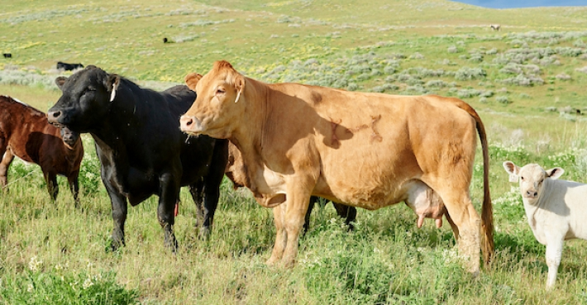
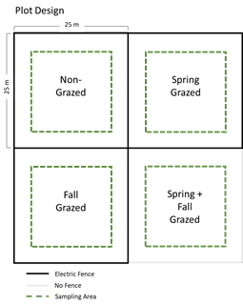
Research:
Dormant Season Grazing to Reduce Cheatgrass and Promote Perennial Bunchgrasses
April Hulet, Katie Lee, Karen Launchbaugh, Jim Sprinkle, and Eric Winford
Plant physiology >
Soil moisture/temperature
Economic Outcomes
Partners: Caribou-Traghee National Forest
Notes:
Builds off the study in Oregon with a focus on cheatgrass instead of medusahead. Additionally, we will be evaluating the impact of fall, spring, and a combination of both. This one is more heavy in mechanistic research…we are collecting soil moisture/temperature data and hourly photos to better understand cheatgrass green-up with the goal to create measurable metrics that can be used to indicate when livestock grazing should be initiated and discontinued.
Economic Outcomes: trade-offs faced by participants in early- and late-season grazing, and summer allotment permittees. AND determine how ecological conditions translate into ecosystem service to value for multi-use public lands. Estimate changes in long-term net benefits and provisioning of public goods as a result of targeted grazing outcomes.

Slide 5
Research/Education:
Supporting outcome-based management on private & public rangelands: training agricultural professionals on monitoring techniques
Jason Karl, Eric Winford, April Hulet, Amy Quandt, and Jeff Herrick
Rangeland Monitoring Workshops
LandPKS
Survey 123 for ArcGIS*
Utilization Gauge
Soil Survey/ESD
*Photo Monitoring with Survey123
https://youtu.be/545adonP-gg
https://landpotential.org/landpks-the-app/landpks/
Partners: USDA-ARS, Idaho State Department of Agriculture, Idaho Rangeland Conservation Partnership, Idaho Rangeland Resources Commission, Owyhee Cattlemen’s Association
Notes:
LandPKS is being used throughout the world. We wanted to see how it compares to standard protocols being used by federal/state agencies (e.g., AIM, NRI) in Idaho with the focus on plant cover. Data was collected in 2019 process of compiling for analysis. This work feeds into Rangeland Monitoring Workshops. During these workshops, we focus on why monitoring is important and provide tools, specially LandPKAS, Survey123 (ISDA), Utilization Gauges, and Soil/Surveys-ESD.

Slide 6
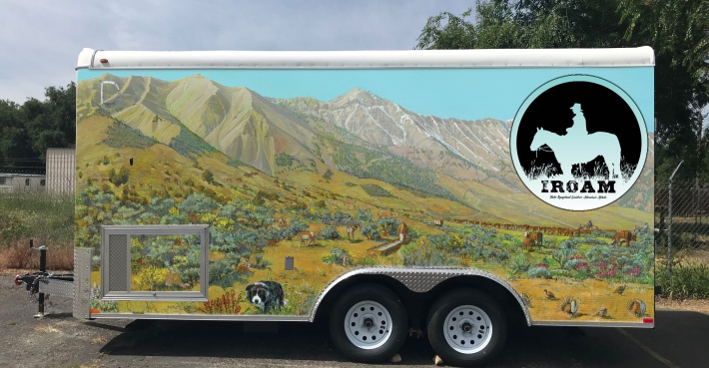
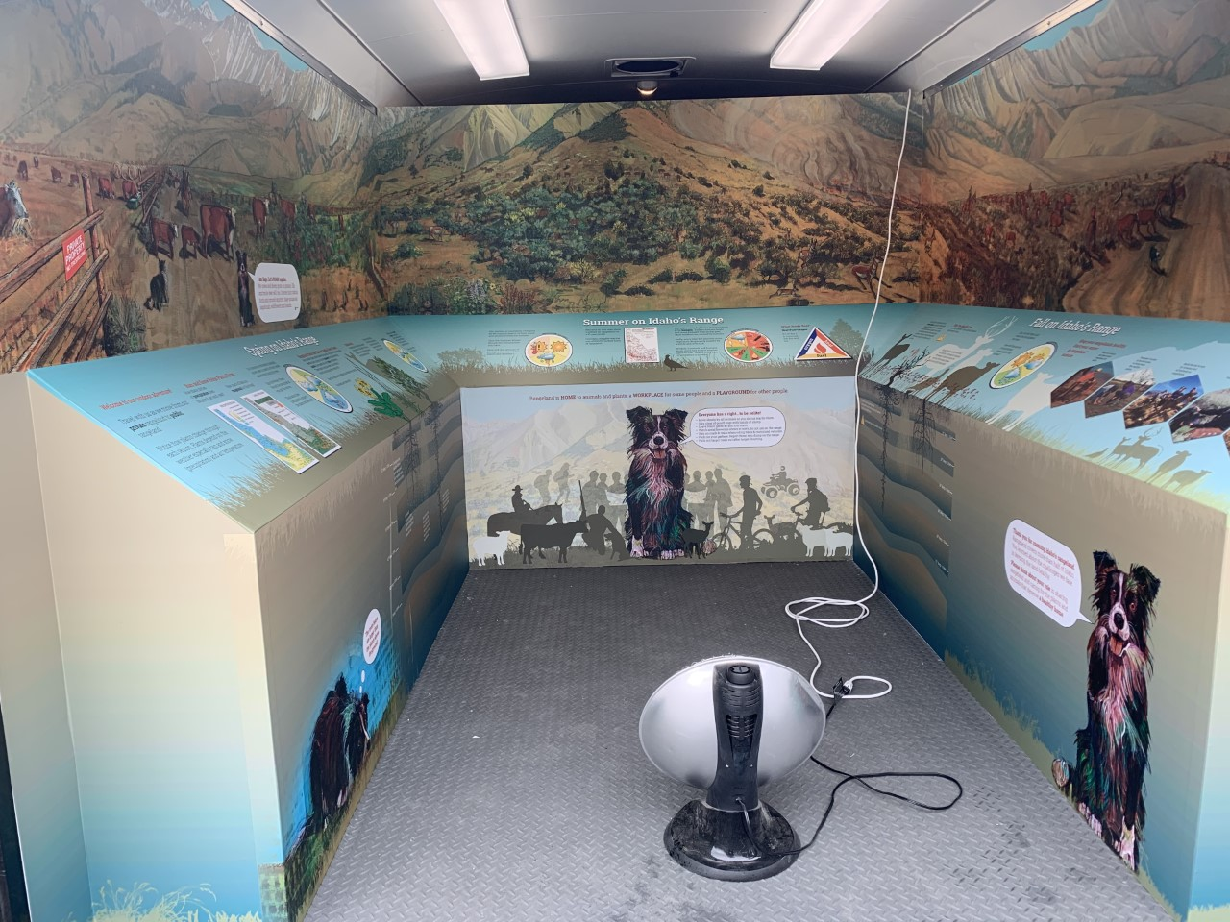
Extension/Outreach: IROAM
Partners: BLM, USFS, NRCS, Laura Moore Cunningham Foundation, Idaho Soil and Water Conservation Commission.
Notes:
A lot of time in 2019 was devoted to the creation of the IROAM trailer and tents. The trailer/tents are designed to take students on a seasonal adventure through Idaho’s rangelands and includes a workbook “Roaming the Range with Sage” that is a self-guided tour.

Slide 7
Extension/Outreach: IROAM
Roaming the Range with Sage Workbook Link:
https://idrange.org/wp-content/uploads/2019/12/IROAM_WorkBook_Roaming-Range-with-Sage_web.pdf
Notes:
Sage guides students through seasons starting with Winter/Spring and moving through Fall. Sage teaches students about precipitation, plants, habitat, manure, good stewardship, wildfires, rangeland tools, and careers. You can see the entire book by clicking the link or visiting idrange.org.

Slide 8
Extension/Outreach: IROAM
IROAM Curriculum:
Section 1: Introduction to Rangeland—Wild Open Spaces
Section 2: Rangeland Soils—Under the Surface
Section 3: Rangeland Plants
Section 4: Water on the Range
Section 5: Home on the Range—Wildlife and Livestock
Section 6: Fire on the Range
Section 7: Plant and Animal Interactions
Putting it all Together:
Rangeland Toolbox Activity
Exploring Rangeland Careers-BINGO
Rangeland Game
Notes:
In addition to the trailer, we compiled rangeland curriculum for seven sections. Educational kits associated with the curriculum are available in the trailer, as well as to Extension Educators and teachers upon request. A pdf of all the curriculum will be available by the end of April 2020. This educational material is promoted through annual teacher workshops/trainings, as well as an I-ROAM Ambassador training that must be completed prior to taking the trailer or tent.

Slide 9
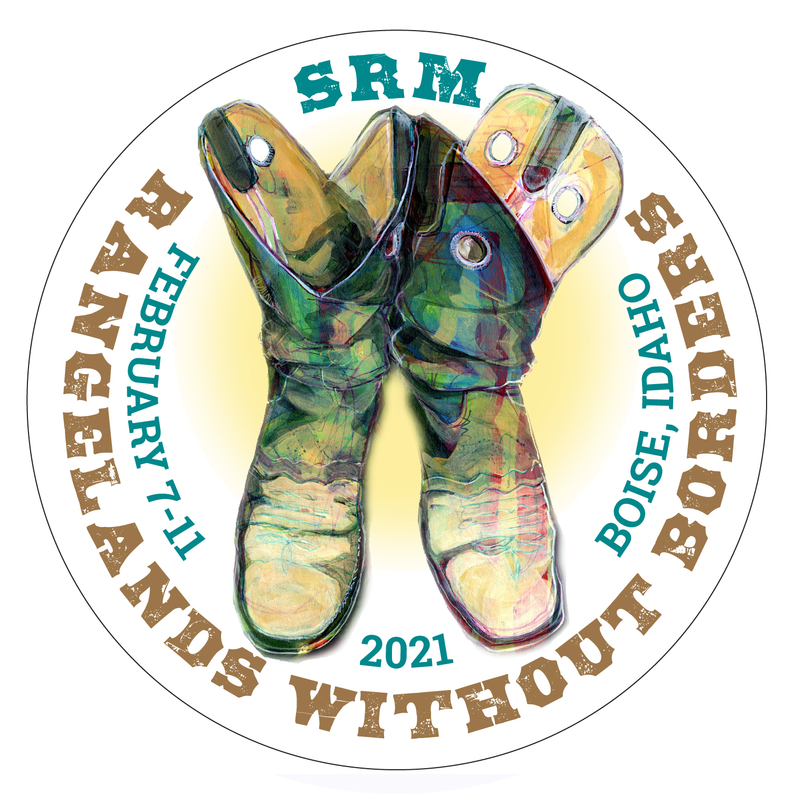
SRM 2021 Annual Meeting: Boise
February 7-11, 2021; The Grove Hotel and Boise Centre
Idaho and International Mountain Section
Education Symposium
We plan to submit a proposal for a “Rangeland Education Symposium”
If you would like to participate in these efforts, please let April know (aprilh@uidaho.edu)
Notes:
Many of us in Idaho are part of the SRM 2021 Annual Meeting Planning Committee. SRM will be held in Boise February 7-11 and we are excited to highlight many of the great things happening in Idaho and surrounding states. We would like to hold a Rangeland Education Symposium and would love to partner with the Rangeland Partnership and others to share ideas and strategies to engage youth in this natural resource. If you are interested in part of the planning, please contact me.

Slide 10
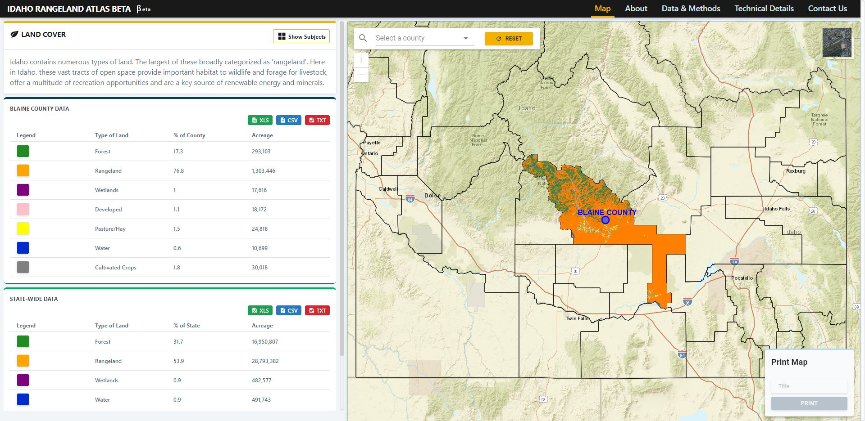
Idaho Rangeland Atlas
A web application providing county- and state-level rangeland facts
Jeremy Kenyon, Bruce Godfrey, Koffi Anderson Koffi, Eric Winford, Katherine Lee
http://gis-dev.northwestknowledge.net/apps/rangeland
Notes:
Updates: this year, members of the UI Rangeland Center – Eric Winford and Katie Lee began looking to add socio-economic data to the atlas, as well as update the existing categories. Our goal is to redouble efforts to enhance this tool in the next year and make this a more effective outreach tool for sharing facts about Idaho range with the general public or with those needing basic estimates of rangelands-related data.

Slide 11
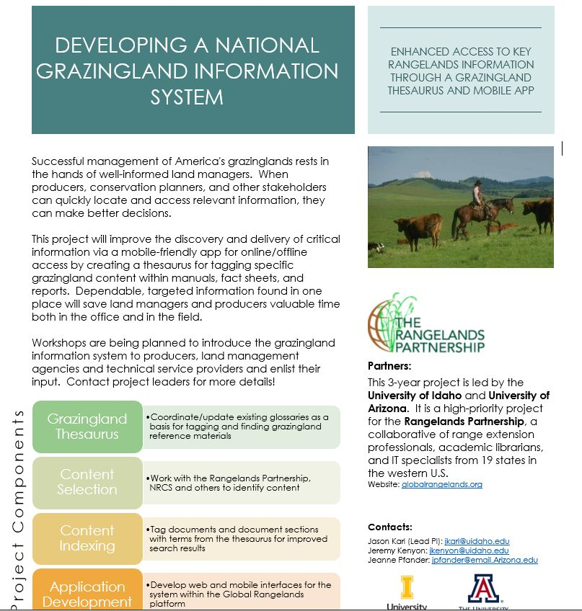
Grazingland (aka Rangeland) Information System
Jason Karl, Jeremy Kenyon, Jeanne Pfander, Sean Di Stefano, Eric Winford, Karen Launchbaugh & many others(!)
Notes:
1. CIG project, brief mention.

Slide 12
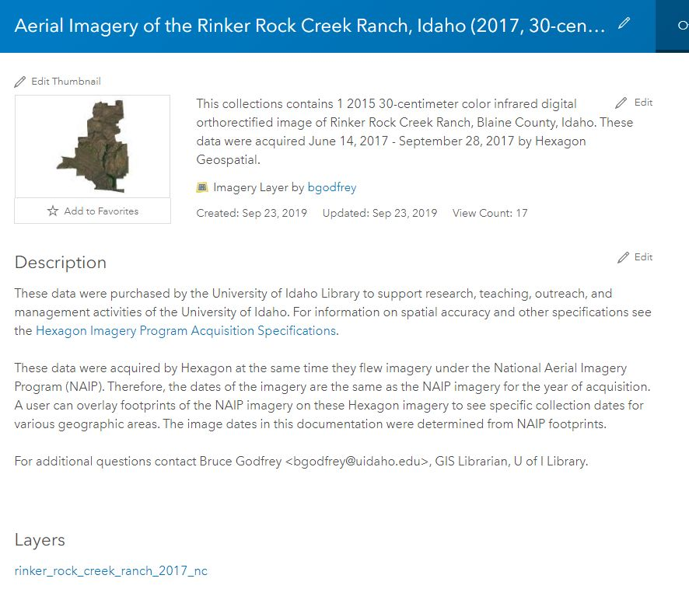
Library Rangeland Collections
Journal Collections:
Cancelled Big Deal bundle of Elsevier journals, worth over $1m, down to $100K
Cancelled REM, Rangelands via Elsevier, but maintain current access through BioOne
A number of other smaller journals with possible rangelands-related content cancelled as well
Data Collections:
Purchased high-resolution imagery of Rock Creek Ranch from vendors, working on 2019 NAIP imagery of Idaho, covering all rangelands areas
Digitization efforts:
Several hundred Ag. Econ working papers including those on ranch economics, grazing fees, and more

